Slide 1
The challenge of tropical conservation

Slide 2
Why should conservation focus on the tropics?
A very high proportion of biodiversity is concentrated in the tropics
Tropical areas have typically been considered to be more at risk (threatened) through ongoing processes connected with human activities.
Tropical forests are considered to be the most biodiverse terrestrial ecosystems
Tropical deforestation has long been of conservation concern and it can be measured relatively easily using satellite imagery

Slide 3
What do we mean by the “tropics”
On the tropic of cancer and Capricorn the sun is directly overhead for one day of the year (no shadow cast)
This is an artificial boundary with respect to biodiversity
Many people’s concept of “tropical” is more closely approximated by “equatorial”
For example, most of Mexico is below the tropics as are parts of the Sahara and Saudi Arabia.
The climate around the lines of the tropics tends to be seasonal and often quite arid

Slide 4
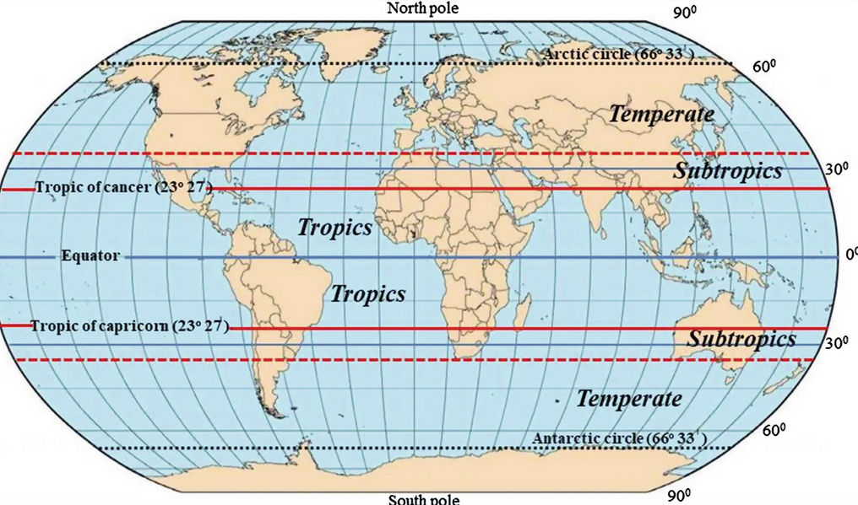

Slide 5
Aims of this lecture
Open, data driven discussion
Look at empirical evidence
Use some dynamic analytical tools to identify conceptual and operational challenges

Slide 6
Gradients of biodiversity
“Biodiversity” (however defined) tends to reach a peak around the equator
Moist, aseasonal conditions
Seasonal tropical forests less diverse with respect to species number and many species in drier forests have small wind dispersed seeds and thus very wide distributions

Slide 7
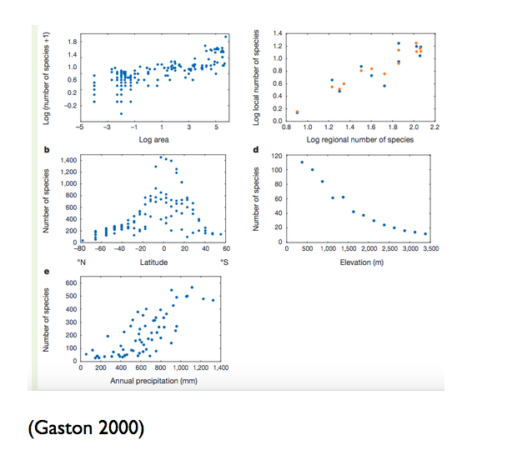

Slide 8
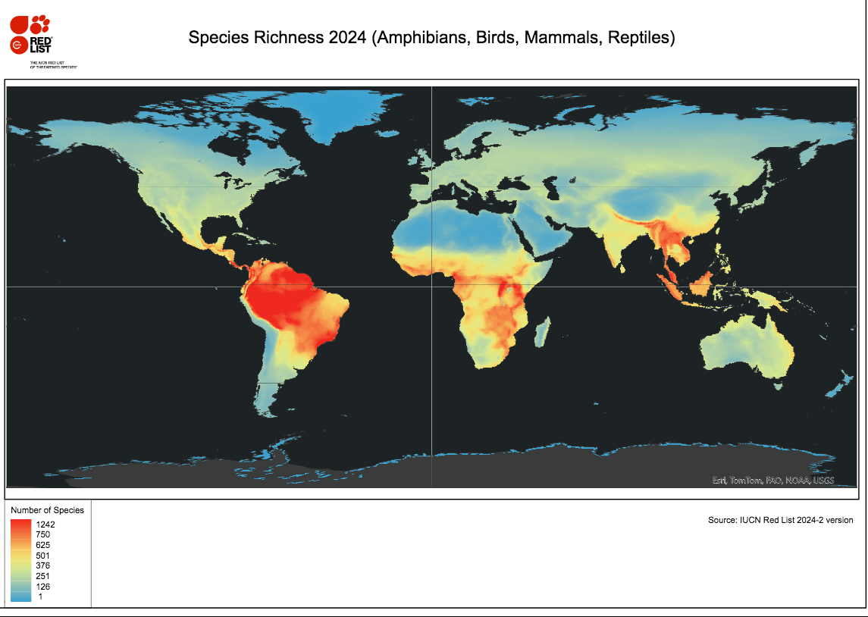

Slide 9
Why is tropical diversity so high?
Wide range of theories
Most compelling explanations involve climatic stability
Climatic conditions do not impose much physiological stress
Large numbers of species can survive the small range of diurnal and annual temperature fluctuations
Climate within the tropics today matches that found more widely across the planet in the past
Longer time scale for evolution
Organisms found in temperate and arctic regions have evolved to tolerate extremes, but not vice versa

Slide 10
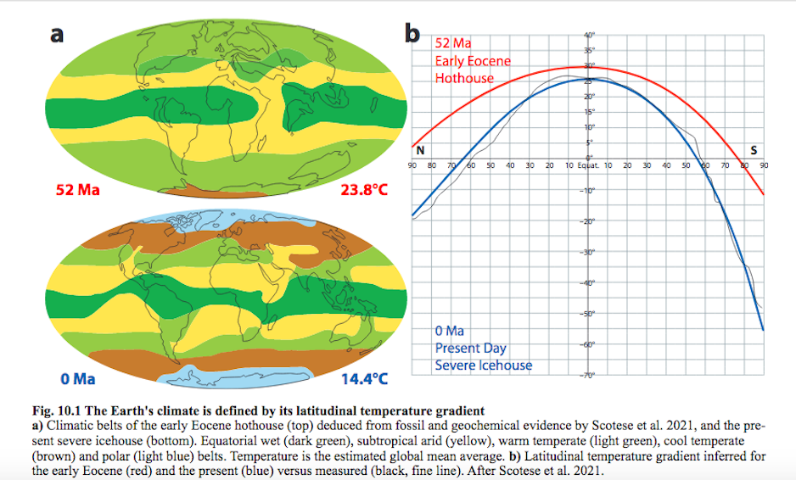

Slide 11
What temperature ranges do organisms experience today in the tropics?
Moist air cannot reach temperatures much above 30 C
With roughly equal lengths of day and night moist air cannot cool to much below 20 C
The equatorial tropics would only be affected by climate change if circulation patterns radically altered rainfall
Some localised changes can occur when forest cover is removed which leads to more insolation, drying of soil surfaces and thus an increase in temperature ranges
Explore here:
http://r.bournemouth.ac.uk:82/Conservation_in_practice/Temperatures_averaged_to_latitudes.html

Slide 12
Is tropical diversity directly measurable?
Shortfalls in knowledge
Linnean shortfall (we don’t know what they are called)
Wallacean shortfall (we don’t know where they are)
Hutchinsonian shortfall (we don’t know their niches)

Slide 13
How many species are there?
No one knows!
Mora’s estimates are quite widely cited
7.8 million animals (5.6 million being insects)
300,000 plants
600,000 fungi
Unknown numbers of bacteria
Only 1.2 million named
In Mexico there are around 2000 species of tree, compared to just below 40 (native) in the UK
Amazon basin perhaps around 10,000 to 20,000? Depending on definitions etc…

Slide 14
Is the red list a reliable guide?
Red listing depends on expertise for assessment
Assessing all the world’s species is impossible
Red listing tends to be robust for well known, well studied groups, particularly birds and some large mammals
As the red listing process has progressed assessment has been increasingly focussed on groups suffering from severe knowledge shortfalls.

Slide 15
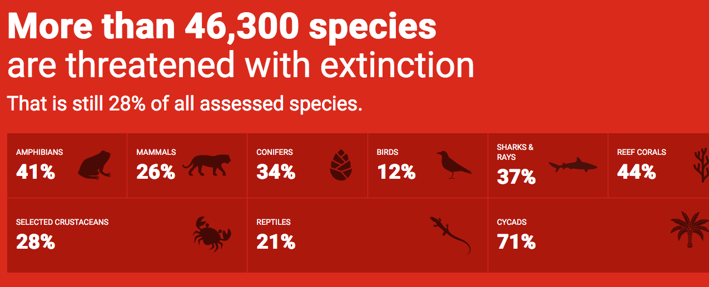

Slide 16
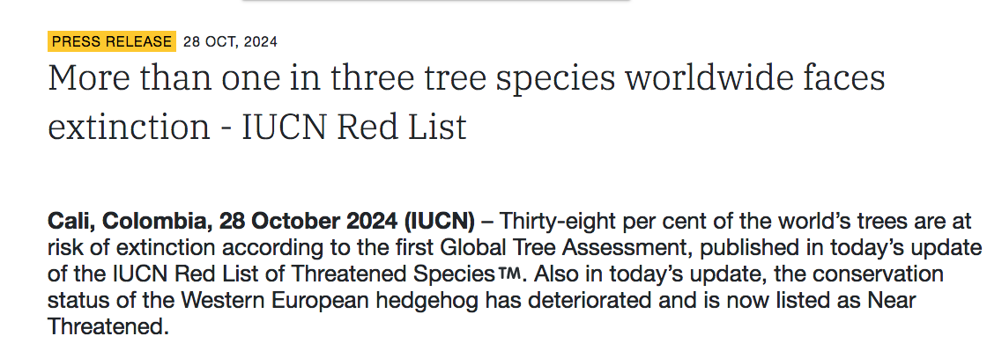
Recent IUCN press release

Slide 17
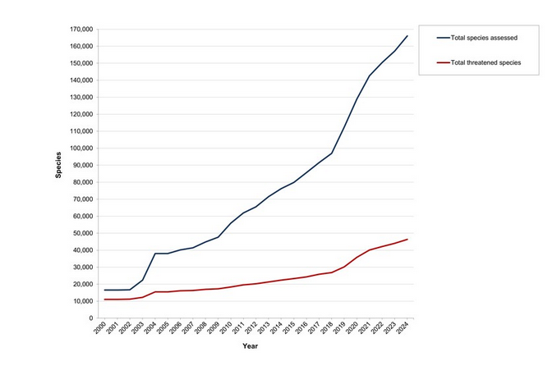

Slide 18
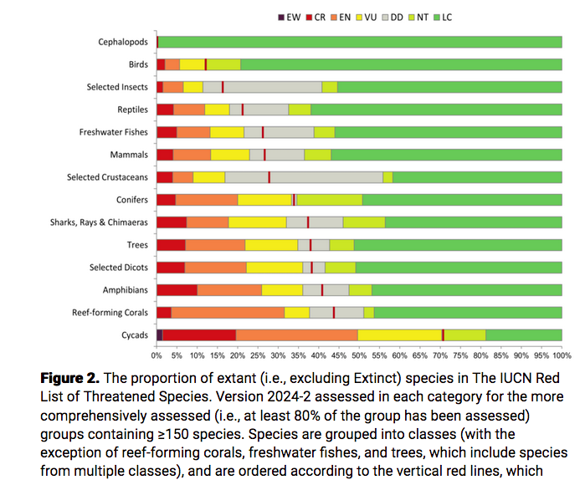

Slide 19
IUCN categories
Not Evaluated
Data Deficient
Least Concern
Near Threatened
Vulnerable
Endangered
Critically Endangered
Extinct in the Wild
Extinct

Slide 20
Does red listing really measure the risk of total global extinction?
Red listing has been criticised as being too “liberal” or too “conservative”
The current handbook provides important insights into the thinking behind the assessment process.
http://r.bournemouth.ac.uk:82/Conservation_in_practice/RedListGuidelines.pdf

Slide 21
Can modelling address knowledge gaps?
Wallacean shortfall typically addressed through the use of species distribution models
Usually take climatic layers as input (as finer grained information on soils and microtopography not available or not practical to include)
Hutchinsonian shortfall means that these models are not actually niche models
Tend to simply match combinations of temperature and rainfall at collection points
If there are few collections they will tend to be very narrow.

Slide 22
Modelling tool for Mexican trees
http://r.bournemouth.ac.uk:3838/conabio/
Programmed to guide red listing process (but not actually used)

Slide 23
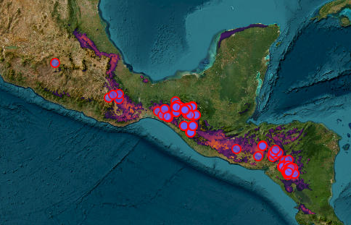
Simple example of knowledge gap
A common species of oak was never recorded in Guatemala due to differences in taxonomist’s naming procedures

Slide 24
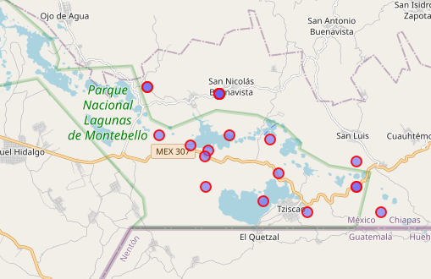
Hampea Montebellensis
Named after the park
Apparently only recorded from the park (a few other records considered dubious)
As the park has been partly deforested the species is considered to be critically endangered

Slide 25
Data from intensively monitored single site
Most famous data set on tropical trees collected by the Smithsonian institute in Panama at Barro Colarado
http://r.bournemouth.ac.uk:82/books/AQM_book/_book/analysis-of-multi-species-data.html

Slide 26
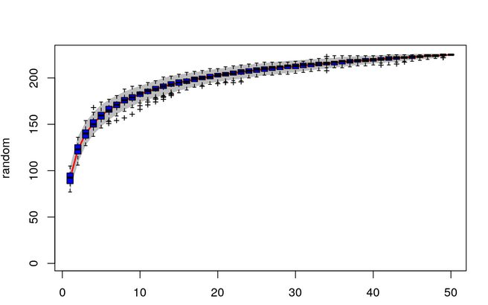
Typical patterns
Even in the tropics a relatively small number of tree species (10 to 40) dominate the forest canopy
However there are many rare species (could be rare locally but abundant elsewhere)

Slide 27
Species accumulation curves
BCI consists of 50 plots
Nearly half the total species count can be obtained from one plot
Typical for species area curves
While population sizes are linearly related to area, species number (biodiversity?) is not
A reduction of 50% of forest cover may only result in a reduction of 1-2% in the recorded number of species (or even less)
How many species would actually be lost if half the Amazon were deforested?

Slide 28
Where is tropical forest being lost?
Complex pattern
Best explored in depth using this tool
https://glad.earthengine.app/view/global-forest-change#bl=off;old=off;dl=1;lon=20;lat=10;zoom=3;

Slide 29
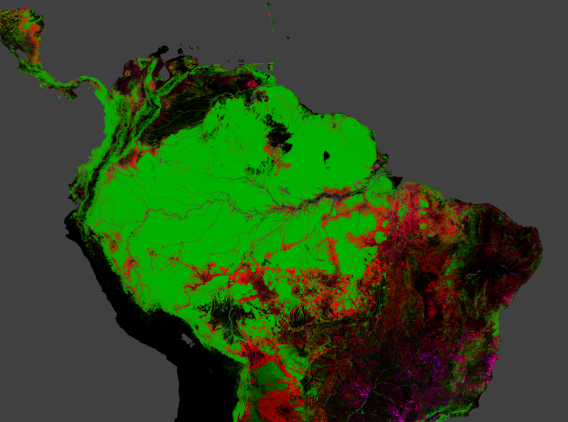
Amazon basin still largely forested arund the equator

