Slide 1
Introduction to Ecosystems
Duncan Golicher

Slide 2
Why study ecosystems?
  Central concept in Ecology
  The ‘scientific study of the interactions that determine the distribution and abundance of organisms’ (Krebs 1972).
  Ecology is a synthetic science (Odum 1977)
  Draws from a wide range of other disciplines.
  Concepts used in ecology such as “ecosystems” have also been adopted by other fields.

Slide 3
What is an ecosystem?
  Text book definition - “An ecosystem is a community of living organisms in conjunction with the nonliving components of their environment, interacting as a system” (Chapin 2002)
  An ecosystem is an interaction structure of organisms and their inorganic environment, which is open and, to a certain degree, capable of self- regulation.’’ (Klotzli 1993)
  An ecosystem consists of living organisms in some abiotic environment. What makes it a system is the fact that there exist specific dynamic relationships between these constituents. What makes it cybernetic is the existence of coordination, regulation, communication, and control in these relationships.’’ (McNaughton and Coughenour 1981)

Slide 4
Which concepts are involved?
  Interactions between biotic and non biotic components
  Nutrient cycles and energy flows
  Feedback loops and cycles.
  Homeostasis
  Fragility vs stability
  Food chains, food webs, trophic cascades
  Keystone species

Slide 5
How did the concept evolve?
  Tansley developed the concept as a counterpoint to the ideas of Clements

Slide 6
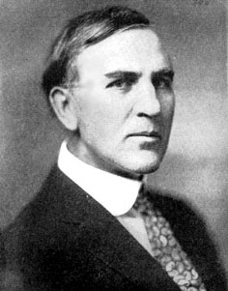

Slide 7
https://people.wku.edu/charles.smith/chronob/CLEM1874.htm

Slide 8
Who was Clements and why were other concepts needed?
  Frederic Clements was a very influential American ecologist/botanist/taxonomist
  Considered to be rigid and dogmatic
  Believed in Lamarkian evolution and teleological processes (goal centred)
  Orderly progression of succession towards a “climax” community
  Many American ecologists are still influenced by Clements
  Clements’ ideas still influential in the climate debate

Slide 9
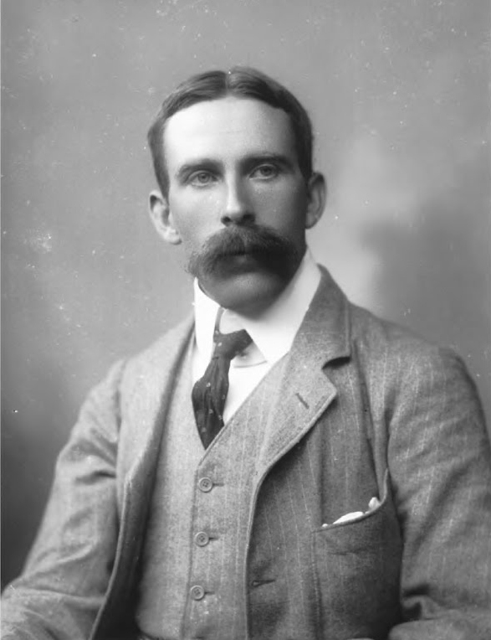
Tansley

Slide 10
Tansley’s “definition”
I have already given my reasons for rejecting the terms ‘’complex organism’’ and ‘’biotic community’‘. Clements’ earlier term ‘’biome’’ for the whole complex of organisms inhabiting a given region is unobjectionable, and for some purpose convenient. But the more fundamental conception is, at is seems to me, the whole system (in the sense of physics), including not only the organism-complex, but also the whole complex of physical factors forming what we call the environment of the biome– the habitat factors in the widest sense. Though the organisms may claim our primary interest, when we are trying to think fundamentally we cannot separate them from their special environment, with which they form one physical system. It is the systems so formed which, from the point of view of the ecologist, are the basic units of nature on the face of the earth.

Slide 11
Tansley’s Ecosystem
  Multi-disciplinary (involves biology, physics and chemistry)
  Recursive (refers to itself in its own definition)
  Scale-independent (doesn’t refer to a specific place)
  Observer- dependent (the system is defined by the person studying it)

Slide 12
What does this imply?
  All definitions of “ecosystem” suggest complexity
  Ecologists may all think about ecosystems in different ways
  Your view of what an ecosystem is may differ from mine

Slide 13
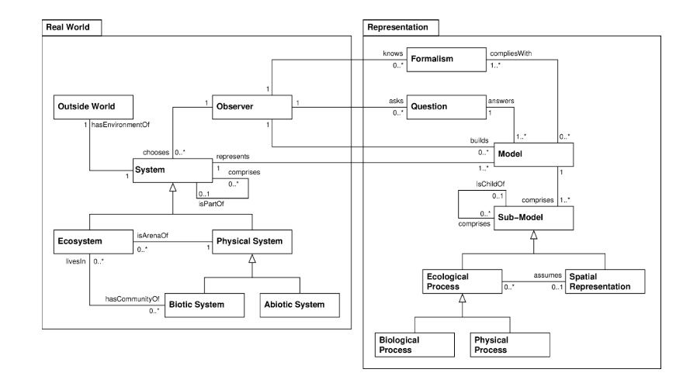
Reality and models

Slide 14
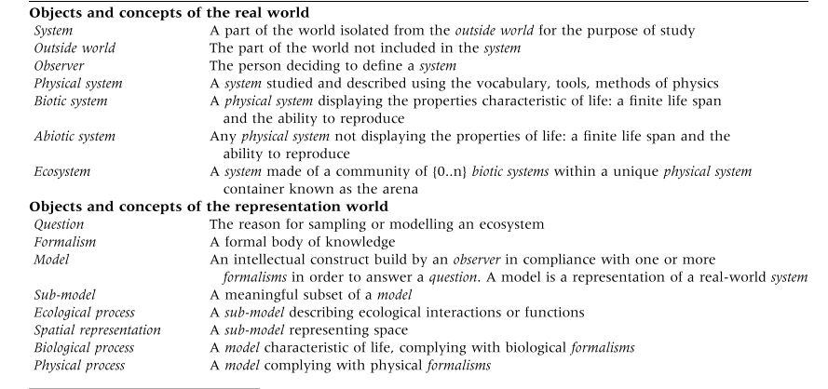
Concepts

Slide 15
References

