Slide 1
Eutrophication
The nitrogen cascade

Slide 2
Eutrophication
Eutrophication comes from Greek eu trophos, i.e. well nourished
The process by which an ecosystem, or parts of it, becomes progressively enriched with nutrients.
Terms often used for lakes and other water bodies
Eutrophic
Mesotrophic
Oligotrophic
When taken to extremes a system may become “dystrophic” or “hypertrophic”
Two key nutrients typically implicated
Nitrogen
Phosphorous
Both are added to ecosystems naturally, and through human activity

Slide 3
Impacts of phosphates and nitrates
It was once assumed that phosphorous was the key limiting nutrient in lakes, while nitrogen was the key limit for terrestrial ecosystems
More recent research shows a more complex picture
Phosphate enrichment is a very important element of freshwater eutrophication.
However, nitrogen derived compounds can play a particularly important role in the eutrophication of coastal ecosystems

Slide 4
Inputs of P and N
Both P and N are used as fertilizers
N is more mobile than P and moves through run off and ground water
P tends to bind to sediments
Sewage and manure contain both at high concentrations
Phosphates also present in detergents

Slide 5
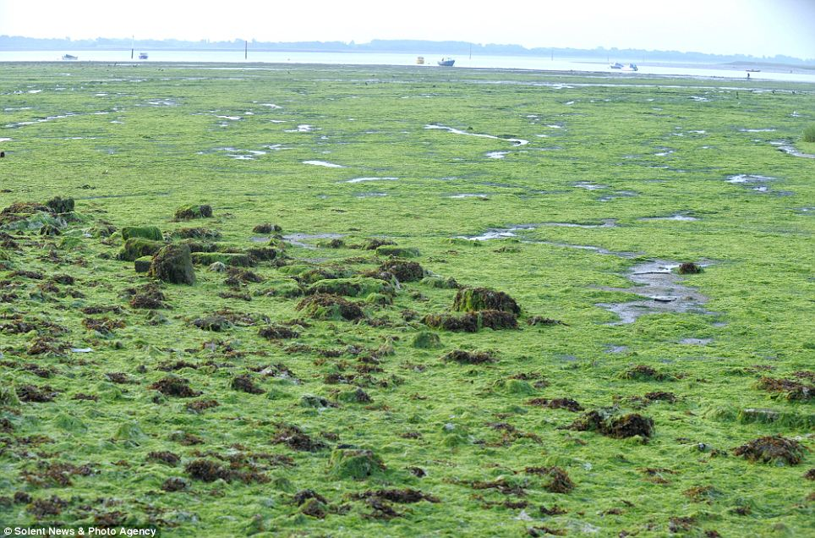
Algal mat (Poole harbour)

Slide 6
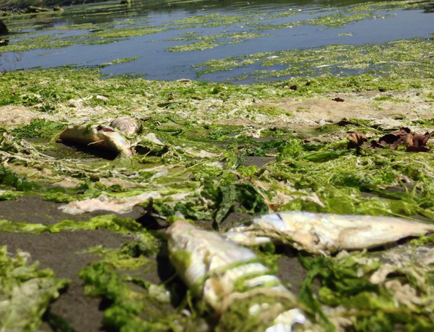
Direct impact of eutrophication
Algal mats or blooms can have the most visible and damaging impact
When an algal mat (or algal bloom) decays, oxygen is depleted
Can lead to fish kills

Slide 7
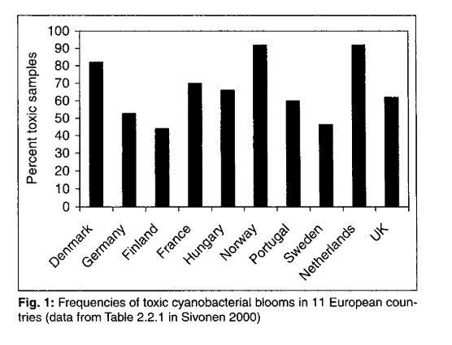
Toxic blooms
Tends to be associated with intensified agriculture

Slide 8
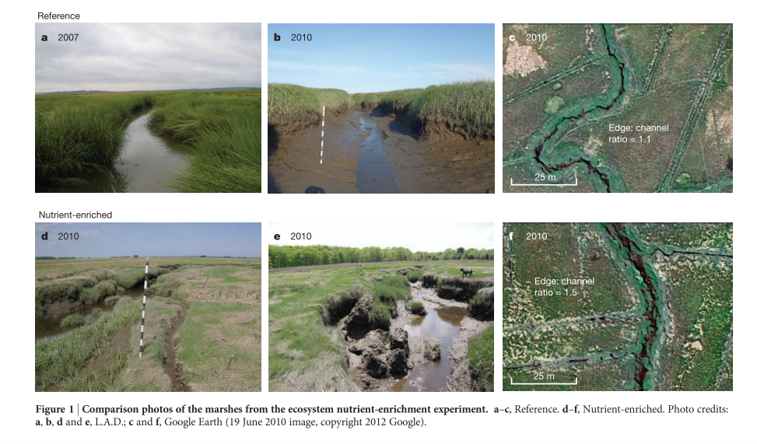
Effects on salt marshes

Slide 9
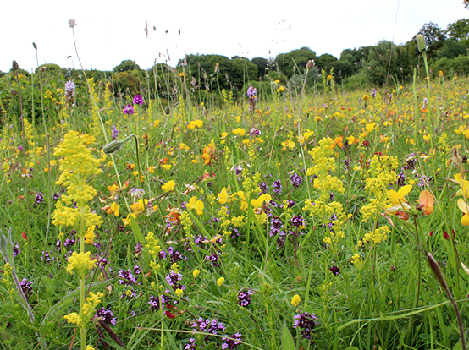
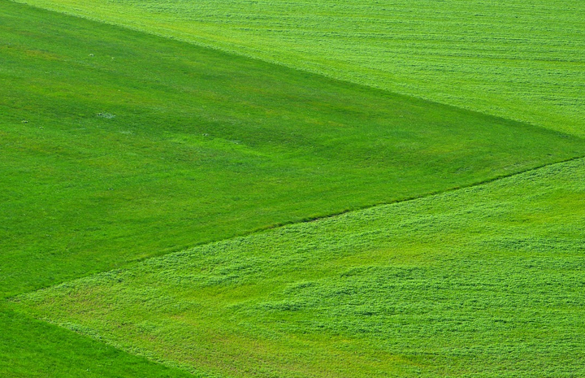
“Improved” grassland

Slide 10
Why focus on nitrogen?
﻿The elements nitrogen (N), carbon (C), phosphorus (P), oxygen (O), and sulphur (S) are all necessary for life, and so are present in all ecosystems
﻿Total amount of N in the atmosphere, soils, and waters of Earth is approximately 4 × 10²¹ grams (g)
More than the total mass of C + P + O + S !
But … > 99% of N unavailable for use
N₂ held together by triple bond

Slide 11
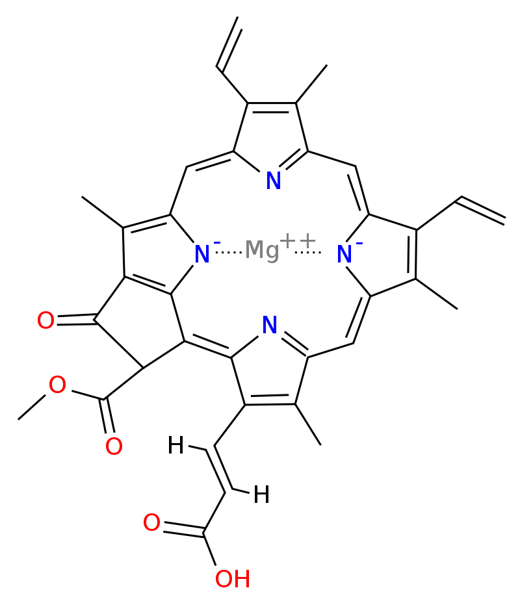
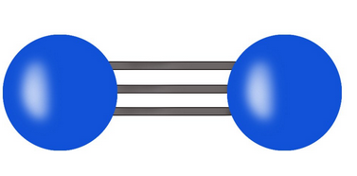
Chlorophyl
C₅₅H₇₂O₅N₄Mg
How does it from this to that?

Slide 12
Biological nitrogen fixation
Nitrogen fixation occurs naturally in soils through a range of microbes known as diazatrophs.
Bacteria,e.g. Azobacter
Archea (“blue green algae”)
Symbiotic relationships with some plants, particularly legumes.
Looser relationship with other plants, e.g. rice

Slide 13
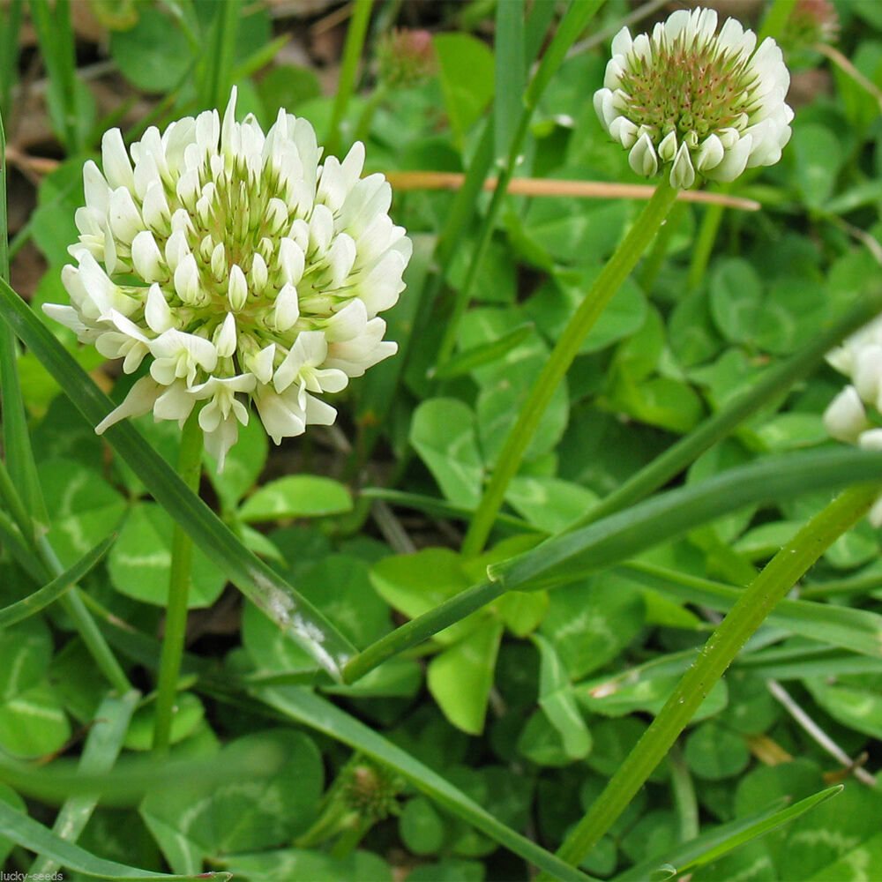
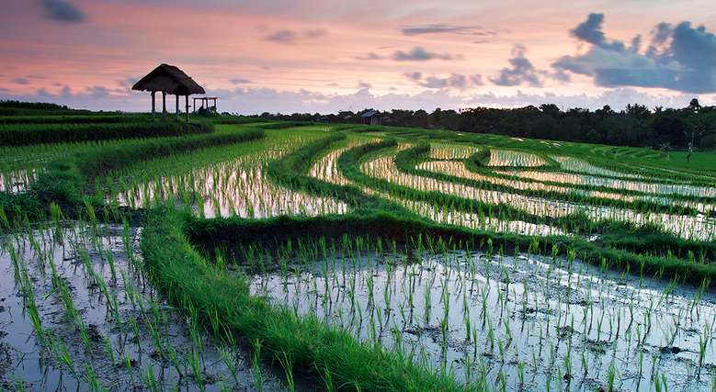
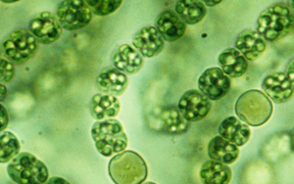
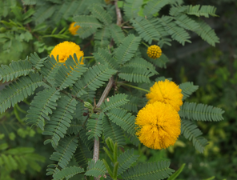
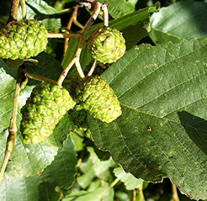
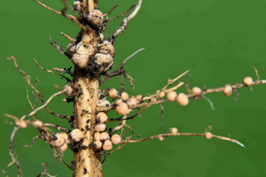
Biological nitrogen fixation

Slide 14
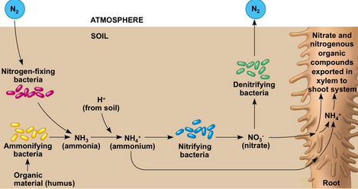
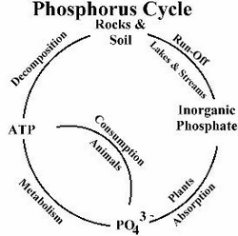
Biological nitrogen fixation
Compare with

Slide 15
Sources of fixed nitrogen
﻿Prehuman world: creation of N_{r} from N₂
lightning
biological nitrogen fixation (BNF).
Prior to human influence active N did not accumulate rapidly in environmental reservoirs: Microbial N fixation and denitrification processes were probably approximately equal

Slide 16
Sources of fixed nitrogen
﻿Production of Nr by humans now much greater than production from all natural terrestrial systems.
Global increase in Nr production has three main causes:
Cultivation of legumes, rice, and other crops that promote conversion of N2 to organic N through biological nitrogen fixation
Combustion of fossil fuels, which converts both atmospheric N2 and fossil N to reactive NOx;
The Haber-Bosch process, which converts nonreactive N2 to reactive NH3 to sustain food production and some industrial activities.

Slide 17
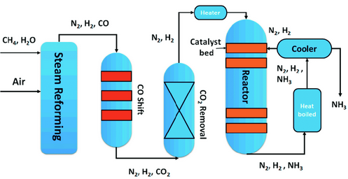
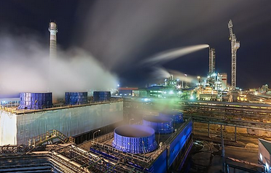
Haber Bosch process

Slide 18
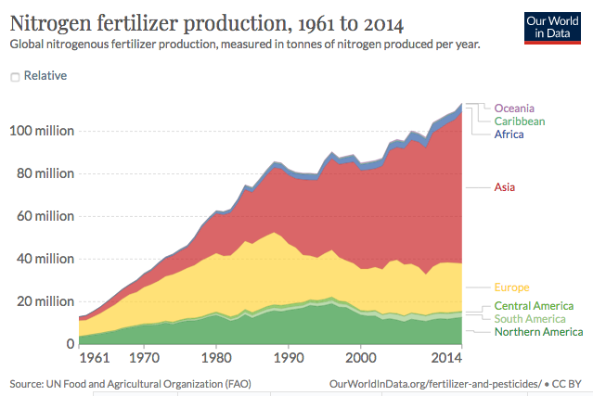
Nitrogen fertiliser production

Slide 19
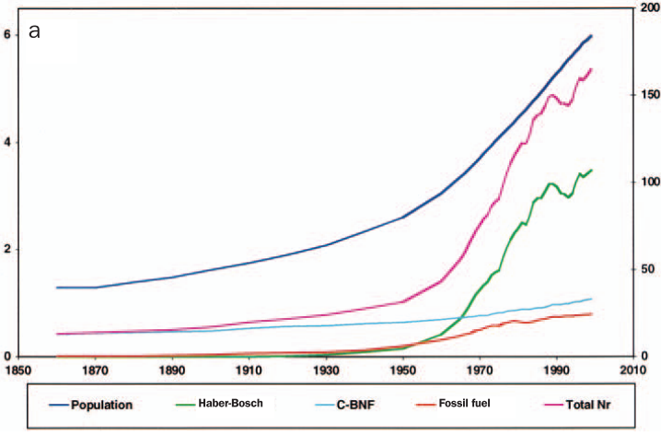
Haber Bosch nitrogen fixation
HB fertiliser
N fixed by legumes etc

Slide 20
Impact on crop yields

Slide 21
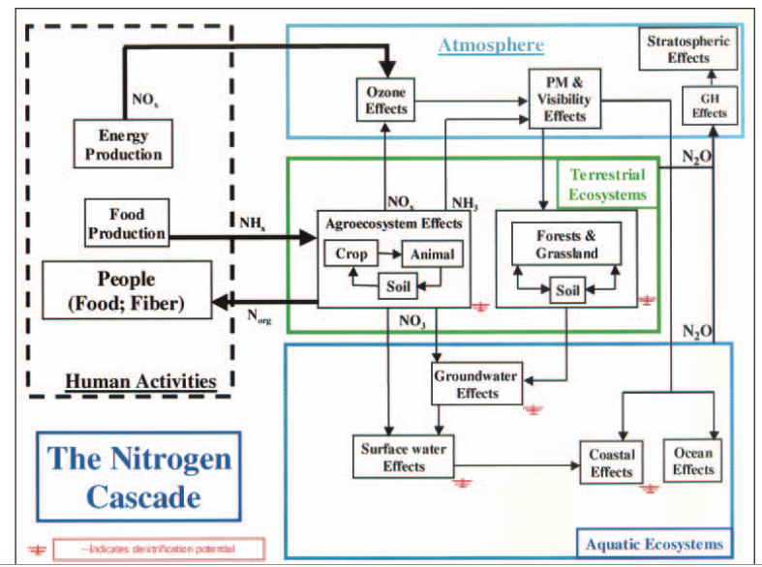

Slide 22
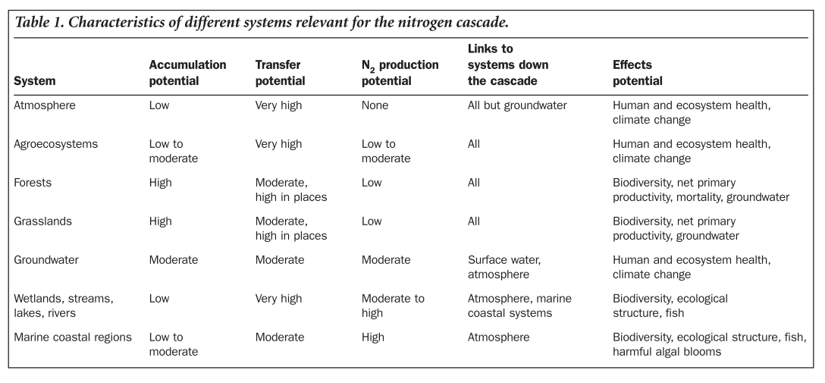

Slide 23
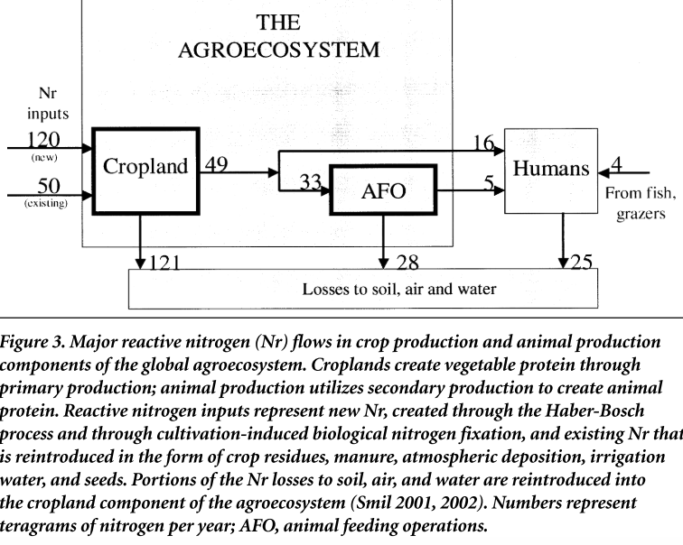

Slide 24
Points to note
Most fixed N added to croplands is “lost” to soil air and water
Losses can end up somewhere else if not denitrified
Around 66% of the N in crops passes through livestock production, and 34% directly consumed by humans
Human consumption of N is around 25% animal product derived and 75% directly from crops (highly variable between countries)
All fixed nitrogen passing through humans ends up in soil, air and water

Slide 25
Improving nitrogen use efficiency
Loss of fertilizer N results from gaseous plant emission, soil denitrification, surface runoff, volatilization, and leaching.
Worldwide, nitrogen use efficiency (NUE) for cereal production is approximately 33%.
The unaccounted 67% represented a $15.9 billion annual loss of N fertilizer (assuming fertilizer-soil equilibrium in 1999).
Increased cereal NUE requires
Application of prescribed rates consistent with in-field variability
Low N rates applied at flowering, and forage production systems.
Adjusting the fertilizer rate by soil mineral N before N application

Slide 26
Nitrogen losses
Denitrification occurs in all ecosystems
Only a fraction of fixed nitrogen reaches the sea
Coastal ecosystems at greatest risk of nitrogen enhanced eutrophication if sources are close by

Slide 27
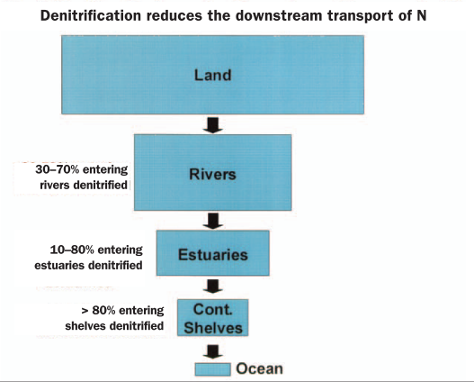

Slide 28
Return to neverland?
Do ecosystems recover from eutrophication?
In some cases recovery is rapid (short sharp shocks)
In others it is very gradual and may not take the expected trajectory
Return to “neverland” baseline may not be achievable
Hysteresis and non linear trajectories of change

Slide 29
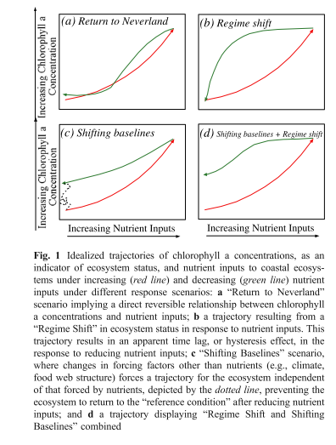

Slide 30
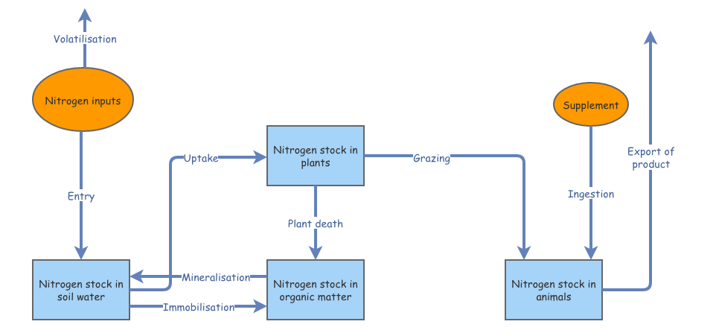
Ecosystem model
https://insightmaker.com/insight/172673/Clone-of-Story-of-nitrogen-dynamics-in-a-shallow-lake

Slide 31
References
Deegan, Linda A., David Samuel Johnson, R. Scott Warren, Bruce J. Peterson, John W. Fleeger, Sergio Fagherazzi, and Wilfred M. Wollheim. 2012. “Coastal eutrophication as a driver of salt marsh loss.” Nature 490 (7420): 388–92. https://doi.org/10.1038/nature11533.
Duarte, Carlos M., Daniel J. Conley, Jacob Carstensen, and María Sánchez-Camacho. 2009. “Return to Neverland: Shifting baselines affect eutrophication restoration targets.” Estuaries and Coasts 32 (1): 29–36. https://doi.org/10.1007/s12237-008-9111-2.
Foley, Jonathan A., Navin Ramankutty, Kate A. Brauman, Emily S. Cassidy, James S. Gerber, Matt Johnston, Nathaniel D. Mueller, et al. 2011. “Solutions for a cultivated planet.” Nature 478 (7369): 337–42. https://doi.org/10.1038/nature10452.
Galloway, James N., John D. Aber, Jan Willem Erisman, Sybil P. Seitzinger, Robert W. Howarth, Ellis B. Cowling, and B. Jack Cosby. 2003. “The nitrogen cascade.” BioScience 53 (4): 341–56. https://doi.org/10.1641/0006-3568(2003)053[0341:TNC]2.0.CO;2.
Howarth, Robert W., and Roxanne Marino. 2006. “Nitrogen as the limiting nutrient for eutrophication in coastal marine ecosystems: Evolving views over three decades.” Limnology and Oceanography 51 (1 II): 364–76. https://doi.org/10.4319/lo.2006.51.1_part_2.0364.
LeBauer, D, and K Treseder. 2008. “Nitrogen limitation of net primary productivity.” Ecology 89 (2): 371–79.

