Slide 1
The nitrogen cycle
Eutrophication and the nitrogen cascade

Slide 2
Why are biogeochemical cycles interesting?
The details underlying biogeochemical cycles may be rather technical.
Conservation of ecosystems may focus on the “bio” rather than the “geochemical”
However, chronic changes in ecosystems that lead to notable changes in the “bio” component often can be traced back to the “geochemical” elements.
For example, Wareham forest is a mosaic of ecosystems that depend on the complex geochemistry of podzol like soils
Carbon to nitrogen ratios are very important.

Slide 3
Why are biogeochemical cycles important?
Processes taking place in the soil (terrestrial) or water (aquatic) ecosystems have visible effects on the biota.
Net primary productivity (the underlying driver of all ecosystems) depends on biogeochemical cycles.
Biogeochemical processes also may be of global concern, particularly when they affect the atmosphere.
At a local level a key process is eutrophication. This may change an ecosystem from one (temporally) stable state into another.

Slide 4
What is eutrophication?
Eutrophication comes from Greek eu trophos, i.e. well nourished
The process by which an ecosystem, or parts of it, becomes progressively enriched with nutrients.
Terms often used for lakes and other water bodies
Eutrophic
Mesotrophic
Oligotrophic
When taken to extremes a system may become “dystrophic” or “hypertrophic”
Two key nutrients typically implicated
Nitrogen
Phosphorous
Both are added to ecosystems naturally, and through human activity

Slide 5
Impacts of phosphates and nitrates
It was once assumed that phosphorous was the key limiting nutrient in lakes, while nitrogen was a key limit for terrestrial ecosystems (remember Leibnitz and modelling)
More recent research shows a more complex picture
Phosphate enrichment is a very important element of freshwater eutrophication.
However, nitrogen derived compounds can play a particularly important role in the eutrophication of coastal ecosystems

Slide 6
Where do inputs of P and N come from?
Both P and N are used as fertilizers
N is more mobile than P and moves through run off and ground water
P tends to bind to sediments
Sewage and manure contain both at high concentrations
Phosphates are also present in detergents

Slide 7
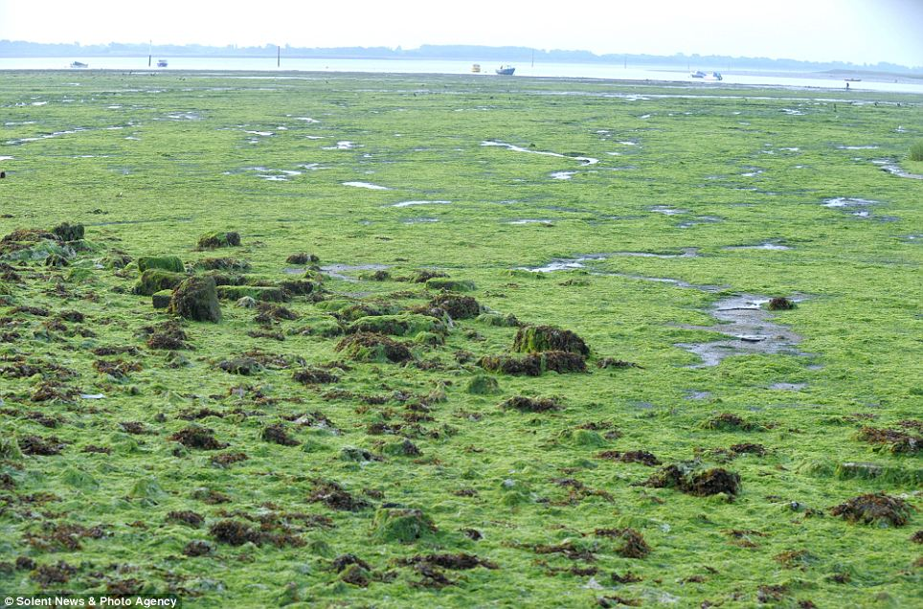
Algal mat (Poole harbour)

Slide 8
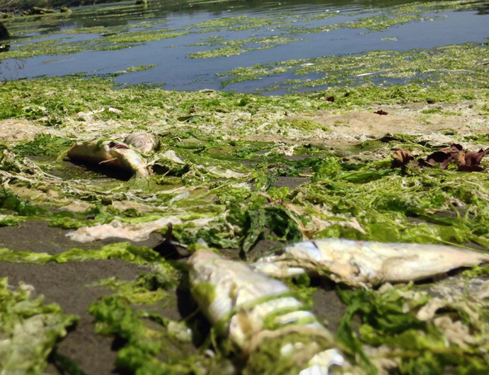
Direct impact of eutrophication
Algal mats or blooms can have the most visible and damaging impact
When an algal mat (or algal bloom) decays, oxygen is depleted
Can lead to fish kills

Slide 9
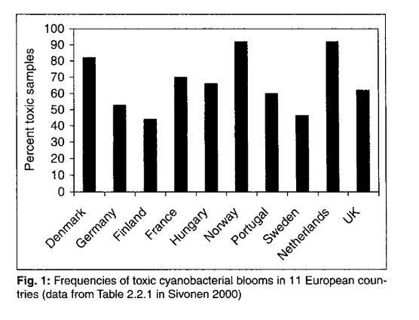
Toxic blooms
Tends to be associated with intensified agriculture (blooms common in countries with high inputs)

Slide 10
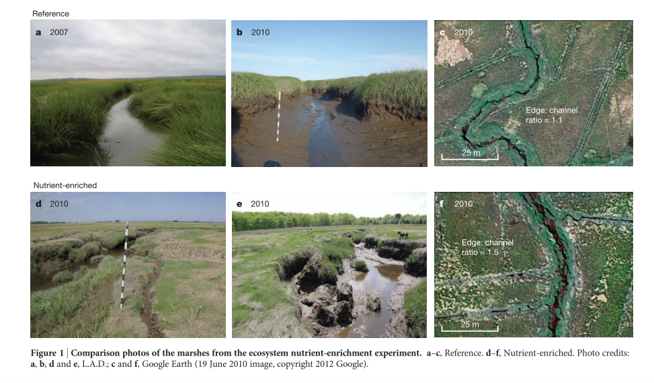
Effects on salt marshes

Slide 11
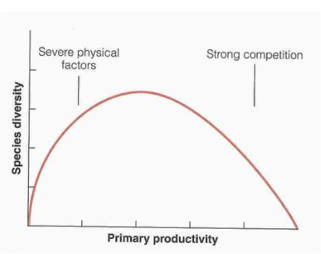
Intermediate productivity hypothesis
There can be a “hump backed” relationship between productivity and species richness.

Slide 12
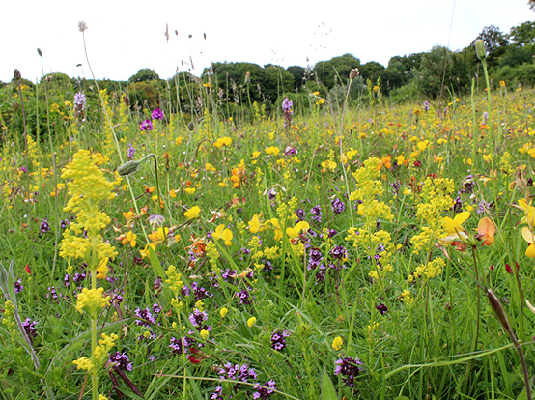
“Improved” grassland

Slide 13
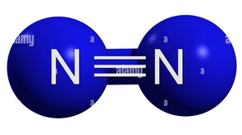
Why focus on nitrogen?
﻿The elements nitrogen (N), carbon (C), phosphorus (P), oxygen (O), and sulphur (S) are all necessary for life, and so are present in all ecosystems
﻿Total amount of N in the atmosphere, soils, and waters of Earth is approximately 4 × 10²¹ grams (g)
More than the total mass of C + P + O + S !
But … > 99% of N unavailable for use
N₂ held together by triple bond

Slide 14
Nitrous oxides
The atmosphere also contains nitrous oxides as trace gases
Three oxides of nitrogen
Commonest is N₂0 at around 0.34 ppm (compare with CO₂ at around 460 ppm)
Released through burning of fossil fuels.
Dissolves in water to form nitric acid
Contributes to “acid rain”
Harmful to human health at high concentrations

Slide 15
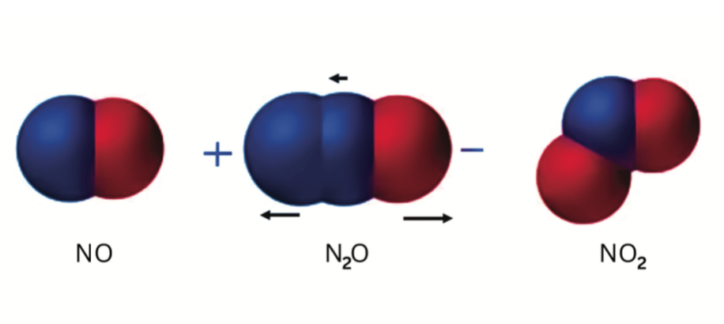
Nitrous oxides

Slide 16
Breaking the triple bond
In order to play a role in ecosystems the nitrogen triple bond has to be broken.
Nitrogen is a component of chlorophyll, amino acids and ATP

Slide 17
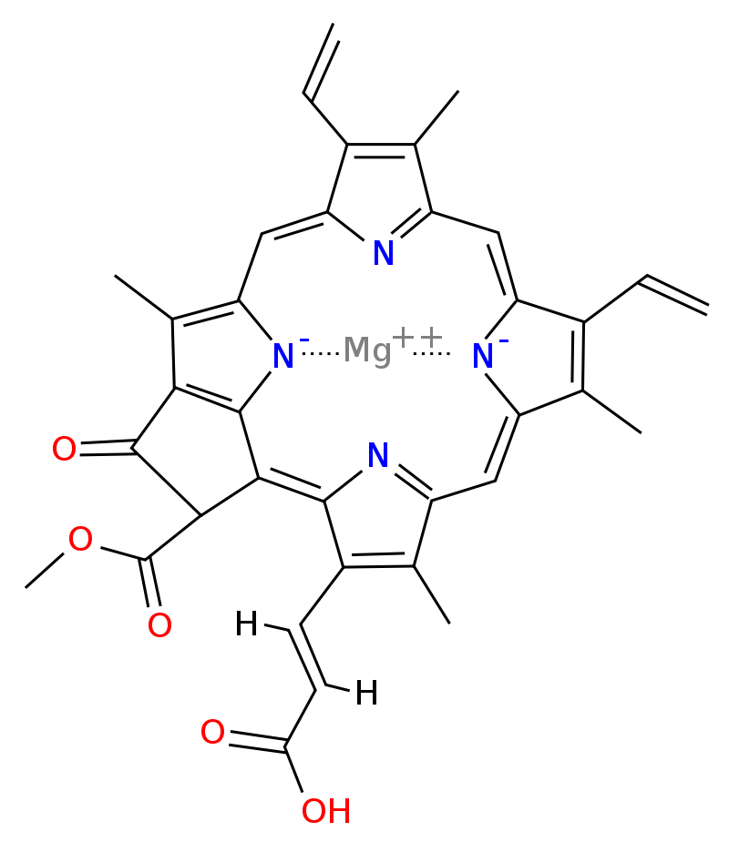
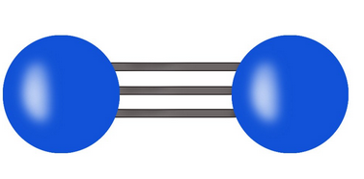
Chlorophyll
C₅₅H₇₂O₅N₄Mg
How does it go from this to that?

Slide 18
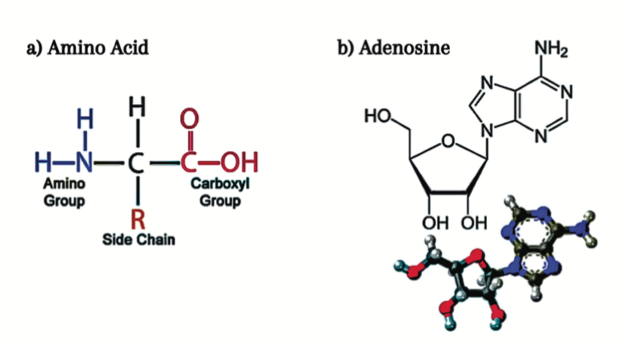
Amino acids and ATP

Slide 19
Biological nitrogen fixation
Nitrogen fixation occurs naturally in soils through a range of microbes known as diazatrophs.
Bacteria,e.g. Azobacter
Archea (“blue green algae”)
Symbiotic relationships with some plants, particularly legumes.
Looser relationship with other plants, e.g. rice

Slide 20
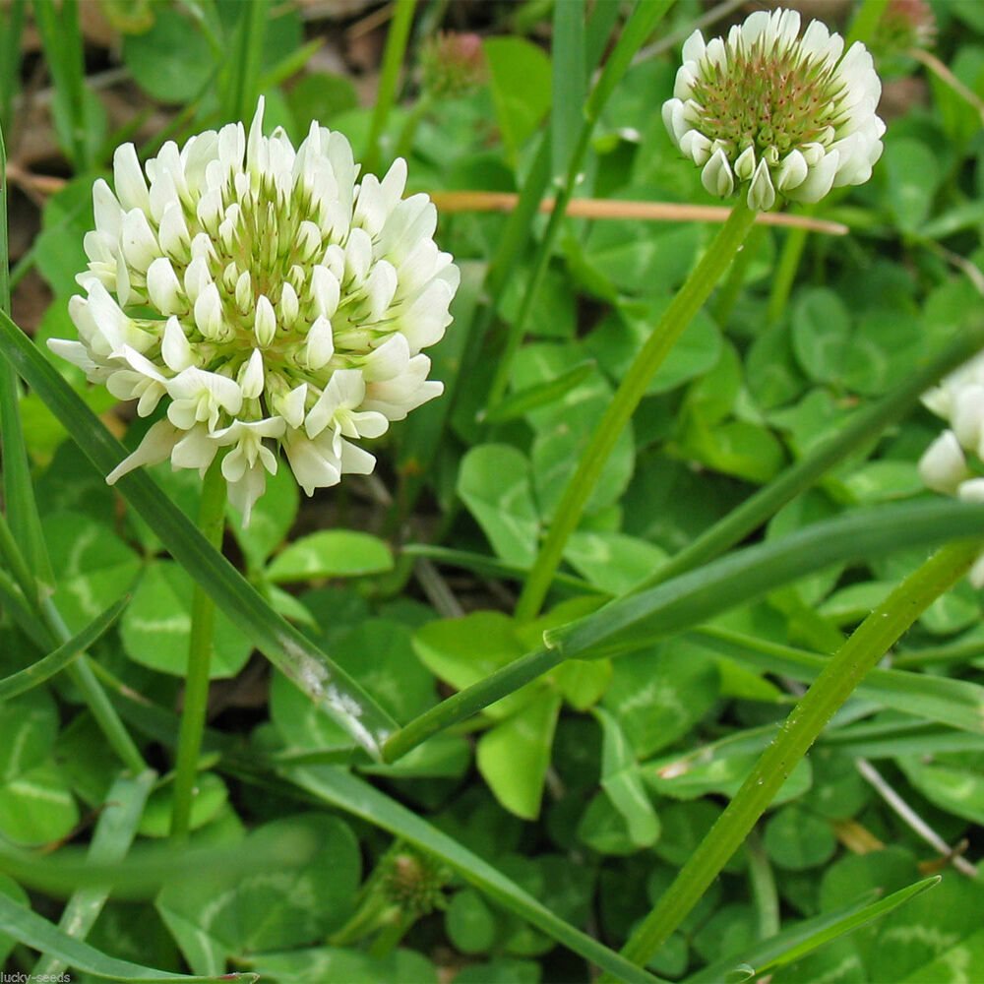
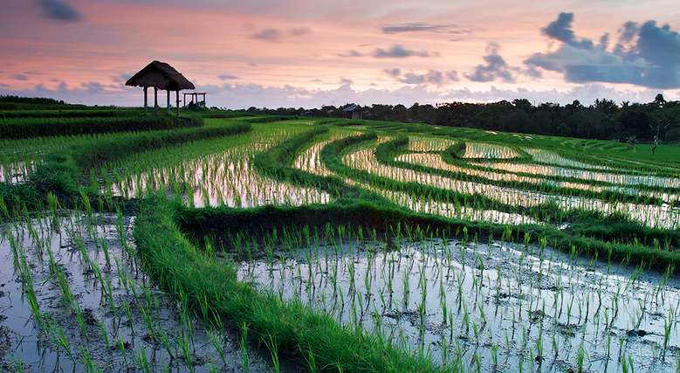
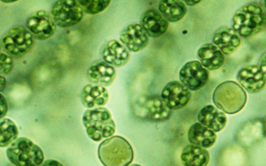
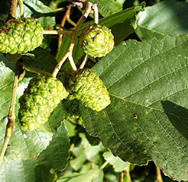
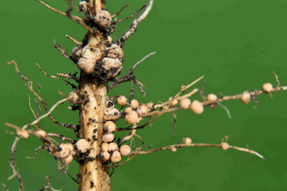
Biological nitrogen fixation

Slide 21
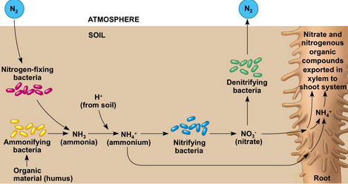
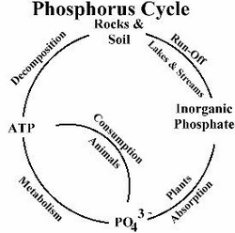
Biological nitrogen fixation
Compare with

Slide 23
Reactions in the soil (nitrification)
In oxygenated soil ammonia is converted to nitrates by specialised microorganisms (ammonia oxidisers)

Slide 24
Denitrification (loss of soil nitrogen to the atmosphere)
Takes place in oxygen poor conditions
Microbes use the reaction as a source of energy
Without denitrification nitrates could reach toxic levels in the soil
Important in treatment of sewage to prevent eutrophication
Releases nitrogen back to the atmosphere.

Slide 25
Anaerobic ammonia oxidation
Does not involve organic matter
Source of energy for some anaerobic microbes

Slide 26
Sources of fixed nitrogen
﻿Prehuman world: creation of N_{r} from N₂
lightning
biological nitrogen fixation (BNF).
Prior to human influence active N did not accumulate rapidly in environmental reservoirs: Microbial N fixation and denitrification processes were probably approximately equal

Slide 27
Sources of fixed nitrogen
﻿Production of N_{r} by humans now much greater than production from all natural terrestrial systems.
Global increase in N_{r} production has three main causes:
Cultivation of legumes, rice, and other crops that promote conversion of N₂ to organic N through biological nitrogen fixation
Combustion of fossil fuels, which converts both atmospheric N₂ and fossil N to reactive NO_{x};
The Haber-Bosch process, which converts nonreactive N₂ to reactive NH₃ to sustain food production and some industrial activities.

Slide 28
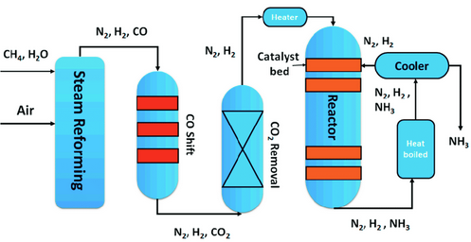
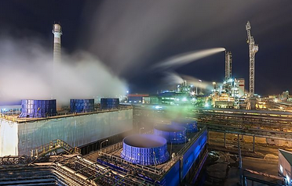
Haber Bosch process

Slide 29
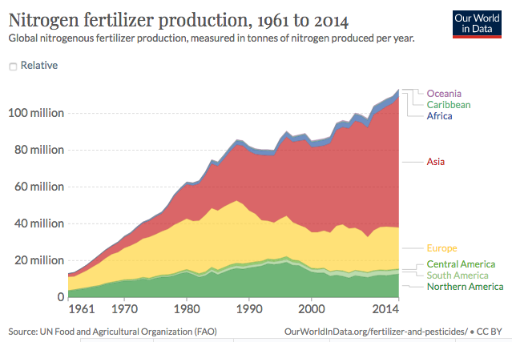
Nitrogen fertiliser production

Slide 30
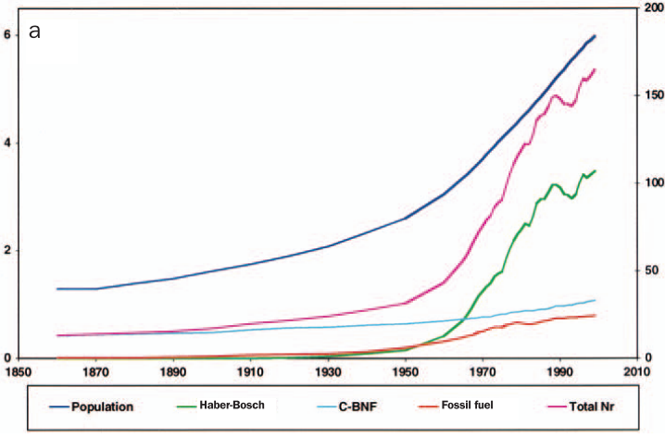
Haber Bosch nitrogen fixation
HB fertiliser
N fixed by legumes etc

Slide 31
Impact on crop yields

Slide 32
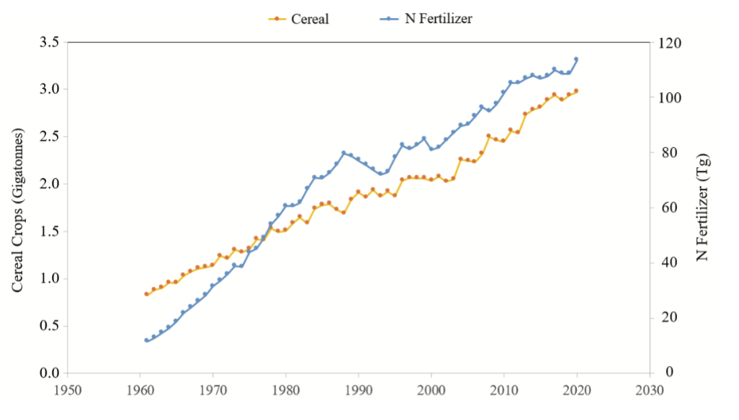
Cereal production and nitrogen fertiliser use

Slide 34
Carbon to nitrogen ratio
There is always more carbon than nitrogen in organic matter.
When an organic substrate has a C:N ratio between 1 and 15, rapid mineralization and release of N occurs, which is available for plant uptake.
The lower the C:N ratio, the more rapidly nitrogen will be released into the soil for plant use
20–30 results in an equilibrium state between mineralization and immobilization.
C:N ratio > 35 results in microbial immobilization.
Soil microorganisms have a C:N ratio of around 8.

Slide 35
Very high C:N ratios lead plants to find alternative sources of nitrogen (e.g in Wareham forest)

Slide 36
Processes in Wareham forest
Conifer plantations tend to add carbon to the soil, but relatively little nitrogen
This can lead to acidification and difficulties in obtaining nitrogen
Fire may make nitrogen temporarily more available
Legumes such as gorse fix nitrogen
Waterlogged soil (mires) lose nitrogen in anoxic conditions through denitrification.
Conversion to agricultural land requires lowering C and raising N
Changing pH through liming makes N more available.

Slide 37
The nitrogen cascade
Fixed nitrogen can be thought of as “cascading” through terrestrial ecosystems
Much is returned to the atmosphere through denitrification
Some finds it way into rivers
Rivers flow into estuaries
Estuaries are joined to near shore maritime ecosystems
Seas are linked to the large oceans.

Slide 38
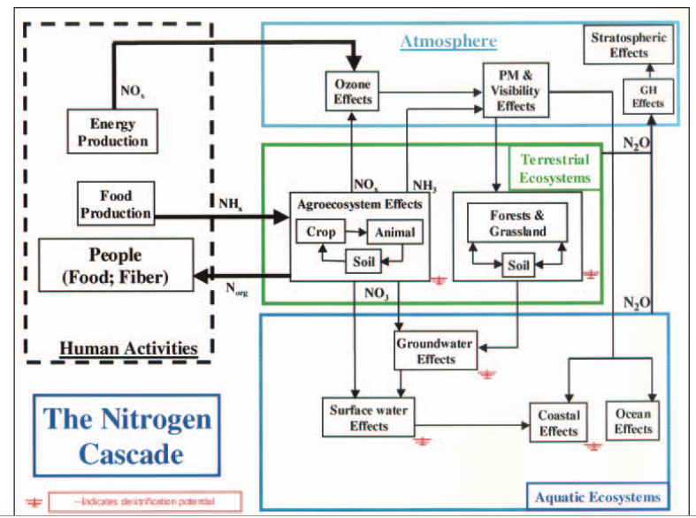

Slide 39
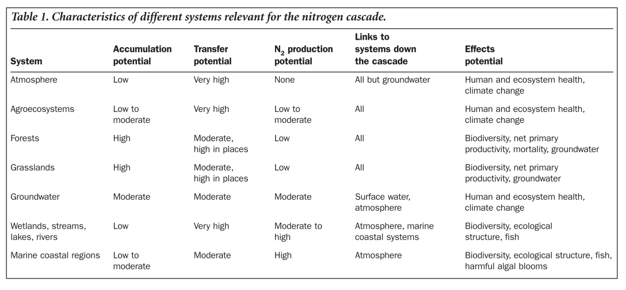

Slide 40
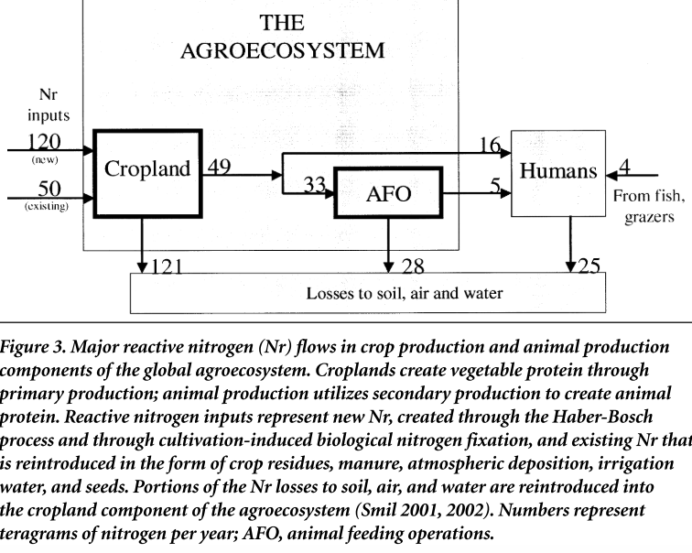

Slide 41
Points to note
Most fixed N added to croplands is “lost” to soil air and water
Losses can end up somewhere else if not denitrified
Around 66% of the N in crops passes through livestock production, and 34% directly consumed by humans
Human consumption of N is around 25% animal product derived and 75% directly from crops (highly variable between countries)
All fixed nitrogen passing through humans ends up in soil, air and water

Slide 42
Improving nitrogen use efficiency
Loss of fertilizer N results from gaseous plant emission, soil denitrification, surface runoff, volatilization, and leaching.
Worldwide, nitrogen use efficiency (NUE) for cereal production is approximately 33%.
The unaccounted 67% represented a $15.9 billion annual loss of N fertilizer (assuming fertilizer-soil equilibrium in 1999).
Increased cereal NUE requires
Application of prescribed rates consistent with in-field variability
Low N rates applied at flowering, and forage production systems.
Adjusting the fertilizer rate by soil mineral N before N application

Slide 43
Nitrogen losses
Denitrification occurs in all ecosystems
Only a fraction of fixed nitrogen reaches the sea
Coastal ecosystems at greatest risk of nitrogen enhanced eutrophication if sources are close by

Slide 44
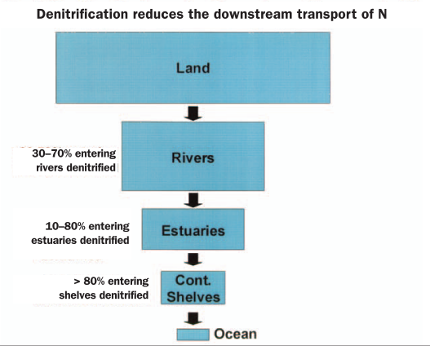

Slide 45
Return to neverland?
Do ecosystems recover from eutrophication?
In some cases recovery is rapid (short sharp shocks)
In others it is very gradual and may not take the expected trajectory
Return to “neverland” baseline may not be achievable
Hysteresis and non linear trajectories of change

Slide 46
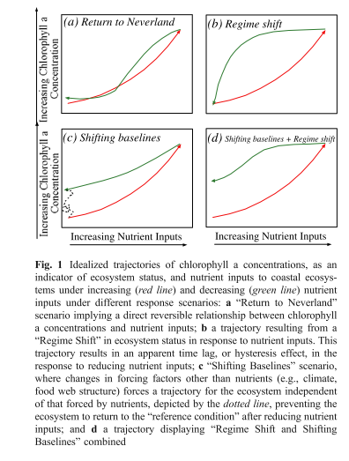

Slide 47
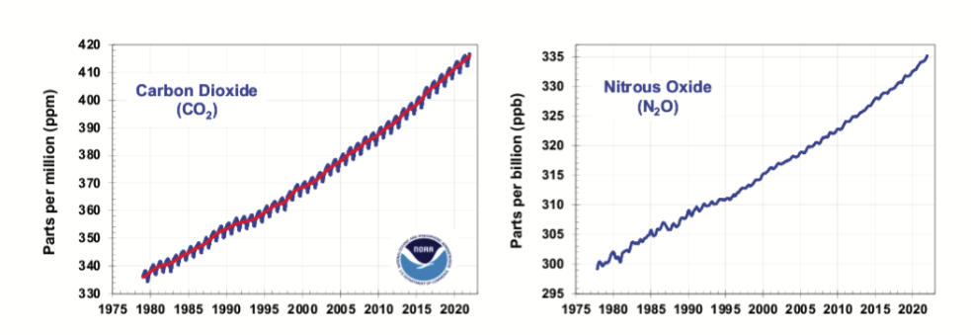
Do nitrous oxides contribute to the greenhouse effect?
Only N₂O has any noticeable greenhouse effect (levels of the other nitrous oxide concentrations are effectively negligible)
N₂O concentrations have more or less tracked increases in CO₂

Slide 48
Comparative role of N₂0
Radiative forcing per added N₂O molecule is about 230 times larger than the forcing per added CO₂ molecule
However, concentrations are much lower.
The observed CO₂ rate of increase is about 2.5 ppm/year.
This is about 3000 times larger than the N₂O rate of increase, which is about 0.0085 ppm/year.
The contribution of nitrous oxide to the annual increase in forcing is therefore around 1/13 that of CO₂.

Slide 49
Conclusions
The nitrogen cycle is not boring!
It is complex and very challenging to understand.
Fixed nitrogen levels in soil and water have a major impact on biodiversity.
Most nitrogen tends to cycle locally but there is a cascade through ecosystems
Like carbon, nitrogen is essential to primary productivity, including food production.
Careful management of nitrogen is essential.

Slide 50
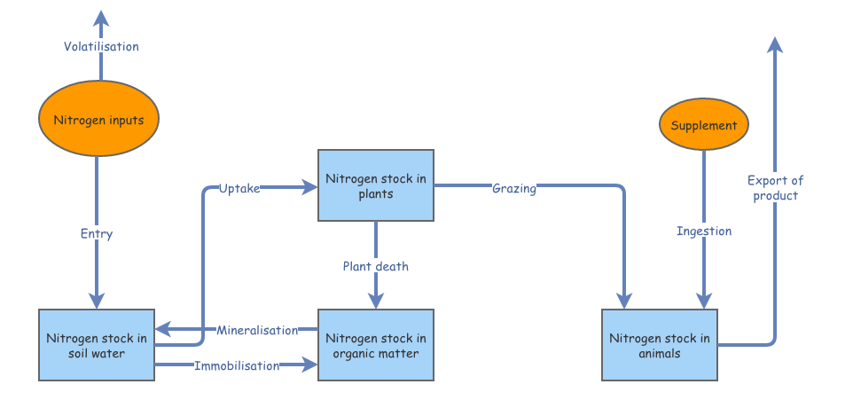
Ecosystem model
https://insightmaker.com/insight/172673/Clone-of-Story-of-nitrogen-dynamics-in-a-shallow-lake

Slide 51
References
Deegan, Linda A., David Samuel Johnson, R. Scott Warren, Bruce J. Peterson, John W. Fleeger, Sergio Fagherazzi, and Wilfred M. Wollheim. 2012. “Coastal eutrophication as a driver of salt marsh loss.” Nature 490 (7420): 388–92. https://doi.org/10.1038/nature11533.
Duarte, Carlos M., Daniel J. Conley, Jacob Carstensen, and María Sánchez-Camacho. 2009. “Return to Neverland: Shifting baselines affect eutrophication restoration targets.” Estuaries and Coasts 32 (1): 29–36. https://doi.org/10.1007/s12237-008-9111-2.
Foley, Jonathan A., Navin Ramankutty, Kate A. Brauman, Emily S. Cassidy, James S. Gerber, Matt Johnston, Nathaniel D. Mueller, et al. 2011. “Solutions for a cultivated planet.” Nature 478 (7369): 337–42. https://doi.org/10.1038/nature10452.
Galloway, James N., John D. Aber, Jan Willem Erisman, Sybil P. Seitzinger, Robert W. Howarth, Ellis B. Cowling, and B. Jack Cosby. 2003. “The nitrogen cascade.” BioScience 53 (4): 341–56. https://doi.org/10.1641/0006-3568(2003)053[0341:TNC]2.0.CO;2.
Howarth, Robert W., and Roxanne Marino. 2006. “Nitrogen as the limiting nutrient for eutrophication in coastal marine ecosystems: Evolving views over three decades.” Limnology and Oceanography 51 (1 II): 364–76. https://doi.org/10.4319/lo.2006.51.1_part_2.0364.
LeBauer, D, and K Treseder. 2008. “Nitrogen limitation of net primary productivity.” Ecology 89 (2): 371–79.

