Slide 1
Gaia, modelling concepts and global greening
Duncan Golicher

Slide 2
The Gaia hypothesis revisited: What does it state?
Three (at least) propositions of the Gaia hypothesis(Kirchner 2002)
Biologically mediated feedbacks contribute to environmental homeostasis
These make the environment more suitable for life
Feedbacks should arise by Darwinian natural selection

Slide 3
Which of these is most relevant?
The most popular interpretations of Gaia use 1 and 2.
The idea that life evolves to influence the feedbacks is more difficult
The concept that life (the biota) mediates physical processes (e.g. climate) is uncontroversial.
However: Do biotic mediated feedbacks lead to homeostatasis?

Slide 4
Can we ever understand Gaia through modelling?
The Earth can be thought of as an ecosystem.
Ecosystems and complexity.
A complicated system can be described in full (e.g an internal combustion engine is a complicated system)
A complex system can never be fully understood and predicted.
Complicated systems have a design. Each part has a function.
Complex system are not designed. Each part may have numerous roles and functions
Some interactions within a complex system can be understood. However the whole system is inherently unpredictable.
Complex systems show emergent properties that occur as the result of diverse interactions

Slide 5
Is the earth a homeostatic system?
Homeostasis returns a systen to its initial state when perturbated.
A simplistic interpretation implies one single negative feedback loop
A more refined interpretation implies more negative feedbacks than positive feedbacks
Attempts to predict measure the strength of each process that leads to feedbacks

Slide 6
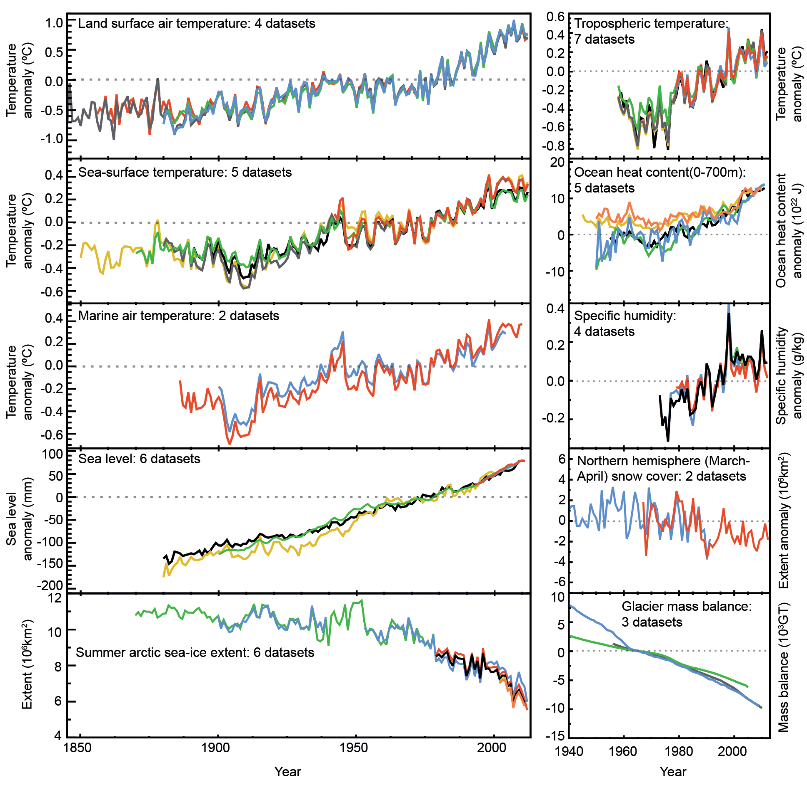
Anthropogenic climate change

Slide 7
Positive feedbacks in terrestrial ecosystems
Warmer temperatures increase soil respiration rates, releasing organic carbon stored in soils
Warmer temperatures increase fire frequency, leading to net replacement of older, larger trees with younger, smaller ones, resulting in net release of carbon from forest biomass
Higher atmospheric CO2 concentrations may increase drought tolerance in plants, potentially leading to expansion of shrublands into deserts,thus reducing planetary albedo and atmospheric dust concentrations
Warming leads to replacement of tundra by boreal forest, decreasing planetary albedo
Warming of soils accelerates methane production more than methane consumption
Warming of soils accelerates $N_{20}$ production rates
-Increased atmospheric CO2concentrations stimulate increased photosynthe-sis, leading to carbon sequestration in biomass (negative feedback).

Slide 8
References
Kirchner, James W. 2002. “The Gaia hypothesis: Fact, theory, and wishful thinking.” Climatic Change 52 (4): 391–408. https://doi.org/10.1023/A:1014237331082.

