Slide 1
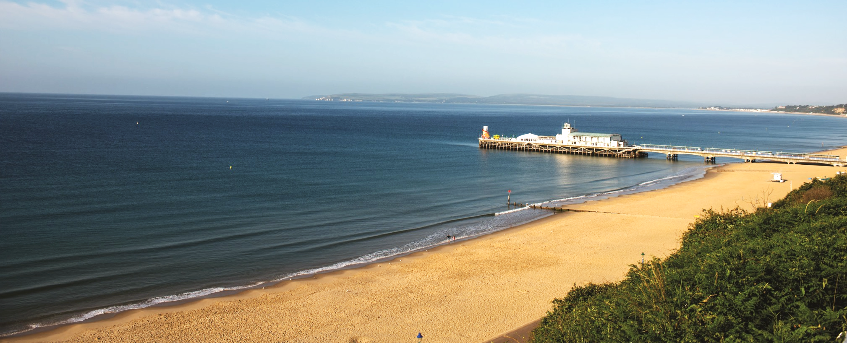



Department of
Life and Environmental Sciences
Download our free Open Day app
BSc Ecology and Wildlife Conservation
Professor Richard Stillman – Head of Department
#BUopenday
#belongatbu

Slide 2
Other courses in the Department of Life and Environmental Sciences
BSc Biological Sciences
BSc Environmental Science
BSc Geography

Slide 3
Contents of this talk
Key features of the course
Who teaches on the course
What to expect
Transferable skills and experience

Slide 4
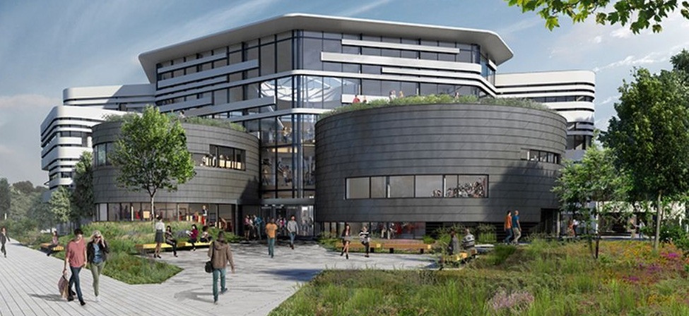

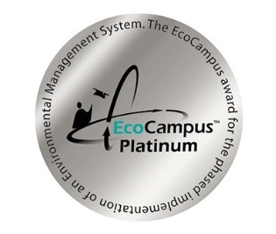
Why BU?
Gender equality in higher education.

Slide 5
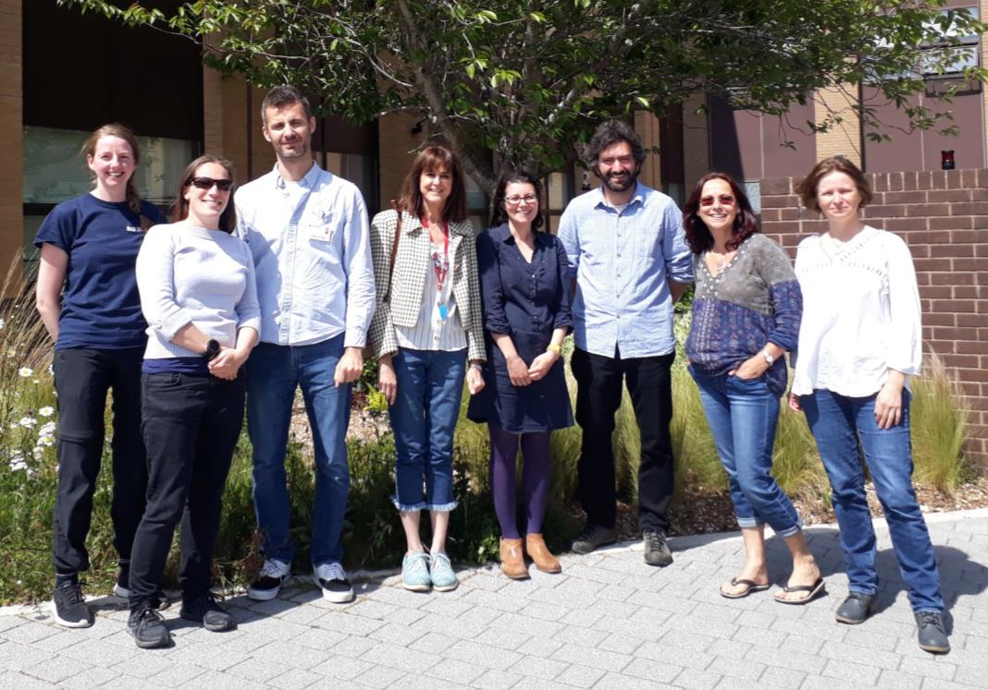
Department Athena SWAN Bronze award
Athena SWAN recognises good practices in the advancement of gender equality
Our self-assessment team and action plan continue to improve our practices

Slide 6
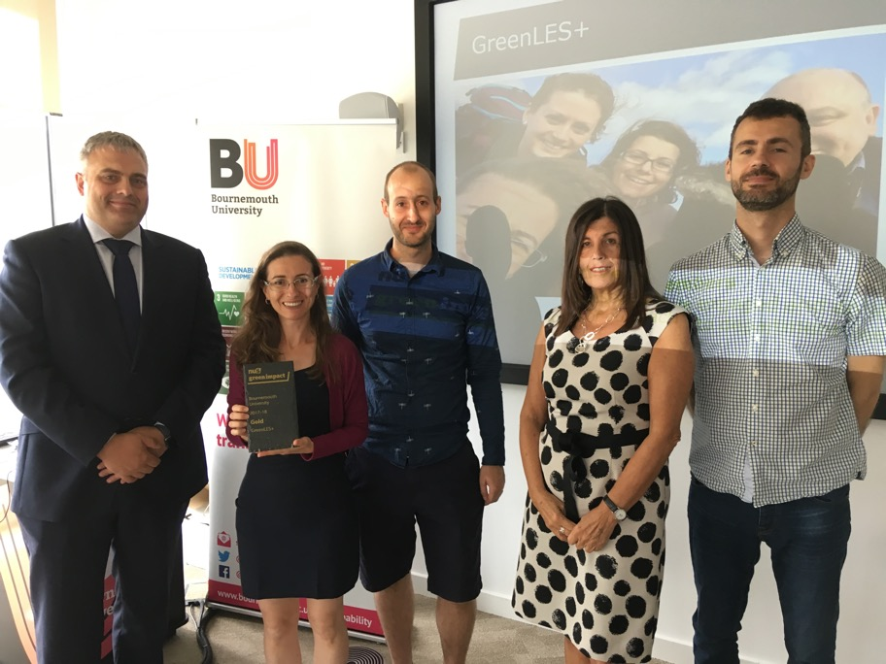

Department Gold Award for Green Impact
Green Impact is an environmental accreditation delivered by the National Union of Students (NUS)
We were audited by BU students trained by NUS

Slide 7
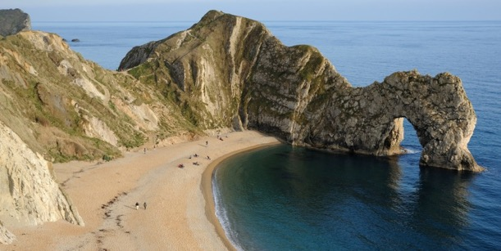
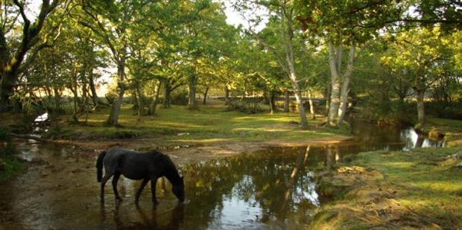
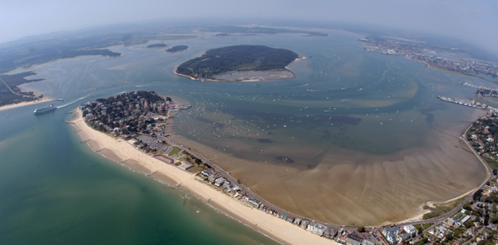
Key features of the course – the location
Benefiting from the outstanding natural surroundings
World Heritage Site
Biodiversity hotspot
National Parks and Nature Reserves

Slide 8

Poole Harbour Special Protection Area

Slide 9
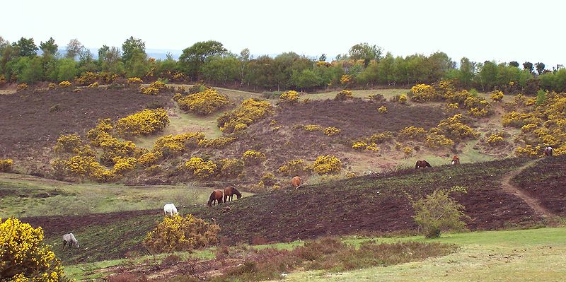
New Forest National Park

Slide 10
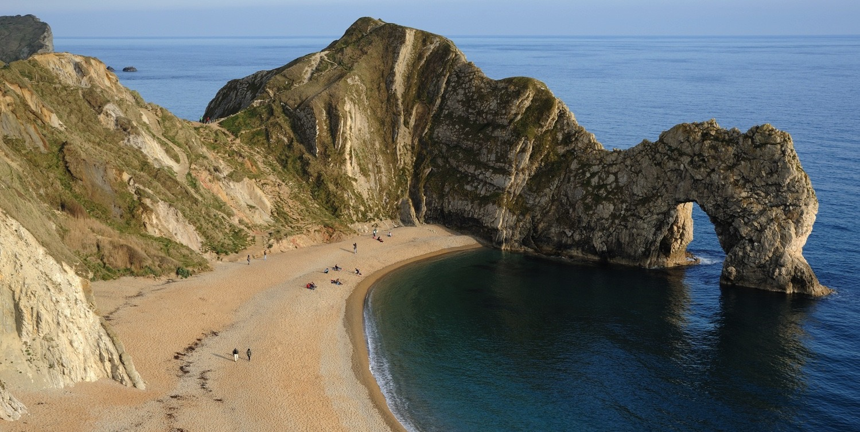
Jurassic Coast World Heritage Site

Slide 11
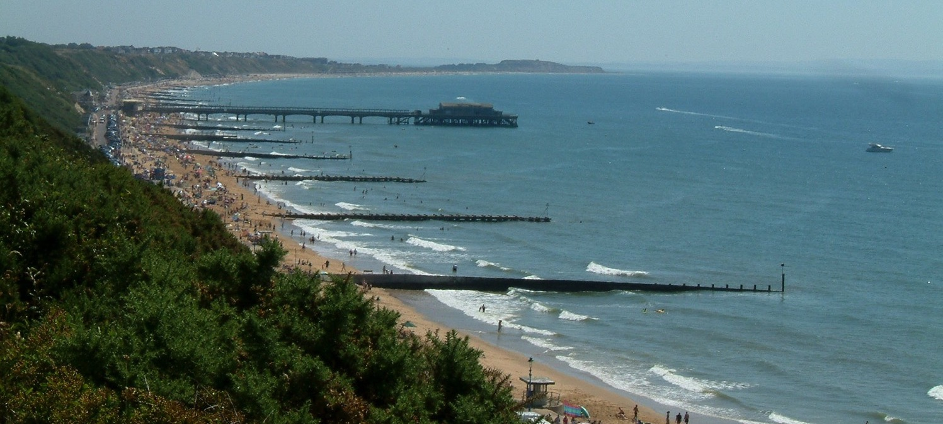
Bournemouth – a great place to study and live

Slide 12
Key features of the course
National and international fieldwork
- Residential field course in UK (1st year)
- Optional international field course (2nd year)
Academic Advisors (tutors) help you learn core skills
Independent research project (3rd year)
Emphasis on transferable skills and employability
  2 work placements (5 weeks each, end of 1st and 2nd year)
  Optional placement year (30 weeks)
  Extracurricular opportunities to build your CV

Slide 13
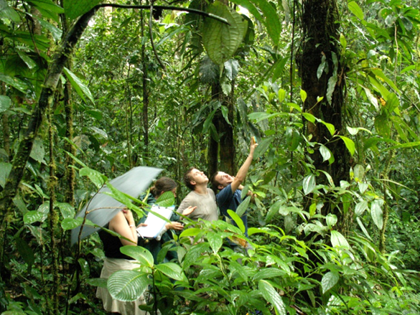
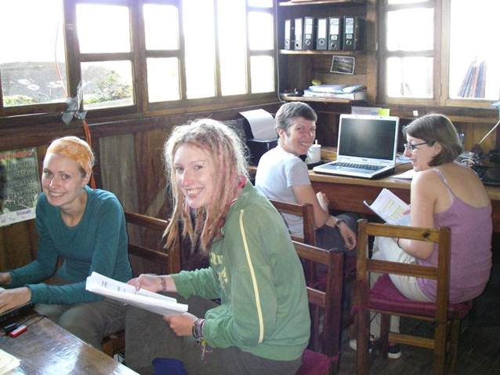
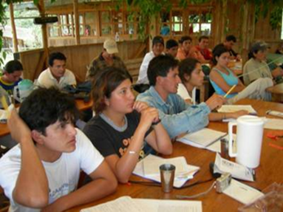
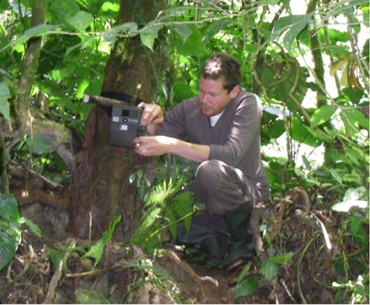
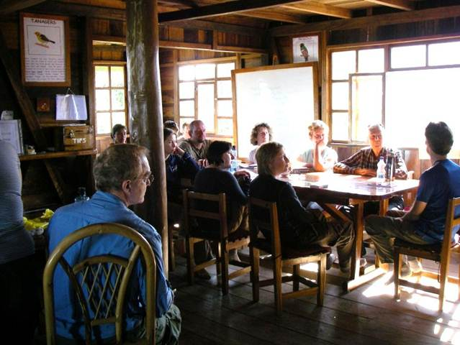
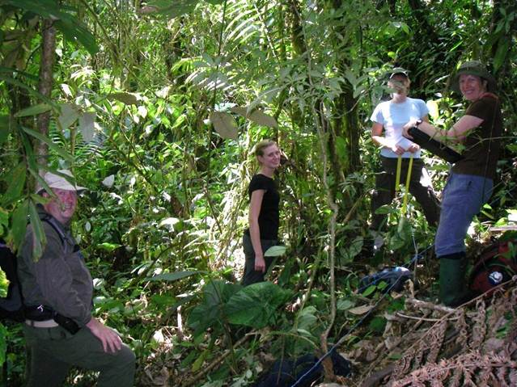


Placements
Life and Environmental Sciences International Fund

Slide 14
Key features of the course
Research-led teaching and scientific underpinning of courses
Lecturers active in their areas of research and enthusiastic about their subjects
Staff with diverse interests

Slide 15
Science matters
Science, Technology, Engineering & Mathematics (STEM) subjects are seen as vital to economic recovery
And science graduates are in demand in all areas of employment - superior skills in problem solving

Slide 16
BSc Ecology and Wildlife Conservation
1st year
Ecological Research Skills, Ecology, Physical Geography, Wildlife Protection, Diversity of Life, Residential Field Trip
2nd year
Advanced Skills for Conservation, Ecosystems, Wildlife Survey Skills, Evolutionary Biology
Choose two options from:
Behavioural Ecology, Environmental Pollution, Geographical Information Systems, Environmental and Societal Challenges, International Field Trip, Applications of Environmental Science, Microbiology, Marine Geography, Quaternary Environments, Animal Biology
3rd year
Independent research project
Choose four options from:
Globalisation and Sustainable Development, Parasitology and Epidemiology, Climate and Environmental Change, Applied Biogeography, Environmental Remote Sensing, Primate Behavioural Ecology, Topics in Wildlife Conservation, Environmental Law and Management, Biological Oceanography, Emergence and Extinction, Freshwater Resource Management, Marine Conservation

Slide 17
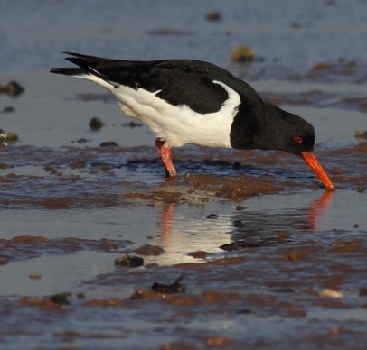

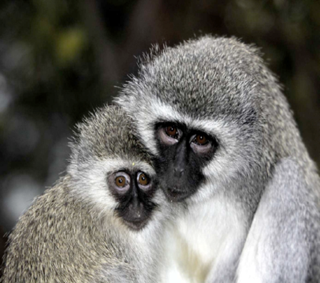
Behavioural Ecology unit (Year 2)
Teaching staff
Richard Stillman, Amanda Korstjens, Paul Hartley
Assessment
50% coursework, 50% exam
Duration
Semester 2 (February to May)
Delivery
34 one-hour lectures, 2 day fieldtrips, 1 field study
Example content
Learn about all animal groups, how animals make decisions, foraging and movement behaviour, social and reproductive behaviour, applying behaviour to wildlife conservation
Leads on to
Primate Behavioural Ecology, led by Amanda Korstjens

Slide 18
Student feedback
‘The course has provided me with a broad range of educational tools which I can apply in an environmental and/or conservation based career. From Habitat Management and Wildlife Behaviour to Environmental Law and Professional Practice.’
Andrew Fisher, BSc Ecology & Wildlife Conservation
‘The variety of subjects available within the course adds significant value to a C.V. In addition, being able to focus during the third year on areas of particular interest has made for a more ‘tailor made’ experience.’
Ann Thornton, BSc Ecology & Wildlife Conservation

Slide 19
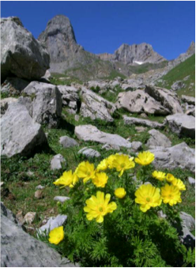
BSc Ecology and Wildlife Conservation
You will be well qualified for:
Ecological NGOs
Government conservation
Ecological consultancy
Ecotourism
Further education
Research degree

Slide 20
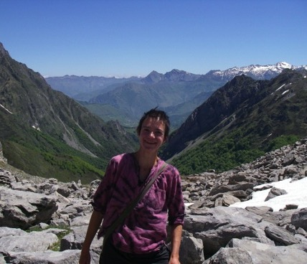
Programme (course) leader
Anita Diaz
Plant and animal interactions, conservation ecology

Slide 21
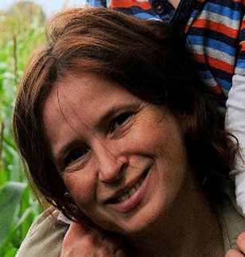
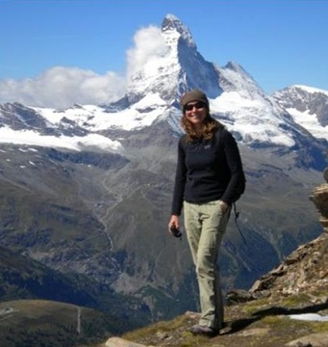
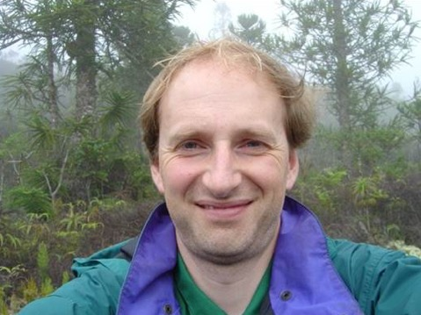
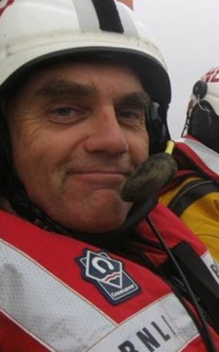
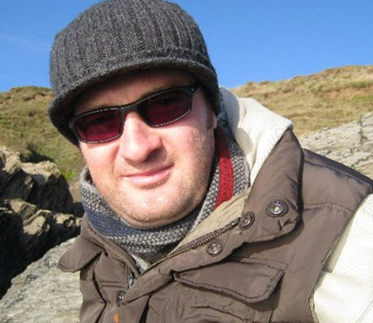
Amanda Korstjens
Primate behaviour and ecology
Kathy Hodder
Ecology and sustainability
Richard Stillman
Bird ecology and modelling
Adrian Newton
Forest ecology and sustainability
Roger Herbert
Marine biology
Rick Stafford
Ecology and statistics

Slide 22
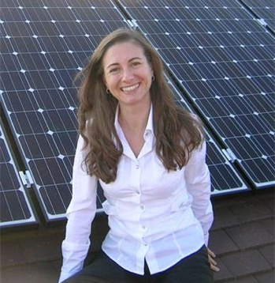
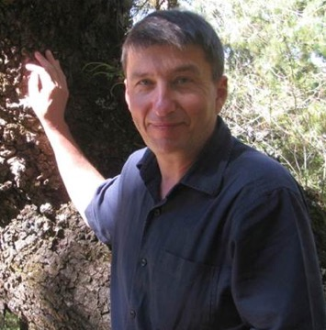
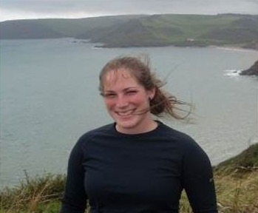
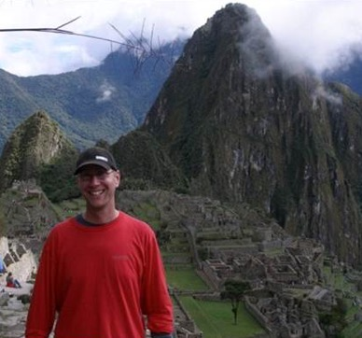
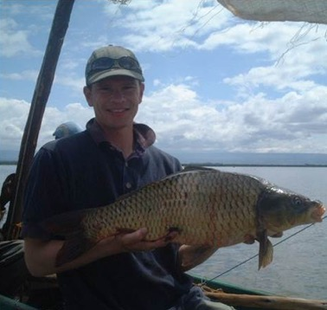
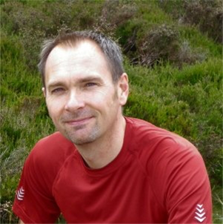
Elena Cantarello
Green economy, forest ecology
Duncan Golicher
Forest ecology and biogeography
Pippa Gillingham
Biogeography
Ross Hill
Remote sensing, GIS
Rob Britton
Fish Ecology
Iain Green
Soil ecology and toxicology

Slide 23
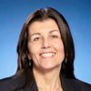
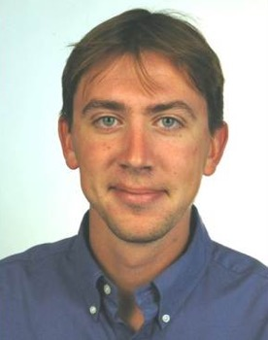
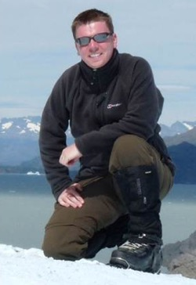
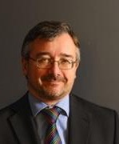
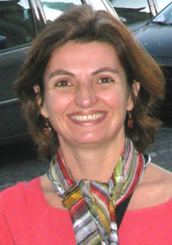
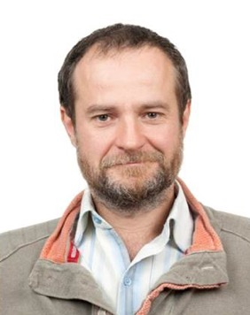
Chris Shiel
Sustainability
Dan Franklin
Marine biology, oceanography
Andy Ford
Geomorphology, remote sensing
Matthew Bennett
Geomorphology
Luciana Esteves
Coastal processes
Marin Cvitanović
Ecosystem services
John Stewart
Paleoecology

Slide 24
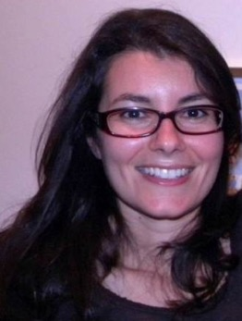
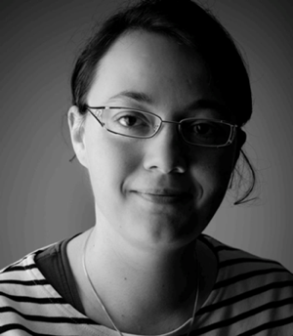
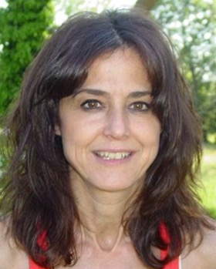
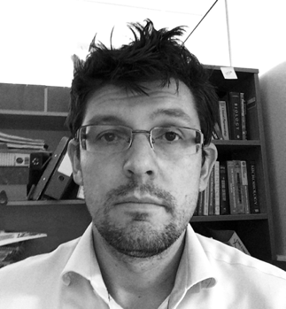
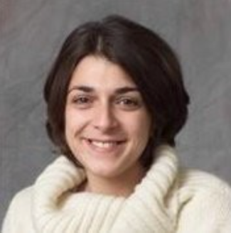
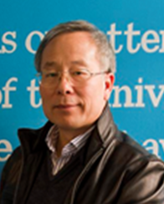
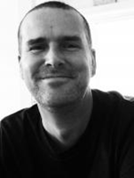
Demetra Andreou
Genetics and Parasitology
Emilie Hardouin
Conservation genetics
Genoveva Esteban
Microbial biology
Kevin McGhee
Human genetics
Anna Mantzouratou
Human Genetics
Wei-Jun Liang
Genetics
Paul Hartley
Genetics

Slide 25
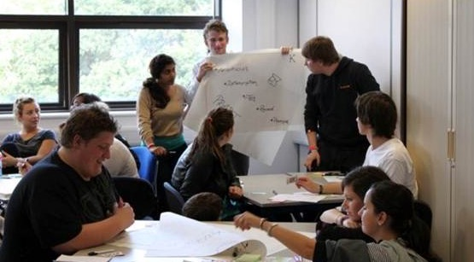
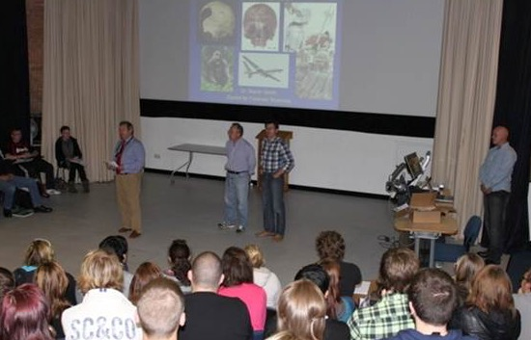
Making the transition to university
Induction focused on:
  The transition to university education
  Professional skills
  Personal goal setting
  Strategies for success
  Developing networks
  Extracurricular activities:
  e.g. student clubs & societies, volunteering opportunities

Slide 26
Support available throughout your study includes:
Academic support
Disability & Additional Learning Support
Language Centre
Library & Learning Support
GROW@BU
Course-specific support
Peer-assisted learning (PAL) sessions
Programme leaders
Academic Advisor (Personal tutor)
Student reps
Study support
  Academic writing
  Exam and revision techniques
  Presentations
  Referencing
  Avoiding plagiarism
Health and wellbeing
Chaplaincy
Counselling
Medical Centre

Slide 27
Other ways you can get involved at BU and build your CV

Slide 28
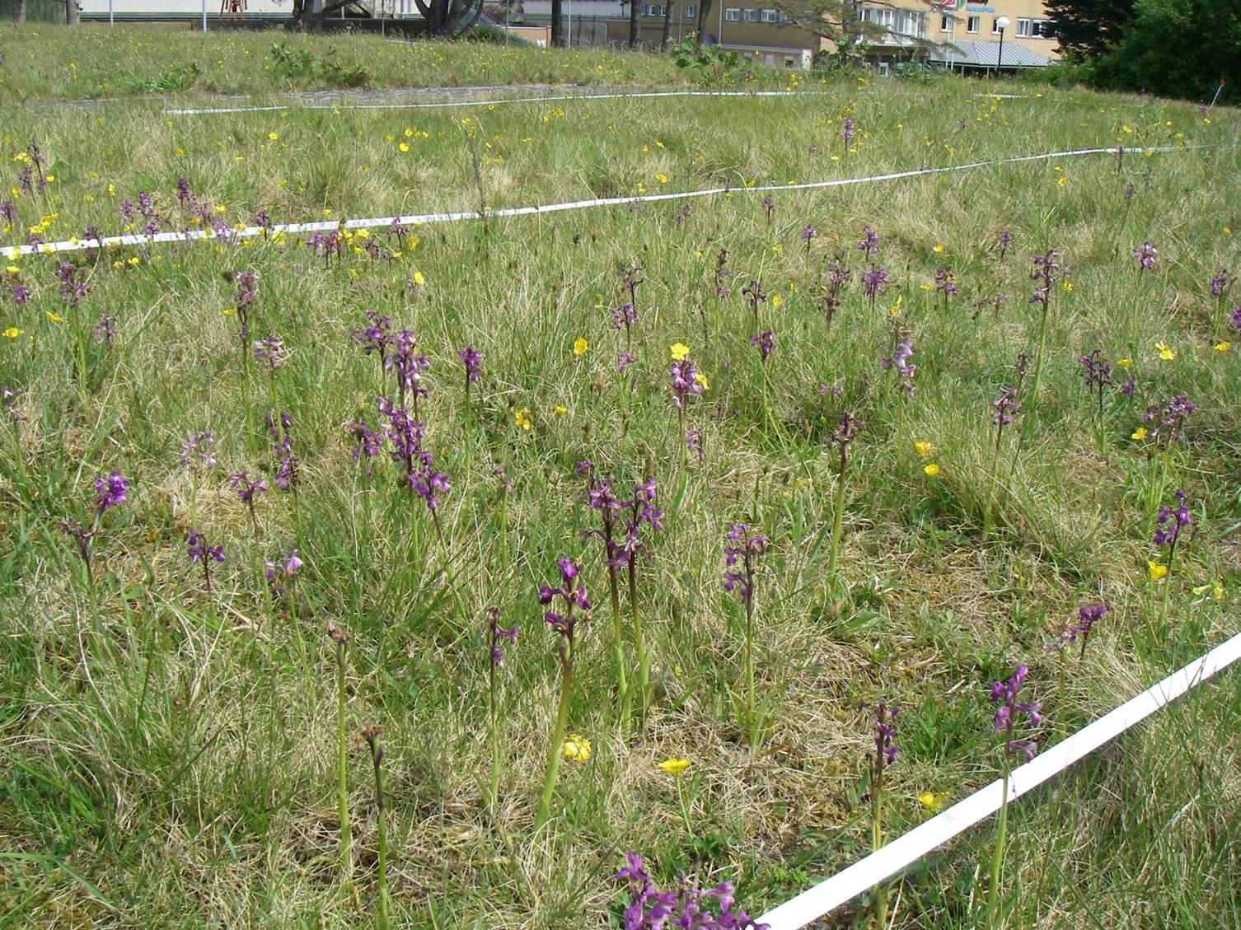
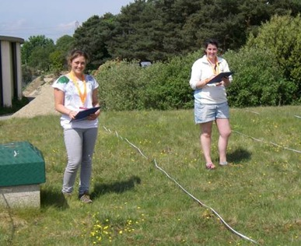
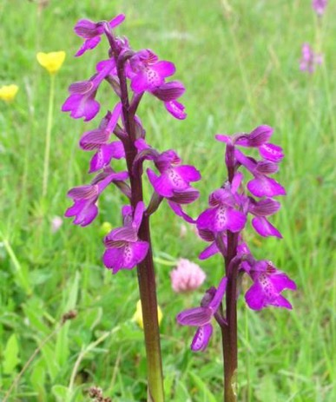

Student societies

Slide 29

Student Research Teams for project team-based experience

Slide 31





Expeditions
Life and Environmental Sciences International Fund

Slide 32



Diverse opportunities for learning & demonstrating skills gained to future employers
Learning in partnership with academic staff and professional practitioners e.g.
Individual Placements
SERTs
Research Assistants
Class Projects
Dissertation
Outreach Events
On your mobile
http://www.cocreate4science.org/

Slide 33


Slide 34

Thank you
What’s next …
Tour / talk to us
Following this talk
Visit us in the Sports Hall
Find out more details about the course
Have any questions answered

