Slide 1
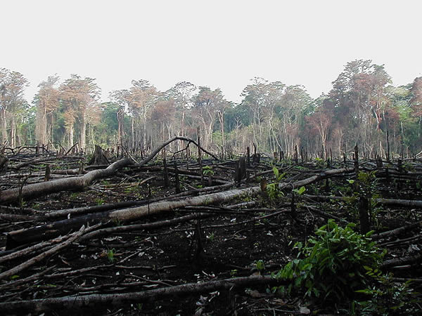
What causes tropical deforestation?

Slide 2
A complex picture
No simple generalisations
Tropical forests are lost due to a large number of factors acting together
Useful conceptual framework divides factors into
Proximate causes
Underlying causes

Slide 3
Results of meta-analysis
Geist and Lambin analysed case studies from Asia, Latin America and Africa
Found large number factors that led to deforestation
Drivers differ in importance between regions
I. Geist, Helmut II. Lambin, Eric III (2001)Land-Use and Land-Cover Change (LUCC)Project IV. International Human Dimensions Programme on Global Environmental Change (IHDP) V. International Geosphere-Biosphere Programme (IGBP) VI. TitleVII. Collection: LUCC Report Series

Slide 4
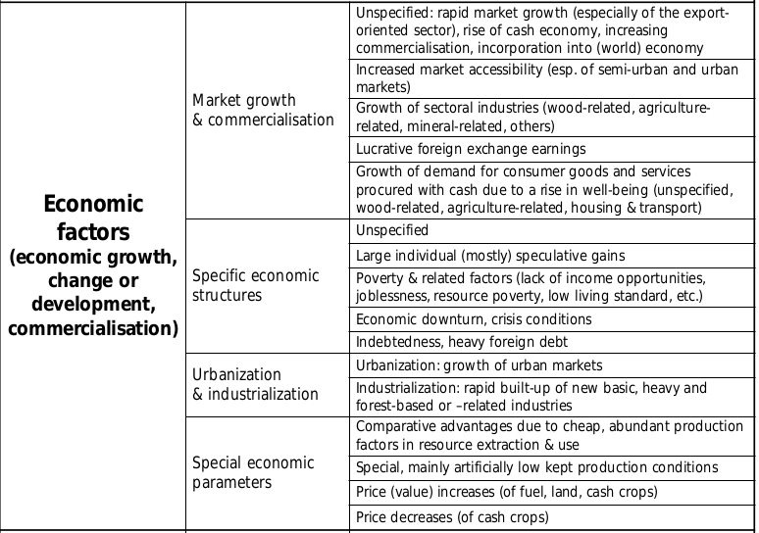
Underlying causes

Slide 5
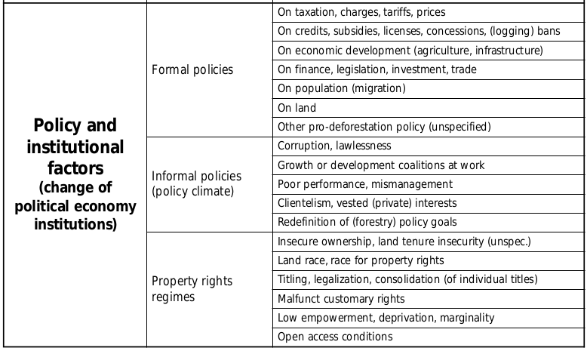
Underlying causes

Slide 6
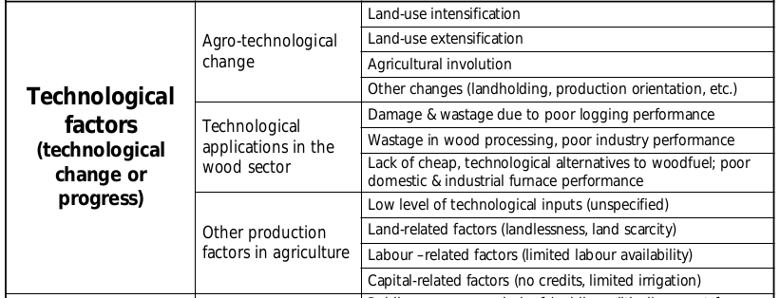
Underlying causes

Slide 7
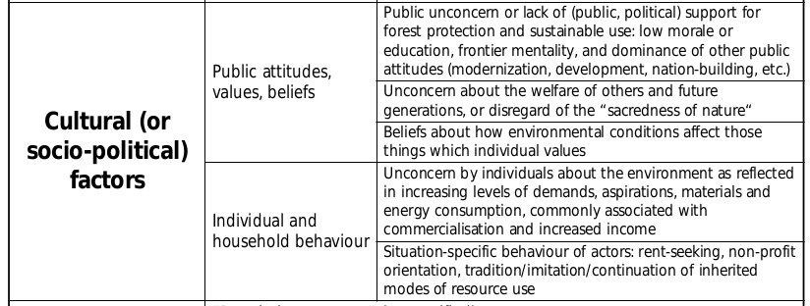
Underlying causes

Slide 8
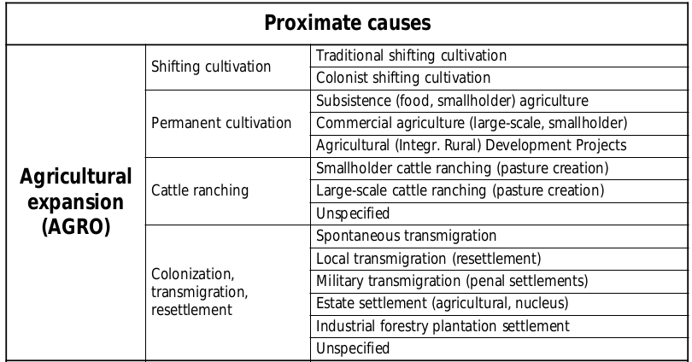
Proximate causes

Slide 9
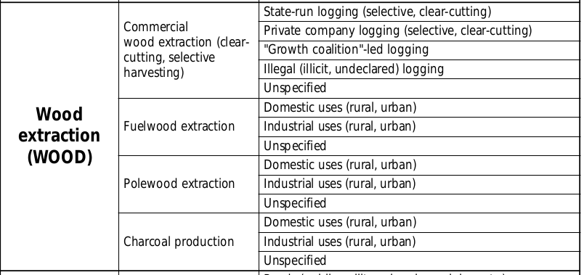
Proximate causes

Slide 10
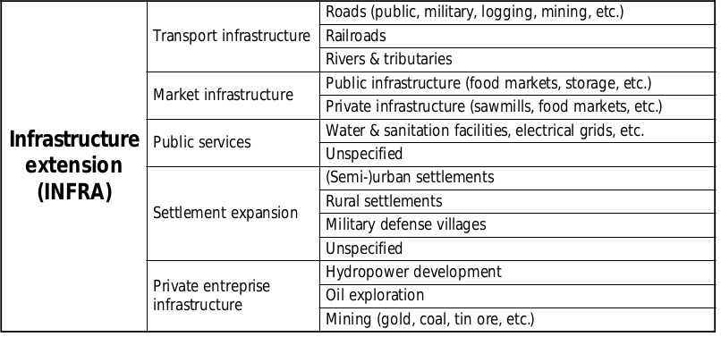
Proximate causes

Slide 11
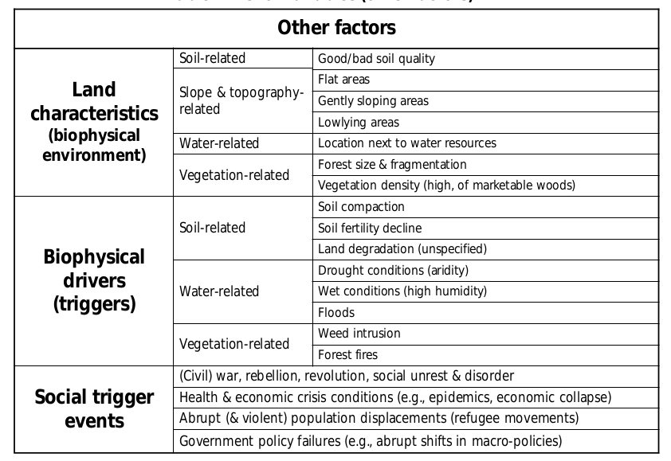
Other factors (facilitators)

Slide 12
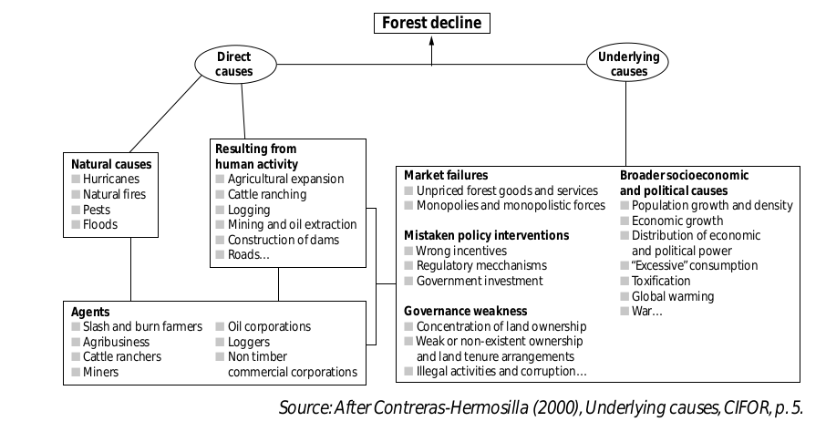

Slide 13
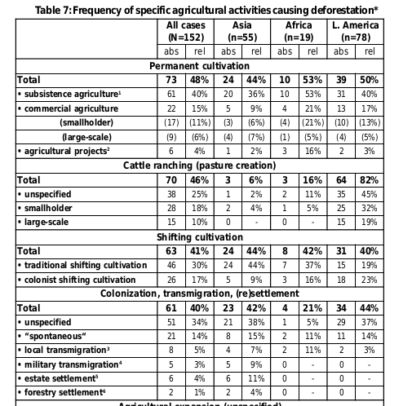

Slide 14
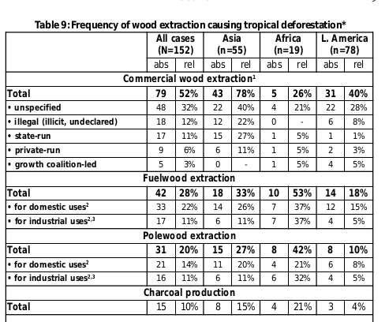

Slide 15
Underlying causes

Slide 16
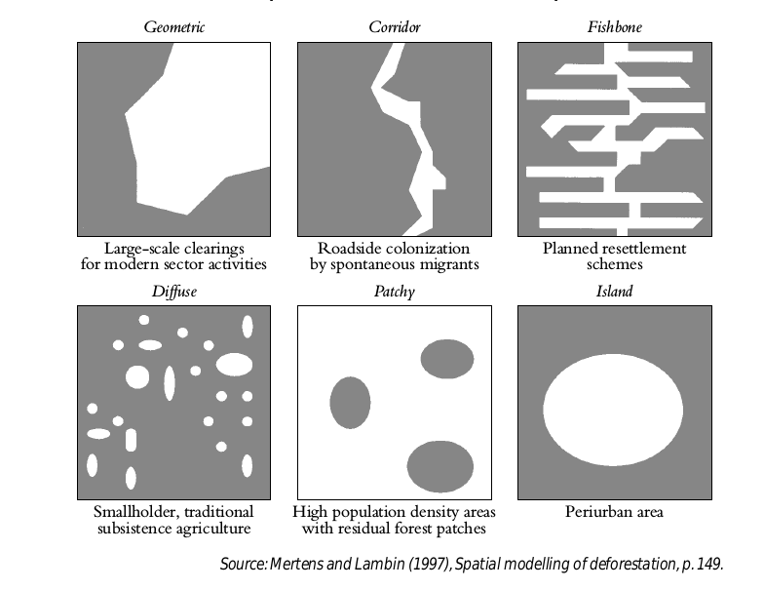
Patterns

Slide 17
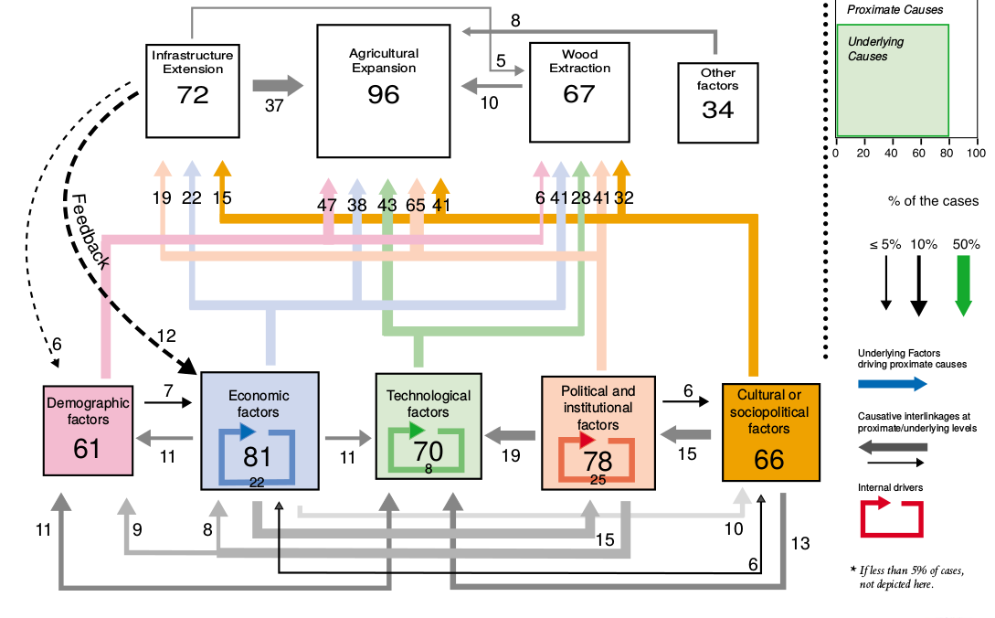

Slide 18
Conclusions
Causes and drivers of tropical deforestation cannot be reduced to a single variable. The interplay of several proximate and underlying factors drive deforestation in a synergetic way.
The expansion of cropped land and pasture is clearly the most important proximate cause of tropical deforestation

Slide 19
Conclusions
Shifting cultivators are not always the key agents of deforestation
Chain-logical causation in the form of 2-factor chains underlies about two thirds of the proximate as well as underlying causes
Population pressure in the form of natural increases in number of population is not a major underlying driving force alone, without migration.
The explanatory power of PAT variables (population, affluence, technology, thought to work together in the seventies) is poor.
Economic growth and technology may slow or reverse deforestation.

