Slide 1
South-Eastern Indochina Dry Evergreen Forests, Cambodia
Ellie Jones

Slide 2
About
The entire ecoregion is 48,000 square miles, with its WWF conservation status is Critically Endangered.
Extensive areas of this ecoregion are in north-eastern Cambodia with a largely deciduous forest canopy.
Global 200 - Most of Cambodia is included in the Global 200; my ecoregion is. The South-Eastern Indochina Dry Evergreen Forests are notable for their diverse large vertebrate faunas (Corbett & Hill, 1992; Stewart-Cox, 1995).
There is high species richness and high biodiversity, but low endemism.

Slide 3
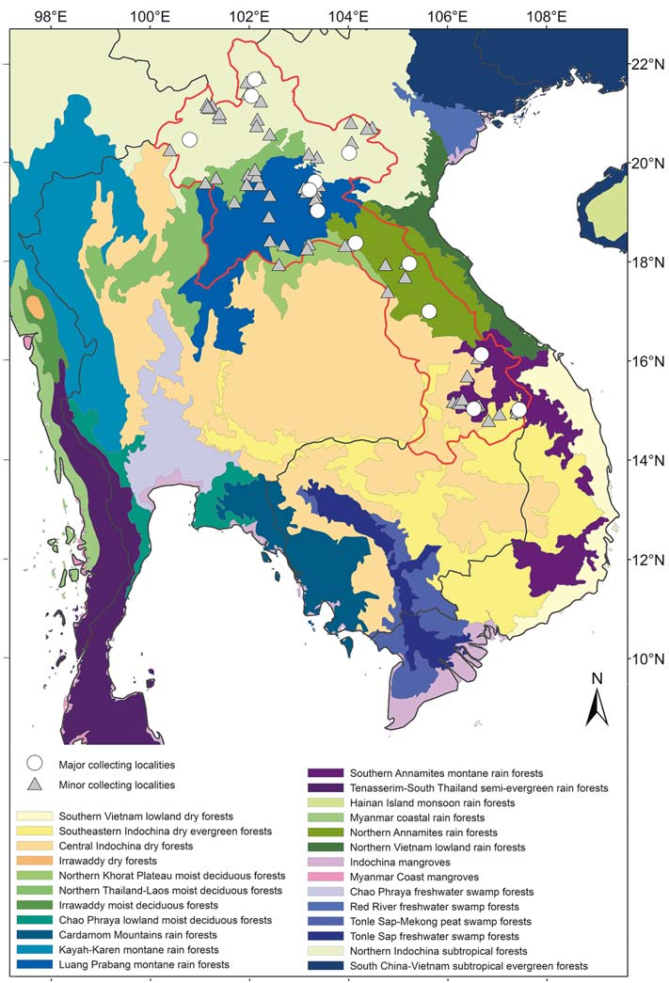
How relevant is the Wilderness Concept?
South East Cambodia has a region called the Srepok Wilderness area, a lowland dry forest which runs through to Vietnam.
Within the …Dry evergreen forest ecoregion there is no wilderness area, but just dense canopies.
(Yellow section is the eco region)

Slide 4
Species Richness
Although dry evergreen forests have floristic relationships to lowland Indo-Malaysian forest communities, they exhibit a unique floristic structure that is rich in species endemic to mainland southeast Asia. There are few local endemics (WWF).
Biodiversity Features
The ecoregion is globally outstanding for species richness.
The known mammal fauna of 160 species includes tiger, Asian elephant, douc langur, red-cheeked gibbon, pileated gibbon, Malayan sun bear, clouded leopard, common leopard, gaur, banteng, Javan rhinoceros, Eld's deer, and southern serow.
720 bird species, 240 reptiles species and over 2,300 species of vascular plants (Ashwell 1994; UNDP 2994).

Slide 5
Endemism
(Range limited to this ecoregion)
Cambodia is in the top 50 most plant-rich countries but data on endemism here is missing.
Endemic Mammal Species
Dendrogale murina (Smooth tailed treeshrew)
The douc langur and the murid Maxomys moi are near endemics.
Endemic Bird Species
The endangered Orange-necked partridge (Arborophila davidi)
(The Germain's peacock-pheasant Polyplectron germaini) and the Grey-faced tit-babbler (Macronous kelleyi) are near endemics.
(Caldecott et al. 1996; WWF 2019)

Slide 6
Forest Structure
The canopy of semi-evergreen forests generally is multi-layered and reaches about 30-40 m, with an open structure.
Dipterocarps are a major component of the forest structure and form emergent tree canopies with such species as Dipterocarpus alatus, D. costatus, Hopea odorata, Shorea guiso, S. hypochra, and Anisoptera costata.
Anisoptera costata is Endangered on the IUCN Red List (Nguyen et al. 2020)
Other giant emergents are species of Ficus, Tetrameles nudiflora, and Heritiera javanica, each forming large buttresses.
High biodiversity but low endemism.
(WWF 2019)

Slide 7
References
Is the info reliable
Critical appraisal
WWF - https://www.worldwildlife.org/ecoregions/im0210
Caldecott, J. O., Jenkins, M. D., Johnson, T. H., & Groombridge, B. (1996). Priorities for conserving global species richness and endemism. BIODIVERSITY AND CONSERVATION, 5(6), 699–727.doi:10.1007/bf00051782
Nguyen, H.N., Vu, V.D., Luu, H.T., Hoang, V.S., Pooma, R., Khou, E., Nanthavong, K., Newman, M.F., Ly, V. & Barstow, M. 2017. Anisoptera costata . The IUCN Red List of Threatened Species 2017: e.T33166A2833752. https://dx.doi.org/10.2305/IUCN.UK.2017-3.RLTS.T33166A2833752.en. Downloaded on 12 March 2020.
UNDP (1994), Global Environment Facility Project Brief. UNDP, Phnom Penh.
Ashwell, D. (1994) State of the environment - Cambodia's biological diversity. Unpubl. paper submitted as IUCN contribution to State of the Environment Report (Ministry of Environment).

Slide 8

South-Eastern Indochina Dry Evergreen Forests, Cambodia
Ellie Jones

Slide 9

General
In Cambodia, numerous powerful drivers of land-use change threaten the remaining natural forest (Davis et al. 2015) and the livelihoods of local communities living on the forest periphery (Pasgaard and Chea 2013).
Investing in agricultural land has increased rapidly in the last two decades (Cotula et al. 2009; Kugelman and Levenstein 2012), particularly for Rubber and Palm oil.

Slide 10

Underlying Causes
Technological factors - land use intensification for Rubber plantations; since mid 2000s, global demand for natural rubber has primarily been the result of the growth of the Chinese tyre and automotive industry. In a study published in Nature Plants, Kenneth Grogan from the University of Copenhagen used high resolution satellite data to estimate the amount of cleared woodland in Cambodia that has had to give way to rubber trees and palm oil plantations since the turn of the millennium. According to the researchers, more than 2.2 million hectares – 24% of Cambodia's woodland – were destroyed between 2001 and 2015. Almost one quarter of the cleared land was used to plant Hevea brasiliensis – a species of rubber tree not native to Cambodia.

Slide 11
Proximate causes
Social trigger event.
Agent Orange, mixture of herbicides that U.S. military forces sprayed in Vietnam from 1962 to 1971 during the Vietnam War for the dual purpose of defoliating forest areas that might conceal Viet Cong and North Vietnamese forces and destroying crops that might feed the enemy. This led to deforestation, but also a number of health effects and deformities in babies.

