Slide 1
Peninsular Malaysia Rain Forests

Slide 2
UNDERLYING CAUSES
Informal policies – Lawlessness and mismanagement
Poverty

Slide 3
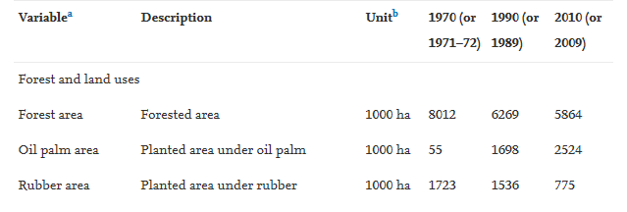
PROXIMATE CAUSES
Oil palm expansion
2 million hectares of closed canopy oil-palm plantations occur in
Peninsular Malaysia.
Between 48-56% of all deforestations in PM has been converted to oil
palm plantations since the 1990s.
Oil palm development was one of the main poverty reduction
strategies initiated by the government in Peninsular Malaysia

Slide 4
The evidence from Peninsular Malaysia suggests that agricultural development to alleviate poverty led to deforestation, and that when poverty had sufficiently decreased, a reduction in deforestation resulted.
Relevant to the hypothesis of the environmental Kuznets curve
but with poverty rate instead of economic growth

