Slide 1
Lowland Rainforest Borneo
Peter davies

Slide 2
About
Considered the second oldest rainforest after the Daintree rainforest in Australia.
427,500km2
Covers 57% of the island
Monthly rainfall exceeds 200mm all year round
Average day temperature of 31°C and never dropping below 25°C at nightfall
Humidity during the day peaks at 70% but at night reaches 100%

Slide 3
Is it in the global 200
Lowland rainforest is part of the global 200
The montane rainforest and the borneo peat swamp forest are also part of the global 200

Slide 4
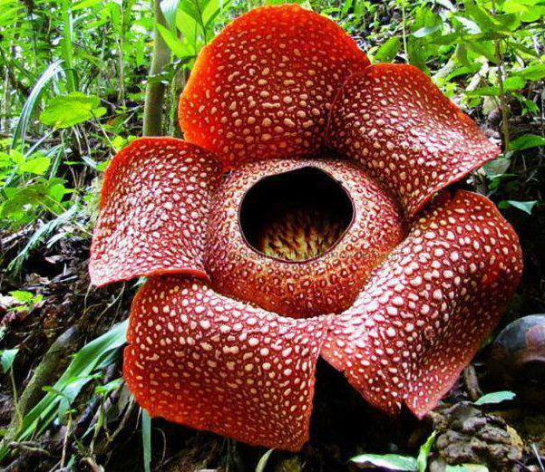
Species
10,000 plant species – 2,000 orchids and 3,000 trees worlds largest flower at 1 metre
380 bird species
15,000 mammal species – wide range from the worlds smallest squirrel to the Asian elephant. Also have the critically endangered Sumatran rhinocerous

Slide 5
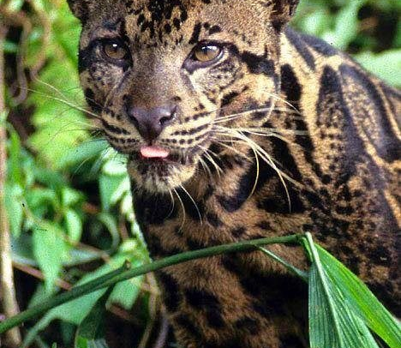
Endemic Species
Borneo is estimated to be home to around
222 mammals (including 44 endemic
420 birds (37 endemic)
100 amphibians
and 394 fish (19 endemic).

Slide 6
How relevent is the Wilderness Concept

Slide 7
References
https://borneolowlandrainforestsic.weebly.com/
https://wwf.panda.org/knowledge_hub/where_we_work/borneo_forests/about_borneo_forests/borneo_animals/

