Slide 1
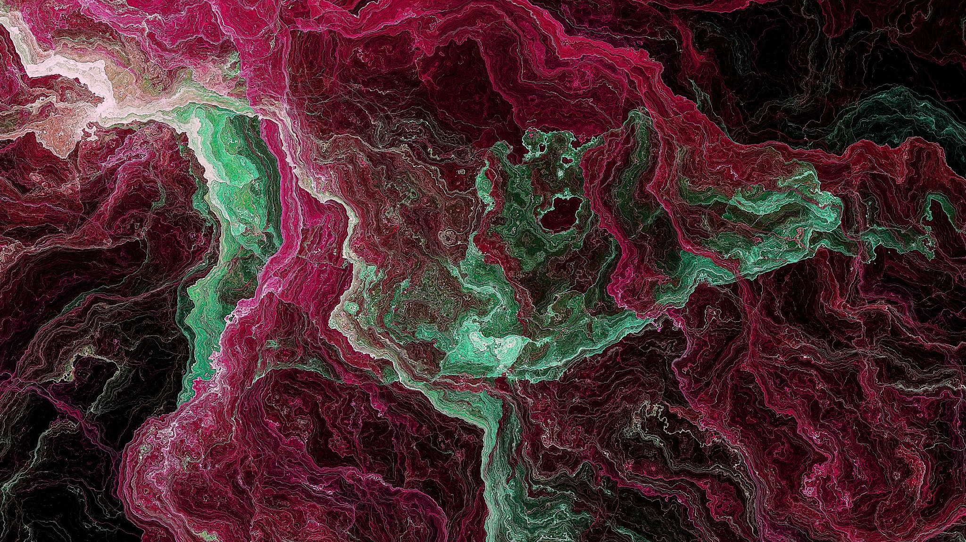
Madagascar lowland forests
Eastern Madagascar Ecoregion

Slide 2
Madagascar, the “living lab”
4th largest island in the world
Isolated for the last 150-180 million years resulting in an extremely unique environment
85% of the 12,000 flowering plants are found only there
Since humans arrived 2000 years ago, 90 % of original forest cover has disappeared or been modified
Many species are critically endangered

Slide 3
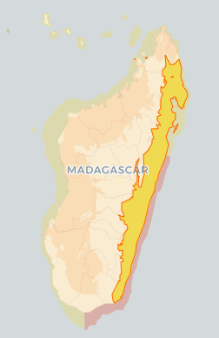
1. General Information
Location
Afrotropical
Narrow strip of humid forests along the East coast
43,000 sq mile (112,000 sq km)
(Scotland = 31,000 sq mile; Wales = 8,000 sq mile )
Surrounded by transitional dry forest (North), Spiny forest (South) and sub humid forest in Central Highlands (West)
Lies from 0m to 800m high

Slide 4
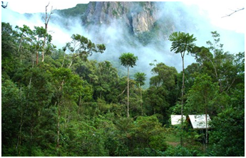
Climate and overall vegetation
Climate:
Rainfall 2,000mm per year throughout region, up to 6,000mm in areas
May to September: drier and cooler
November to March: Cyclones (Natural Threat)
Mean annual Temperature: 26Celcius
Dense evergreen trees: >30m canopy (Canarium, Albizia, Brochoneura acuminata) and plants such as Diospyros, Ocotea, Symphonia

Slide 5
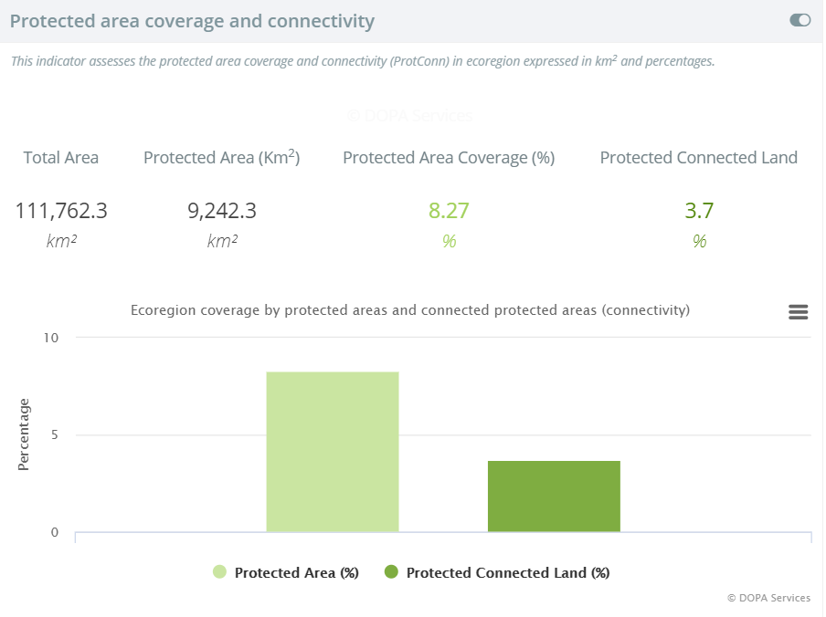
Protected areas
22 Protected areas over 10 sq km
7 National Parks
5 Special Reserves
3 Marine/Coastal Parks
3 Wetlands of International Importance
2 Paysages Harmonieux Protégés
1 Strict Nature Reserve
1 World Heritage Site

Slide 6
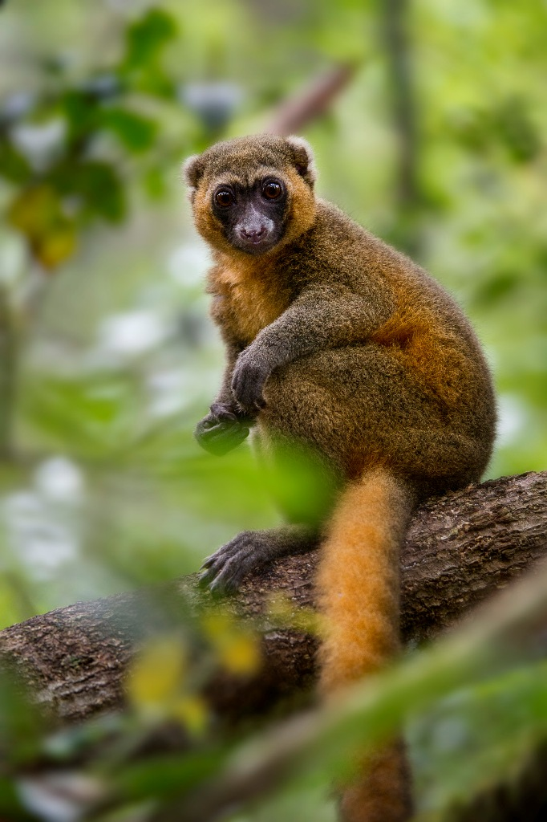
2. Biodiversity
Mammals
5 families of Malagasy primates
7 of Rodentia (endemic)
6 of Carnivora (endemic)
7 of Chiroptera
5 families of Lemurs, 15 species (aye-aye, dwarf lemur, eastern wooly lemur, golden bamboo lemur)
Out of 25 endemic and near-endemic species:
22 are threatened
8 are critical
9 are endangered
5 are vulnerable

Slide 7
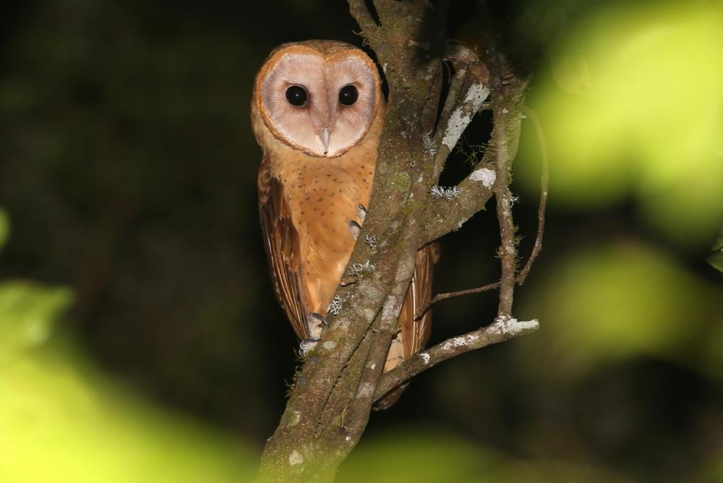
Birds
Great diversity, some of the rarest in the world
Eastern region harbours over 165 breeding species, 42 unique
Serpent Eagle
Madagascar red owl

Slide 8
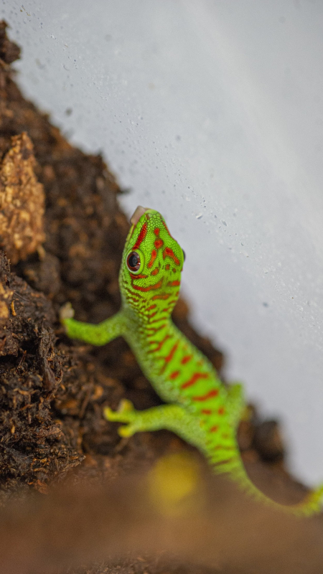
Amphibians and Reptiles
Numerous species
Chameleons and dwarf chamelons unique to area
Endemic geckos
Skinks unique to ecoregion
Snakes
Frogs
50 reptiles, 29 amphibians, >100 fish species only found in ecoregion are severely threatened

Slide 9
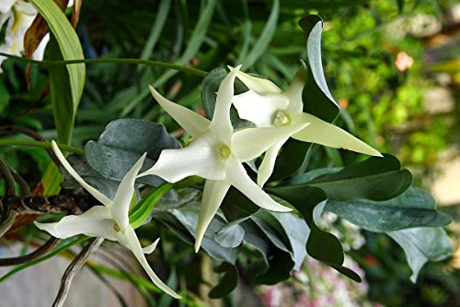
Vegetation
82% are specific endemic
Majority of 171 species of Malagasy Palms (97% endemic) are in ecoregion
Orchids are abundant e.g. Angraeceum sesquipedale

Slide 10
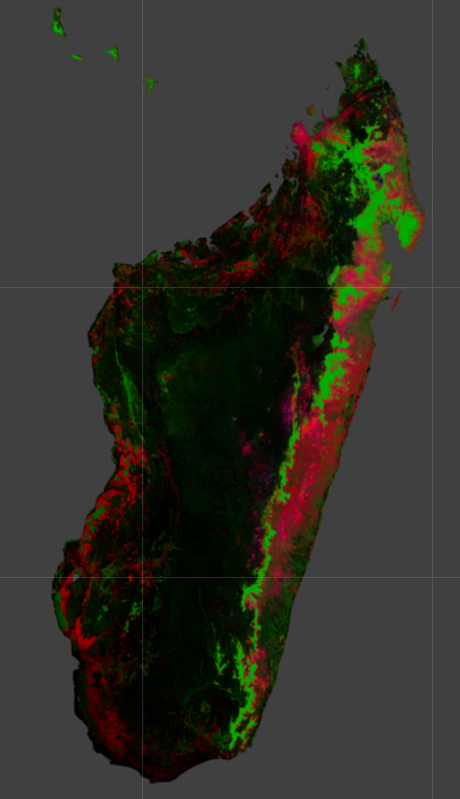
3. Status of the Ecoregion
Ongoing deforestation
Significant amount of forest has been removed
Remaining areas are in protected areas/Reserves
7% are well protected
27% poorly protected
Few management plans

Slide 11
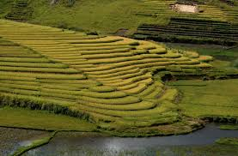
4. Threats
Slash-and-Burn agriculture practices
Manioc and Rice
Land is used 2 to 3 years than let to 'rest' for 10 (ideally)
Periods are becoming shorter due to population increase
Leading to very degraded soils, unusable for crops
Increase in pressure on land and forests
Wildfires
Legal and illegal logging
Over-exploitation of selected species for decorative purposes
Cattle

