Slide 1
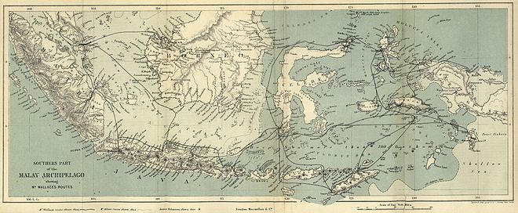
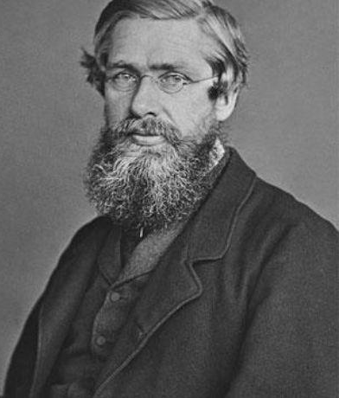
Alfred Russel Wallace

Slide 2
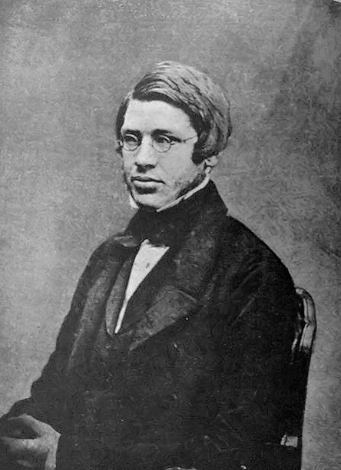
Introduction
Alfred Russel Wallace (1823-1913) was a British naturalist during the Victorian era.
He was a man of many talents - an explorer, collector, naturalist, geographer, anthropologist and political commentator.
Most famously, he had the revolutionary idea of evolution by natural selection entirely independently of Charles Darwin.
He established the scientific discipline known as ‘Biogeography’.
Wallace wrote more than 20 books and over 1,000 articles and published letters.
He collected thousands of specimens from all over the world, and you can see many of these in the Natural History Museum today.
His specimens are displayed in various museums and collections and in multiple countries.
Also an early scientist to comment upon the impact humans were having.
Note: Even all of this information barely scratches the surfaces of his life, voyages, discoveries or books.

Slide 3
Early life.
Wallace was born in Monmouthshire in 1823 to a middle-class family.
His father had squandered the family wealth in failed investments.
He left school at 14 and spent many years finding ways to earn a living.
Wallace had no formal training as a biologist and did not go to university. He trained and worked as a land surveyor, initially with his older brother’s firm.
Working outdoors, Wallace grew interested in the natural world and began collecting insects. As his interest in insects grew, he became inspired reading about naturalists such as Carl Linnaeus, Charles Darwin, and Alexander von Humboldt: these were scientists who had travelled overseas gathering samples, compiling data, and discovering new species.

Slide 4
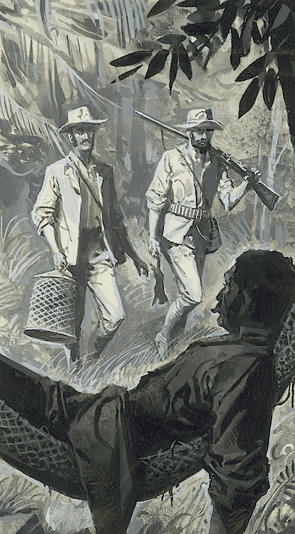
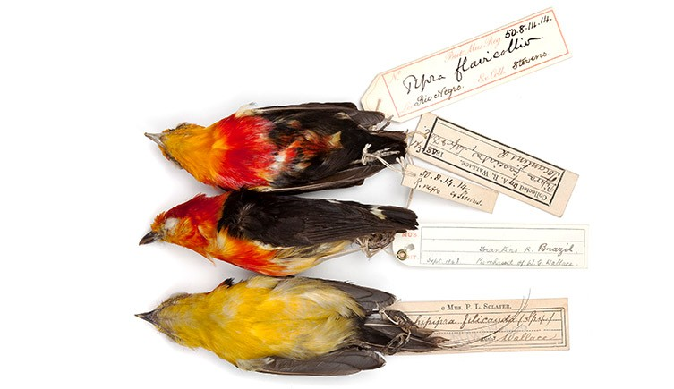
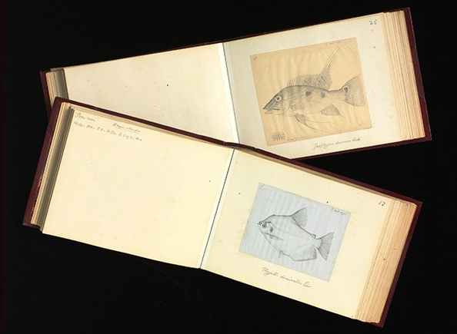
Travels across the Amazon
“Even before he embarked on his first voyage to Brazil, Wallace was interested in evolution, writing:
“I should like to take some one family [of beetles] to study thoroughly, principally with a view to the theory of the origin of species.”
In Brazil he realized that geographical barriers often mark species boundaries.”

Slide 5
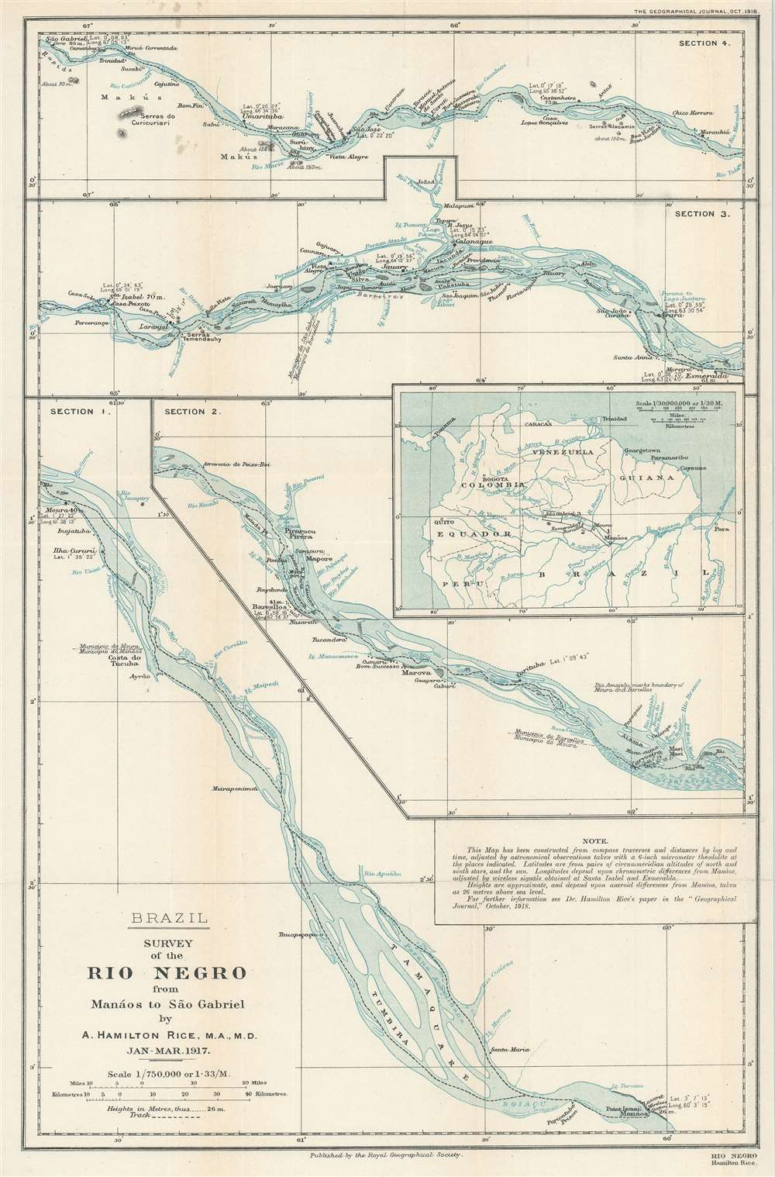
Travels with Bates.
“To emulate his scientific heroes, in 1848, aged 25, Wallace embarked on a voyage to Brazil with the naturalist Henry Bates.
Wallace had little money and he intended to fund his work by collecting specimens in the Amazon for sale to British collectors and institutions. He also put his surveying skills to use, spending four years charting the course of the Rio Negro, collecting specimens, and making observations about the people and the languages he encountered along the way.
Wallace spent six years in Brazil before sailing back to the UK in 1852 with his collection of specimens.
Unfortunately, the ship he was sailing on caught fire in the middle of the Atlantic Ocean. The passengers and crew abandoned ship and Wallace spent 10 days in an open boat before he was picked up. All the specimens he had brought on the ship were lost, along with most of what he had written and drawn.
Fortunately for Wallace, he had insured the specimens and he received money for their loss.
He now worked hard, authoring two books and writing six papers for academic journals. He also spent time meeting and getting to know other British naturalists.”
Surveyed map of the Rio Negro created by Wallace.

Slide 6
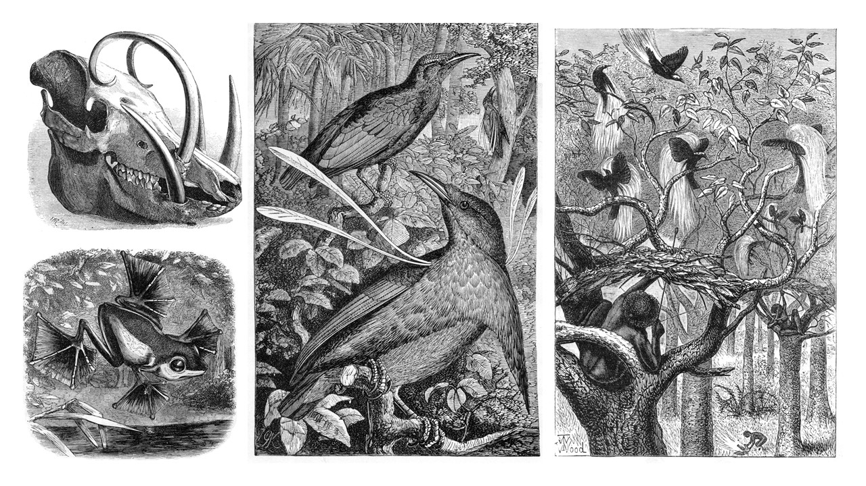
Voyage and discovery across the Malay Archipelago (1854-1862).
In 1854, aged 31, Wallace set out for the Malay Archipelago. During his travels and collecting across the many islands he discovered over 5,000 new species and documented the behaviour of the Orangutan in Borneo, noting how similar it was to a human. He was the first European to observe and document the Birds of Paradise alive. He is considered the father of Biogeography and discovered/established the ‘Wallace line’ that still exists to this day, which states that west island creatures were of mainland Asian origin, and east island creatures evolved from ancestors from Australia.

Slide 7
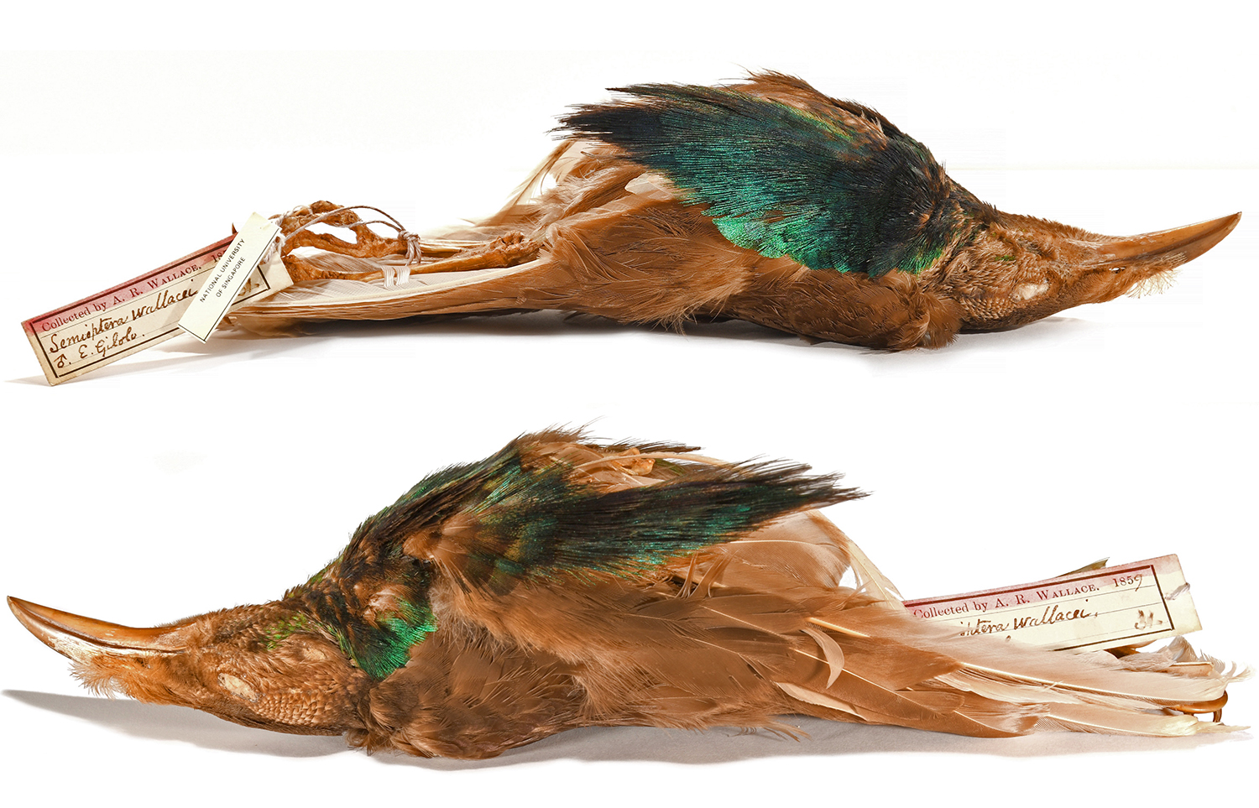
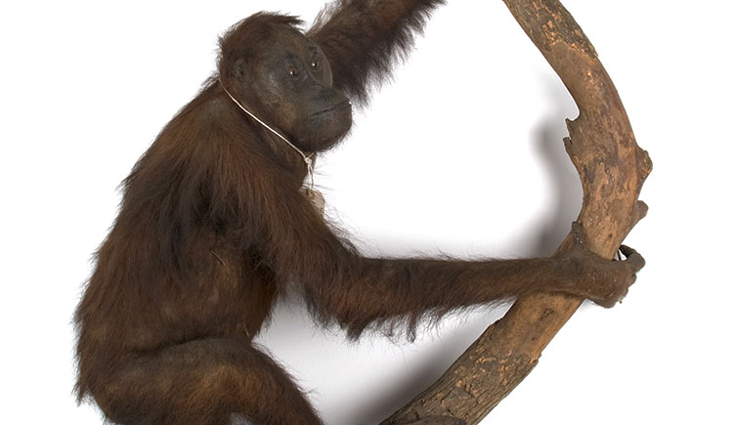
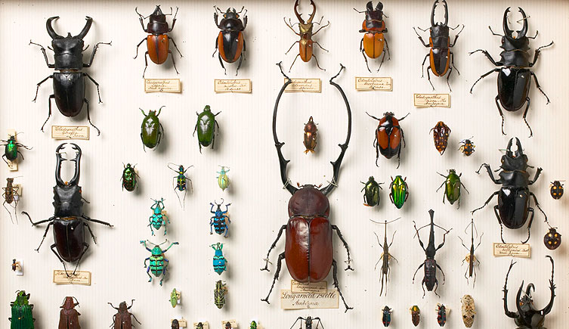
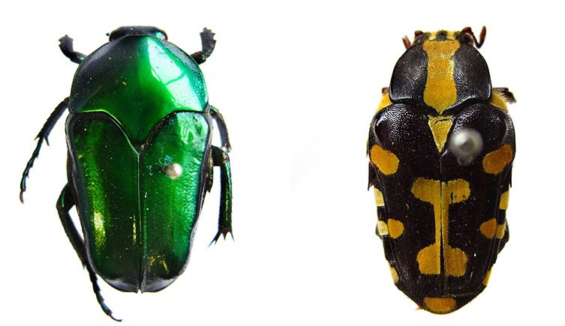
Total collections from the East.
“I find that my Eastern Collections amounted to:
310 specimens of Mammalia.
100 specimens of reptiles.
8,050 specimens of Birds.
7,500 specimens of shells.
13,000 specimens of Lepidoptera.
83,200 specimens of coleoptera.
13,400 specimens of other insects.
125,600 specimens of Natural history in all.”

Slide 8
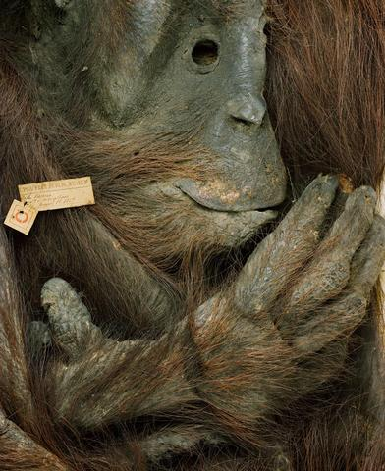
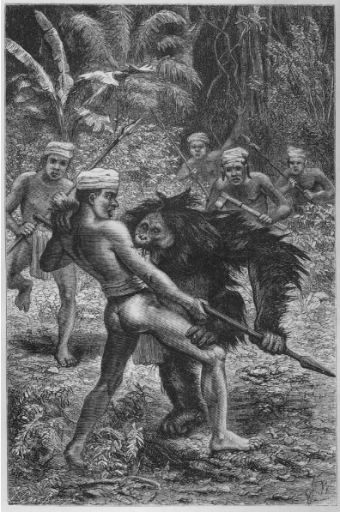
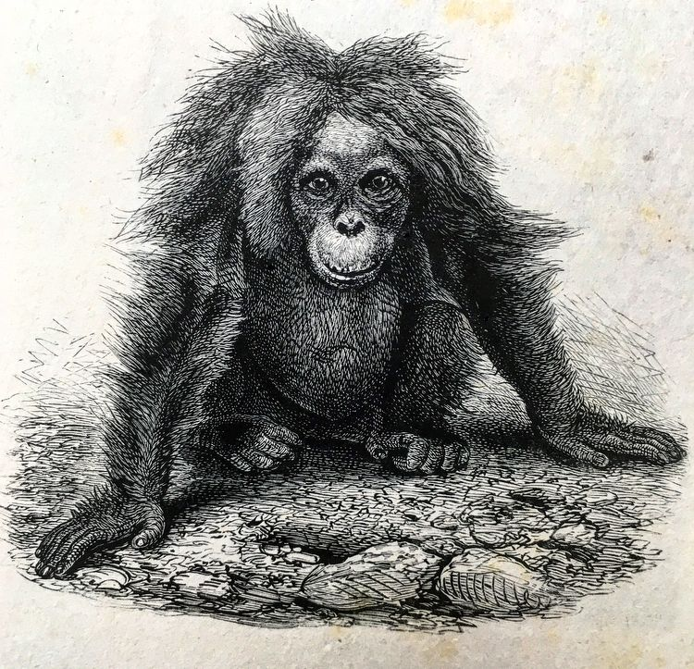
“I slept very soundly with half a dozen smoke-dried human skulls suspended over my head.” – Wallace when staying in a Dayak village in Borneo.
During his time in Borneo, Wallace would collect many specimens and discover many new species of primarily insects. Here he interacted with the Native Dayaks and hunted and described the Orangutan, even looking after an orphaned individual and saying how similar it was to a human baby.

Slide 9
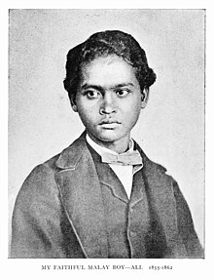
Local assistance.
Whilst Wallace collected the majority of his specimens himself, a fellow Englishman called Charles Allen initially accompanied him as an assistant, but during his voyage Wallace employed many locals to help hunt and skin (Primarily) birds. It has recently been calculated that Charles Allen and the various native assistants employed by Wallace collected about ~ 40,000 of the 125,600 natural specimens.
Wallace wrote extensively about his local assistants. One assistant who accompanied Wallace for most of his travels across the archipelago was a Malay boy called Ali. Initially hired as a cook, Ali would help to shoot, collect and skin many thousands of the bird specimens in Wallace’s collection, including the famous Wallace’s Standard wing.
In 1907 American herpetologist Thomas Barbour was in Ternate met an elderly Malay Gentleman who said “I am Ali Wallace.”.
“I therefore now present his likeness to my readers as that of the best native servant I ever had, and the faithful companion of almost all my journeyings among the islands of the far East”. – Alfred Russel Wallace.
Portrait of Ali ca. 1862.

Slide 10
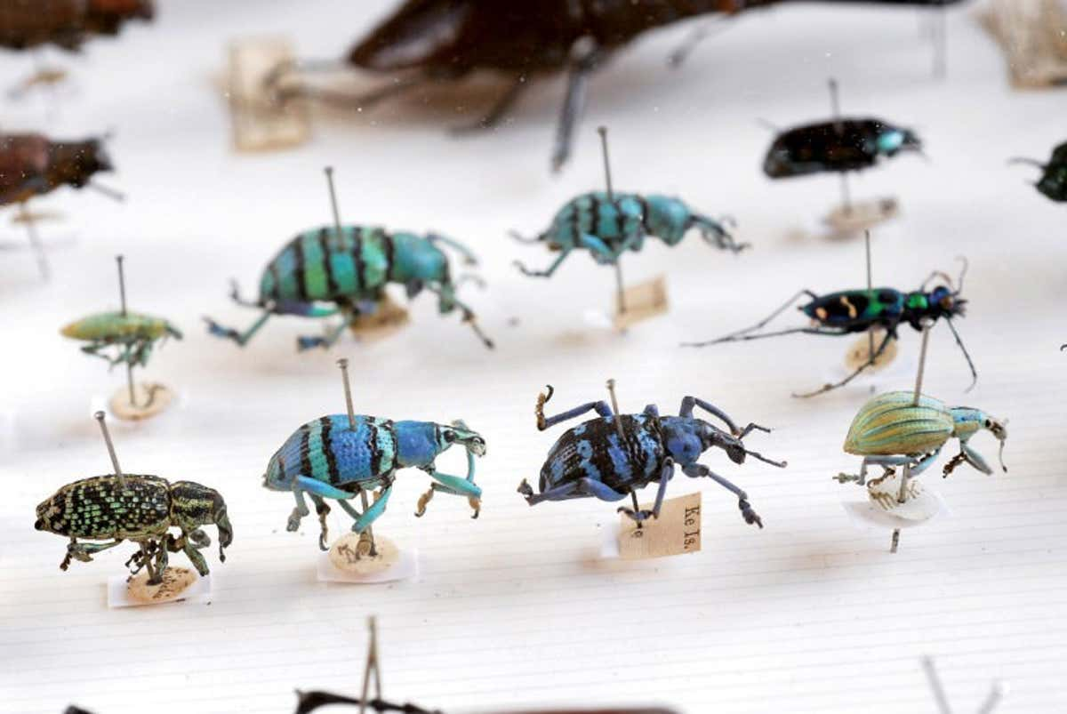
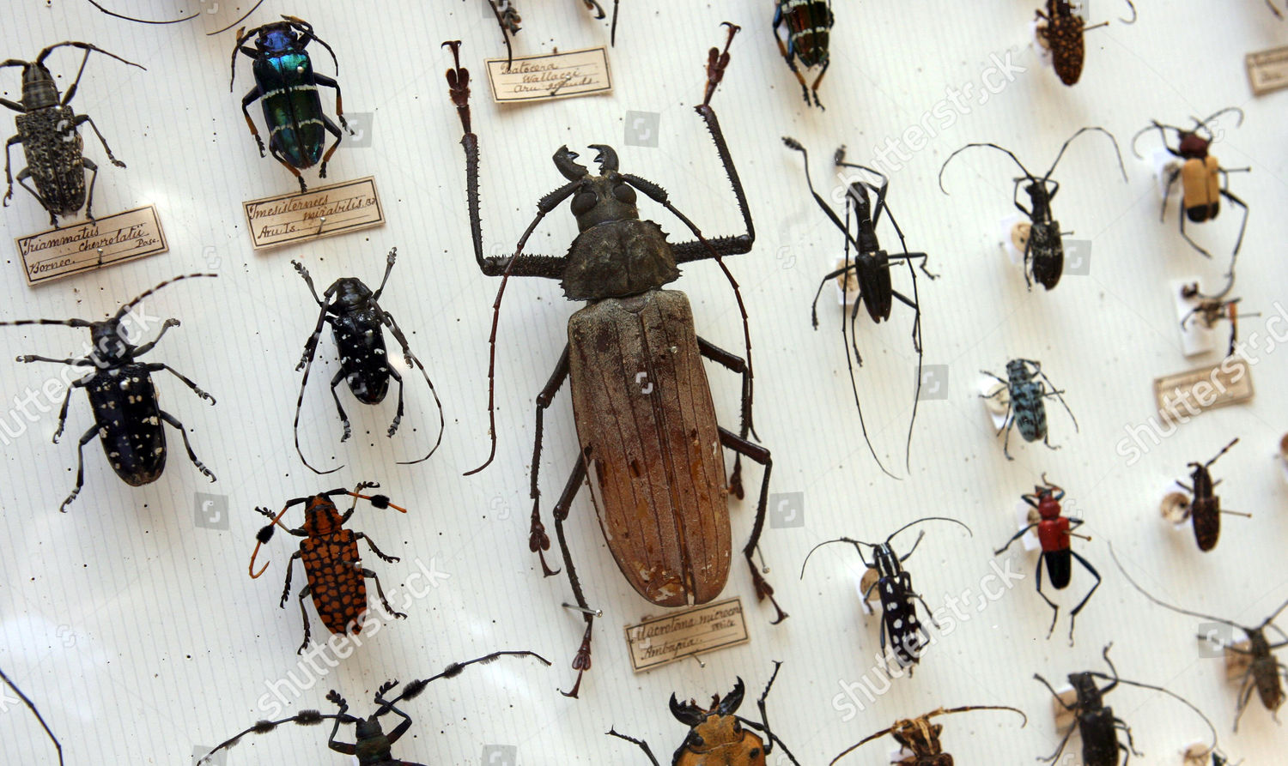
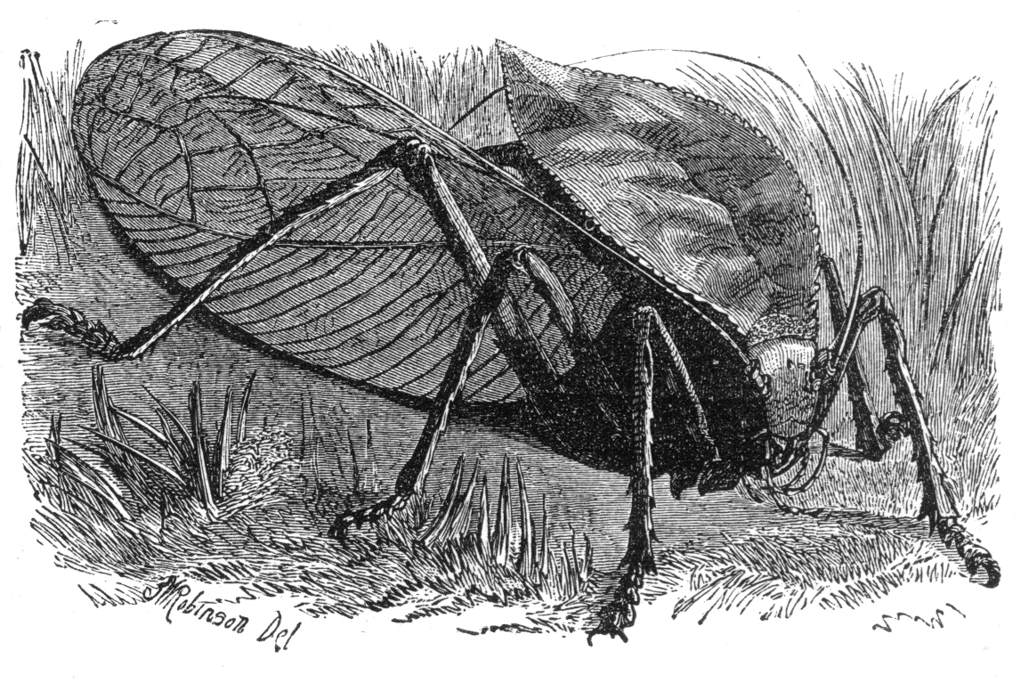
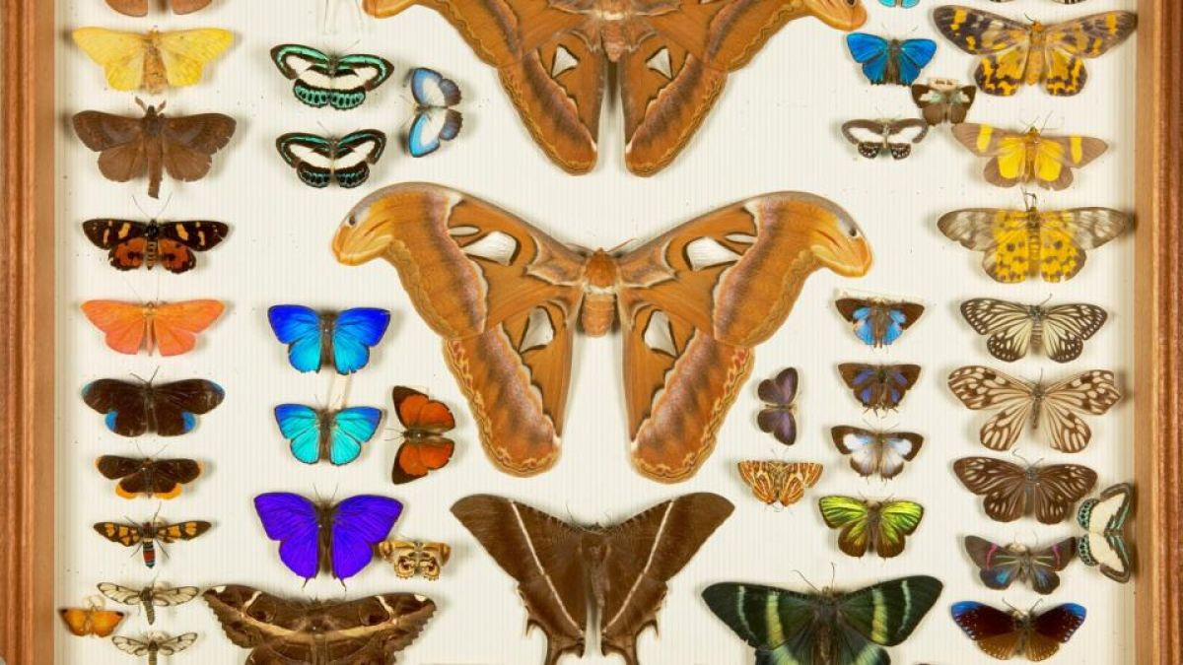
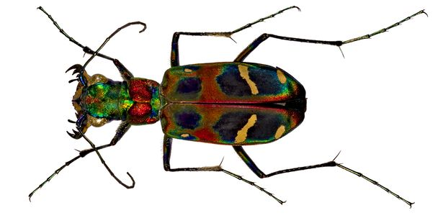
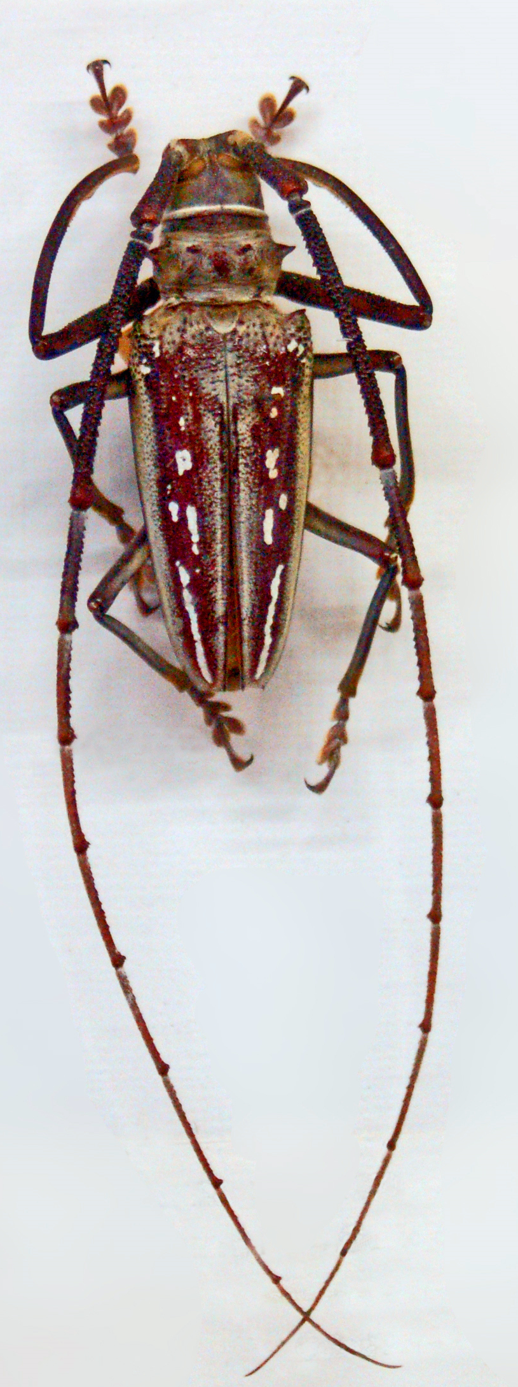
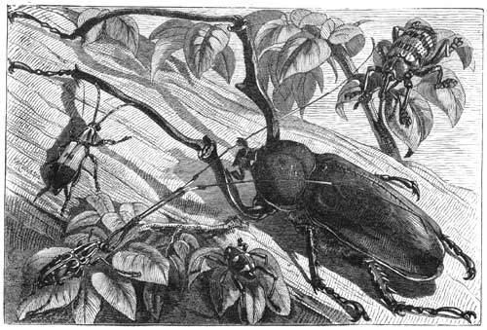
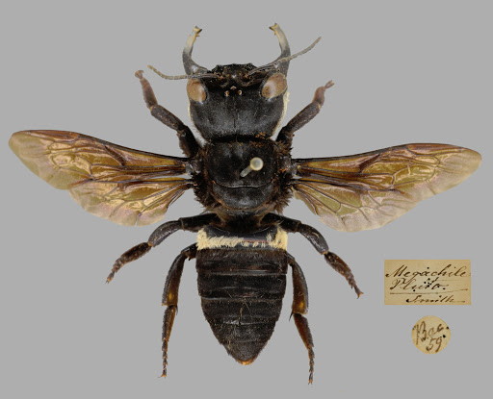
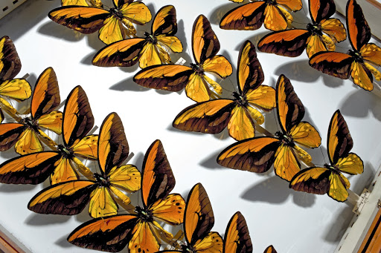
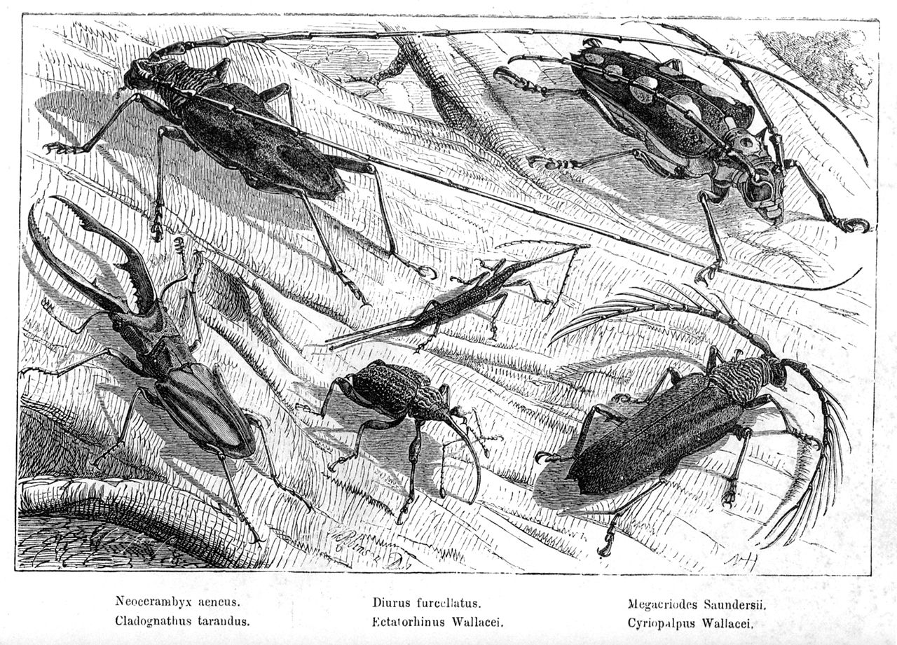
Insects
Wallace’s primary fascination throughout his life scientific career were insects, especially Coleoptera (beetles) and Lepidoptera (butterflies). They comprised the majority of his collections.
He discovered thousands of new species of them and they helped shape his ideas about evolution, due to both the enormous variety of species and the individual variation within species.

Slide 11
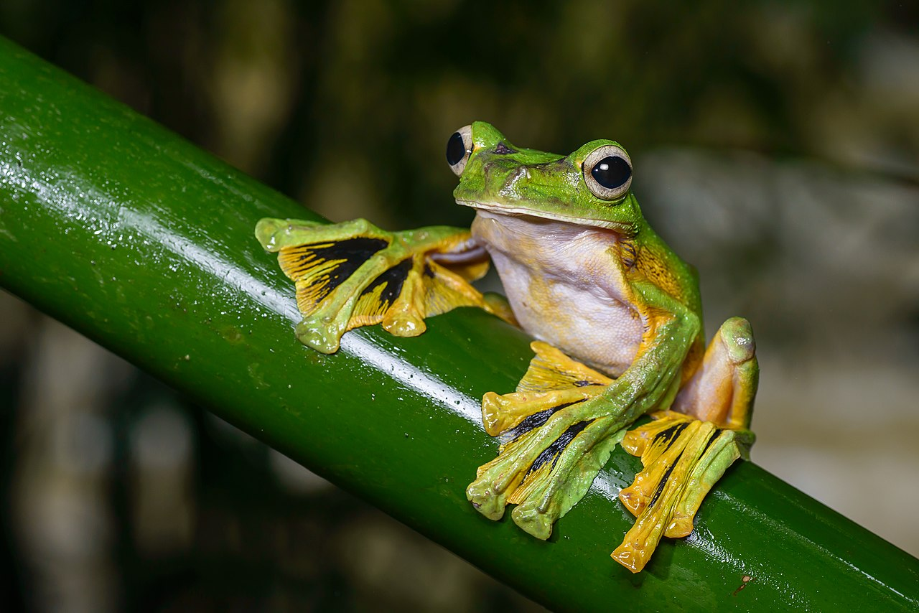
Wallace's flying frog
(Rhacophorus nigropalmatus), Borneo.
“This is, I believe, the first instance known of a "flying frog," and it is very interesting to Darwinians as showing that the variability of the toes which have been already modified for purposes of swimming and adhesive climbing, have been taken advantage of to enable an allied species to pass through the air like the flying lizard.”

Slide 12
Sarawak Law.
In 1855, Wallace published the ‘Sarawak law’ paper, named after the Sarawak region of Borneo, in which he discussed the natural law that lead to the emergence of new species. In it he states:
“‘the following law may be deduced from these [preceding] facts: Every species has come into existence coincident both in space and time with a pre-existing closely allied species.’”
In the fossil record you found species that we physiologically similar (i.e. generally closely related to) and located geographically close to the range of modern species.

Slide 13
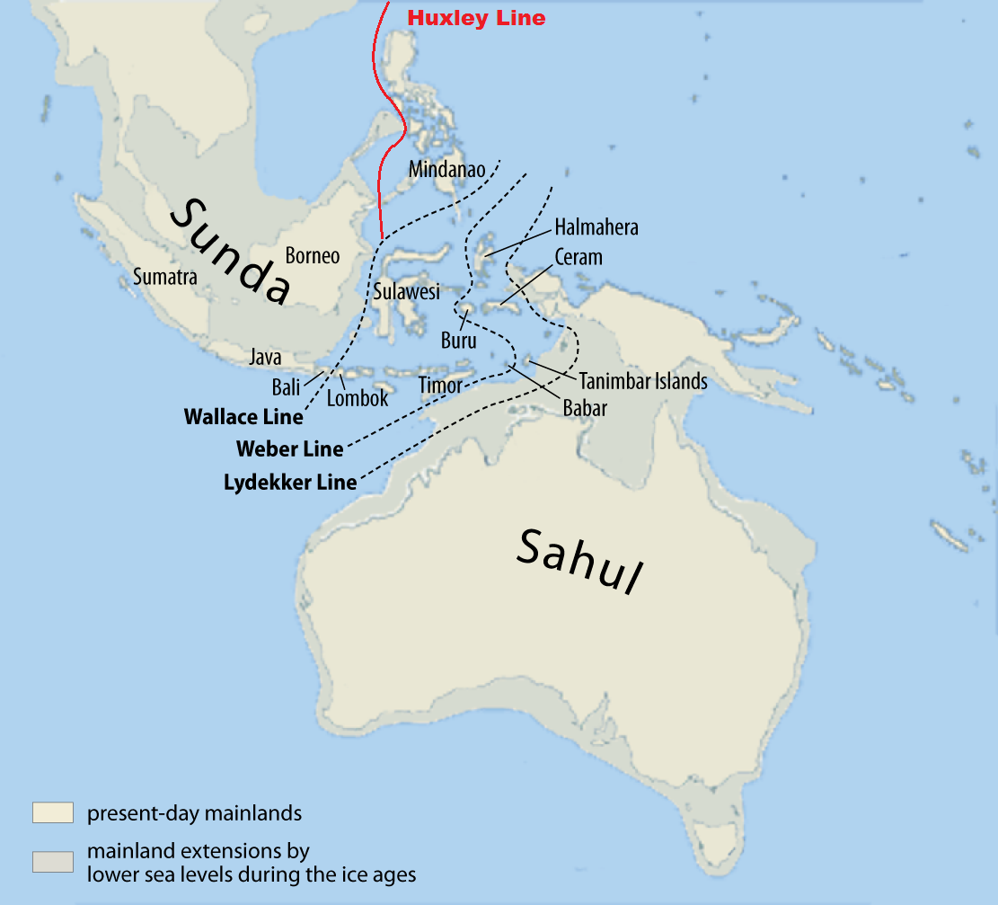
The Wallace line
The Wallace line denotes the natural boundary between the Asian and Australian fauna of the Malay archipelago. It runs between Bali and Lombok and Borneo and Sulawesi.
“It is estimated that as recently as 15,000 years ago, sea levels were more than 110 metres lower than they are today. Most of the islands that comprise present-day Indonesia and Malaysia were one landmass, now referred to as Sundaland. Nearby Australia and Tasmania also comprised a single landmass which is sometimes called Sahul.
That Borneo, Sumatra, Java and Bali were once connected is commonly accepted among Indonesians, without the need for scientific explanation. [But Wallace found the scientific reason behind it].
Lombok was not connected to Bali. Although the distance between Bali and Lombok is only 35 kilometres, the Lombok Strait is so deep that it has been filled by water for millions of years.”
When Wallace spent a few days collecting on the islands of Bali and Lombok, he noticed both islands had completely contrasting faunal assemblages despite only being separated by less than 30 miles of sea.

Slide 14
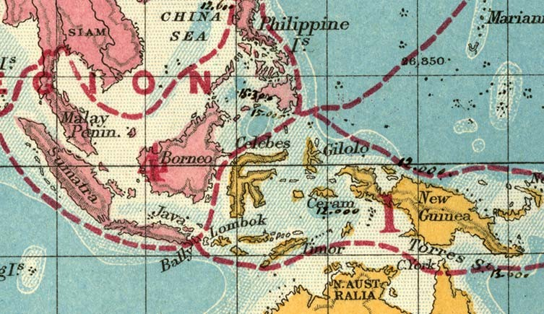
Distinct bird species distributions
Bali (West)
Lombok (East)
Woodpeckers
Barbets
Trogons
Paradise flycatchers
Paradise shrikes
Blue drongos
Weaver birds
Pheasants
Jungle fowl
Cockatoos
Megapodes
Honeysuckers.
Lories.
“Wallace identified the 250m depth of the Lombok Strait as the single most compelling explanation for the differences between Asian and Australian animals. It caused various species to remain isolated from each other on opposite sides of the Lombok Strait through centuries of migrations and evolution.”

Slide 15
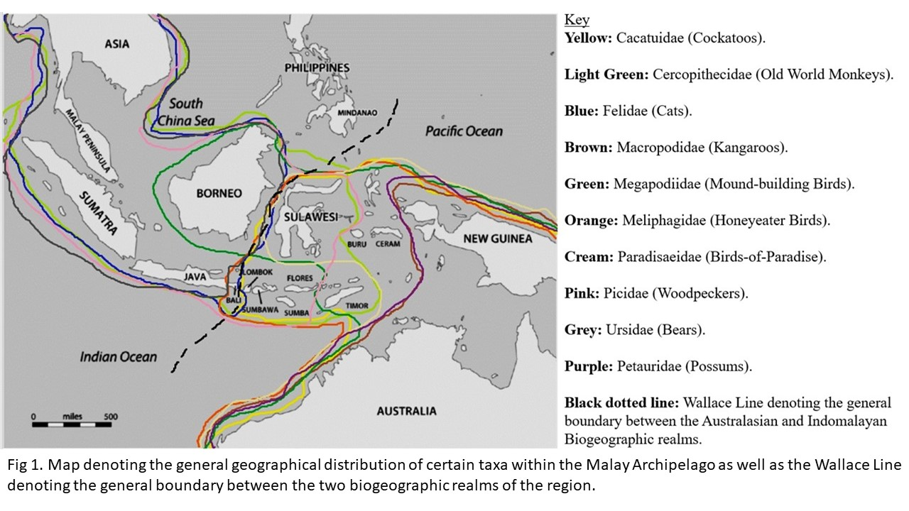

Slide 16
Vertebrate distributions
(not every vertebrate group in the Archipelago is mentioned here):
Western half of Archipelago
Eastern half of Archipelago
Cercopithecidae (Old world monkeys)
Felidae (Cats).
Elephantidae (Elephants).
Hominidae (Orangutans).
Ursidae (Bears).
Picidae (Woodpeckers).
Cacatuidae (Cockatoos).
Macropodidae (Kangaroos).
Megapodiidae (Mound-building birds).
Meliphagidae (Honeyeater birds).
Paradisaeidae (Birds-of-Paradise)
Petauridae (Possums).

Slide 17
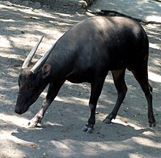
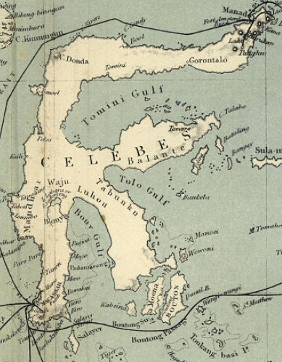
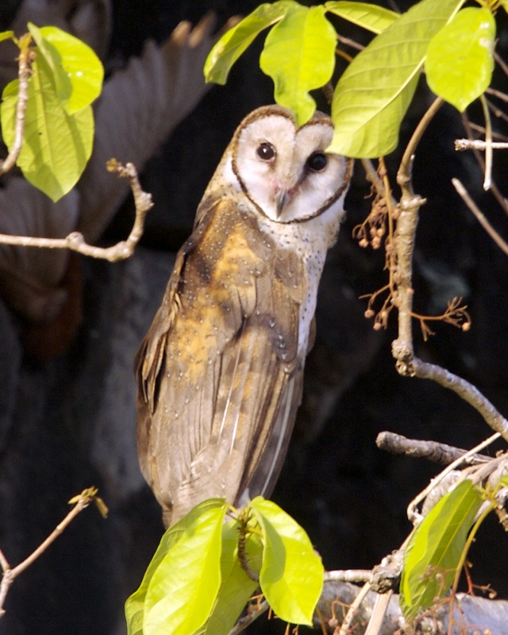
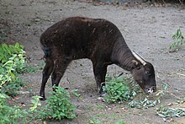
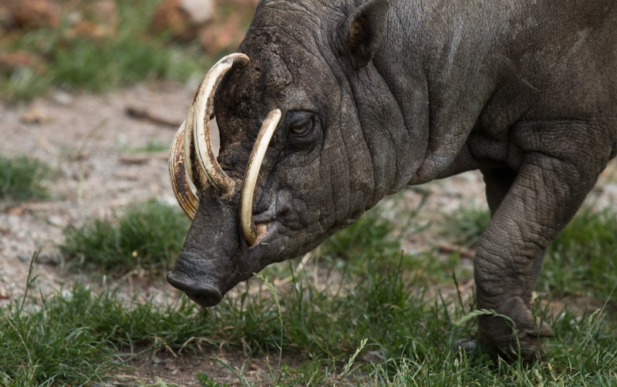
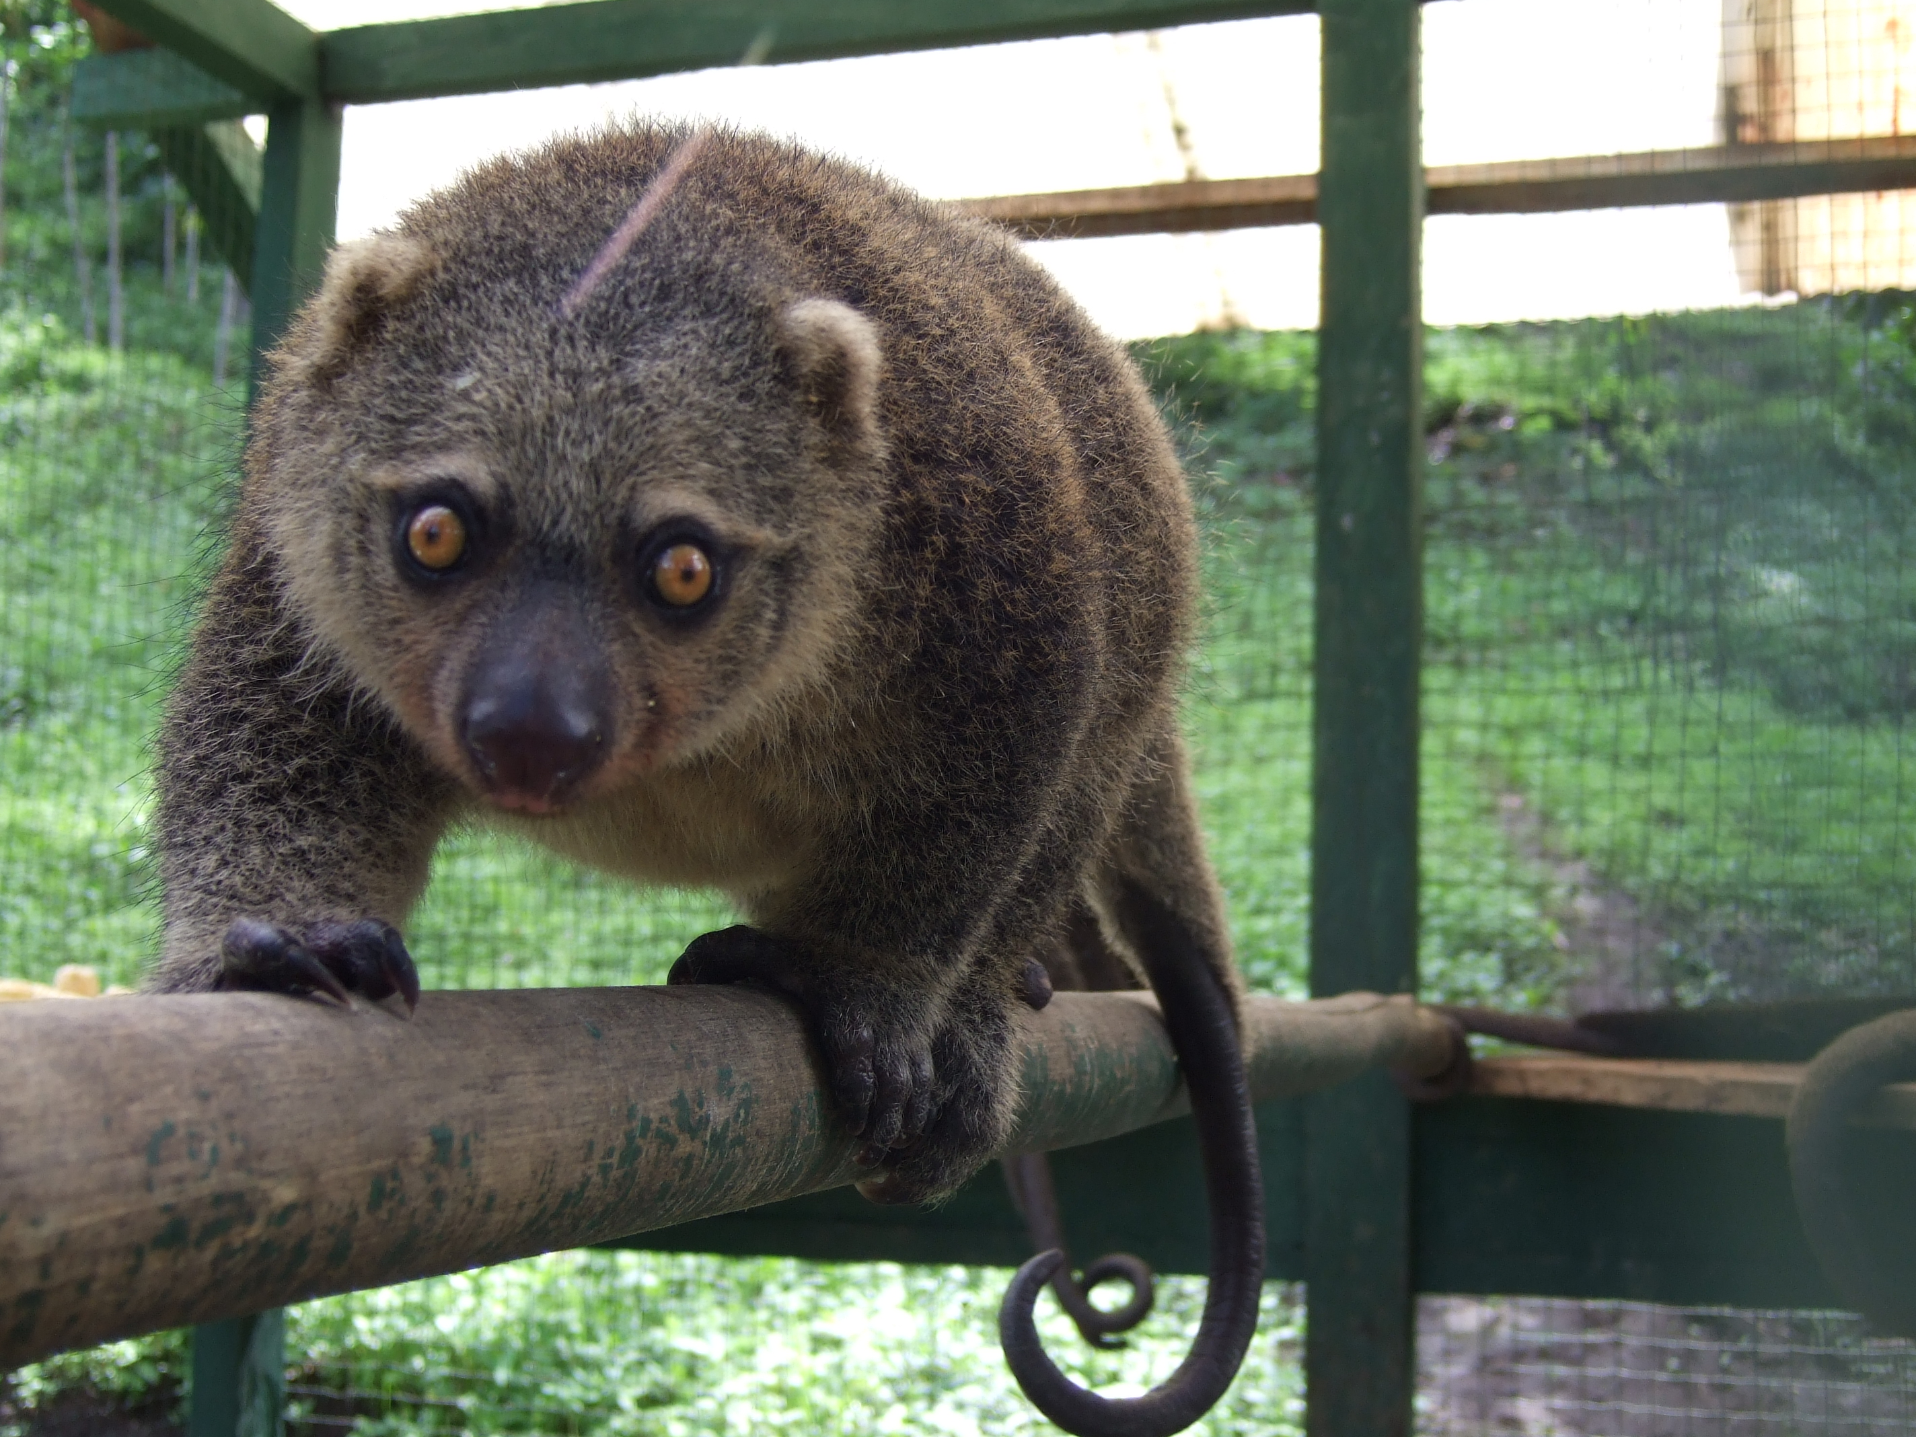
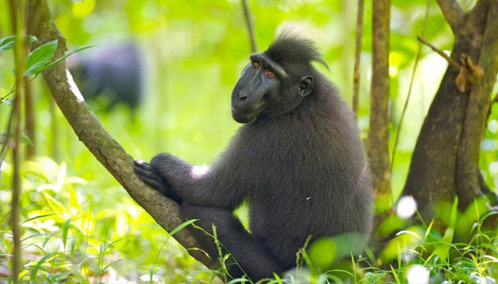
Island of Sulawesi
(known as Celebes in Wallace’s day).
Wallace introducing the natural history of Celebes and it’s surrounding islands:
“THE position of Celebes is the most central in the Archipelago. Immediately to the north are the Philippine islands; on the west is Borneo; on the east are the Molucca islands; and on the south is the Timor group—and it is on all sides so connected with these islands by its own satellites, by small islets, and by coral reefs, that neither by inspection on the map nor by actual observation around its coast, is it possible to determine accurately which should be grouped with it, and which with the surrounding districts. Such being the case, we should naturally expect to find that the productions of this central island in some degree represented the richness and variety of the whole Archipelago, while we should not expect much individuality in a country, so situated, that it would seem as if it were pre-eminently fitted to receive stragglers and immigrants from all around.
As so often happens in nature, however, the fact turns out to be just the reverse of what we should have expected; and an examination of its animal productions shows Celebes to be at once the poorest in the number of its species, and the most isolated in the character of its productions, of all the great islands in the Archipelago.”
Lowland anoa
(Bubalus depressicornis).
Sulawesi masked owl (Tyto rosenbergii).
Mountain anoa (Bubalus quarlesi).
Babirusa.
Genus: Babyrousa.
4 Species.
Sulawesi bear cuscus
(Ailurops ursinus)
Celebes crested macaque
(Macaca nigra).
Deep seas surround The Wallacean islands in the centre of the Archipelago. Various islands received random stragglers over time.

Slide 18
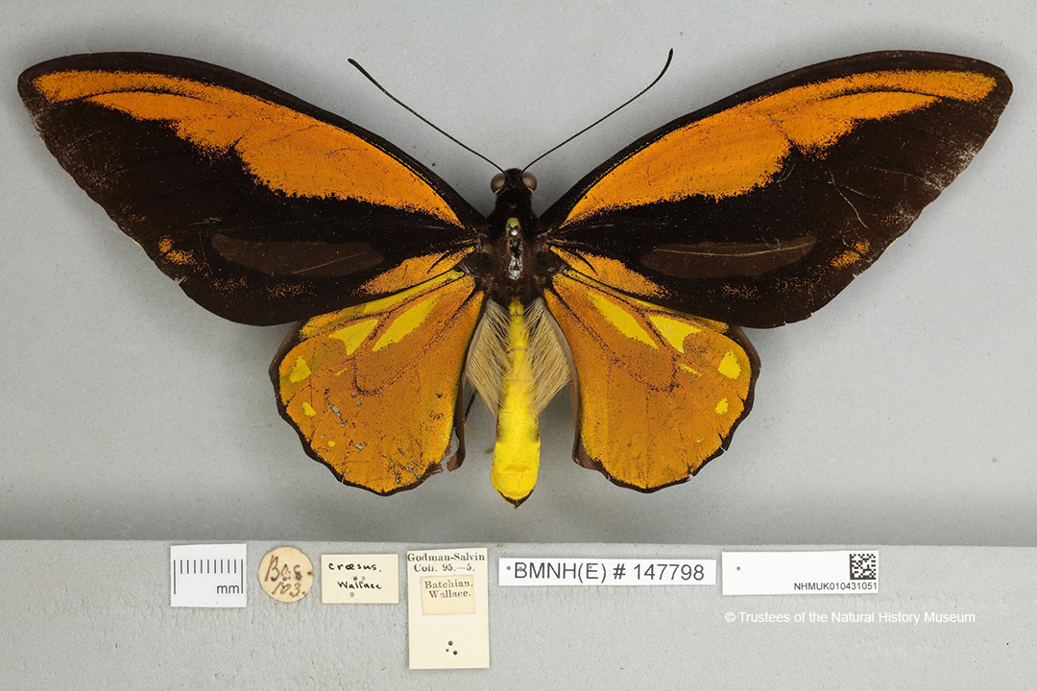
Wallace's golden birdwing
(Ornithoptera croesus)
Wallace knew of unique and endemic species that evolve and exist on islands, and he discovered many endemic species found nowhere else on earth.
“The beauty and brilliancy of this insect are indescribable, and none but a naturalist can understand the intense excitement I experienced when I at length captured it. On taking it out of my net and opening the glorious wings, my heart began to beat violently, the blood rushed to my head, and I felt much more like fainting than I have done when in apprehension of immediate death. I had a headache the rest of the day, so great was the excitement produced by what will appear to most people a very inadequate cause.”
Male Ornithoptera croesus

Slide 19
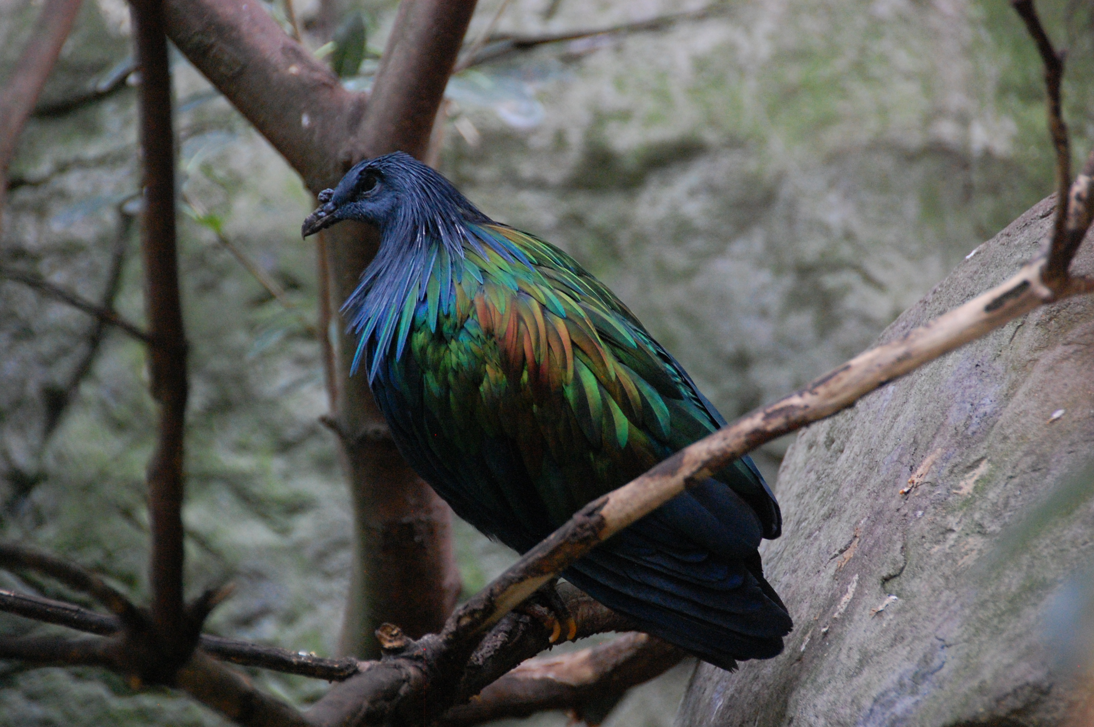
Nicobar pigeon
(Caloenas nicobarica) evolution and adaptations.
Closest living relative of extinct Dodo.
“This is certainly a very curious case of adaptation to an unusual and exceptional necessity. The bird does not ordinarily require great powers of flight, since it lives in the forest, feeds on fallen fruits, and roosts in low trees like other ground pigeons. The majority of the individuals, therefore, can never make full use of their enormously powerful wings, till the exceptional case occurs of an individual being blown out to sea, or driven to emigrate by the incursion of some carnivorous animal, or the pressure of scarcity of food. A modification exactly opposite to that which produced the wingless birds (the Apteryx, Cassowary, and Dodo), appears to have here taken place; and it is curious that in both cases an insular habitat should have been the moving cause. The explanation is probably the same as that applied by Mr. Darwin to the case of the Madeira beetles, many of which are wingless, while some of the winged ones have the wings better developed than the same species on the continent. It was advantageous to these insects either never to fly at all, and thus not run the risk of being blown out to sea, or to fly so well as to be able either to return to land, or to migrate safely to the continent. Pad flying was worse than not flying at all. So, while in such islands as New Zealand and Mauritius far from all land, it was safer for a ground-feeding bird not to fly at all, and the short-winged individuals continually surviving, prepared the way for a wingless group of birds; in a vast Archipelago thickly strewn with islands and islets it was advantageous to be able occasionally to migrate, and thus the long and strong-winged varieties maintained their existence longest, and ultimately supplanted all others, and spread the race over the whole Archipelago.”

Slide 20
Evolution by natural selection
“One day in 1858, while feverish and confined to his hut with malaria on the island of Ternate (now in Indonesia), Wallace had a realisation. He came to understand how species evolved - they changed because the fittest individuals survived and reproduced, passing their advantageous characteristics on to their offspring.”
He wrote:
“As animals usually breed much more quickly than does mankind, the destruction every year from these causes must be enormous in order to keep down the numbers of each species, since evidently they do not increase regularly from year to year, as otherwise the world would long ago have been crowded with those that breed most quickly. Vaguely thinking over the enormous and constant destruction which this implied, it occurred to me to ask the question, why do some die and some live? And the answer was clearly, on the whole the best fitted live… and considering the amount of individual variation that my experience as a collector had shown me to exist, then it followed that all the changes necessary for the adaptation of the species to the changing conditions would be brought about. In this way every part of an animal’s organization could be modified exactly as required, and in the very process of this modification the unmodified would die out, and thus the definite characters and the clear isolation of each new species would be explained.”

Slide 21
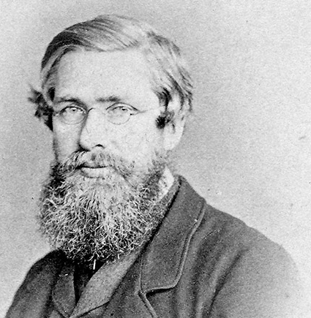
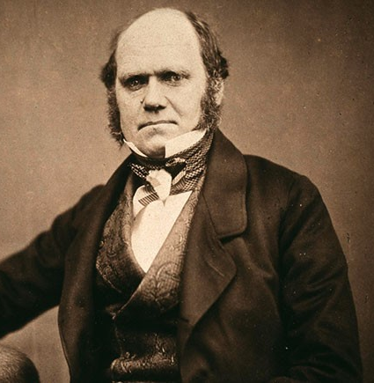
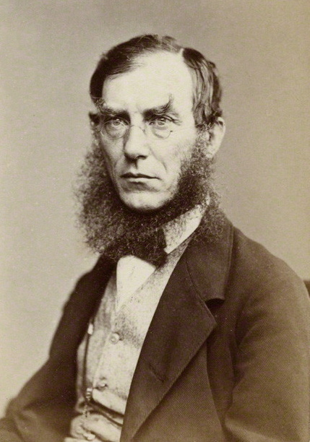
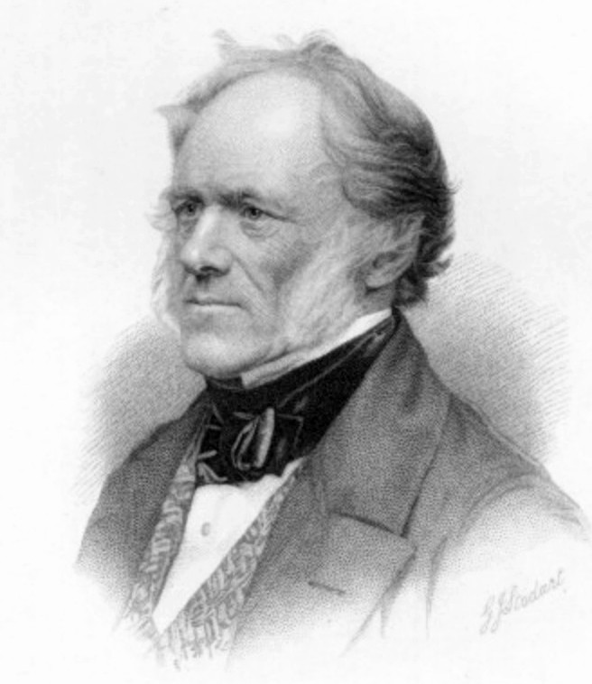
“Wallace immediately wrote to someone he knew was interested in the subject, Charles Darwin. Darwin had been working on the very same theory for 20 years, but was yet to publish. He sought the advice of his friends [Joseph Dalton Hooker a famous botanist, and Charles Lyell a famous geologist], who determined that the ideas of both men would be presented at a meeting of the Linnean Society. Darwin's masterpiece, The Origin of Species, came out the following year.
From that time on, Darwin overshadowed Wallace and it has usually been his name alone associated with the theory of evolution by natural selection.
Wallace expressed no resentment at this - in fact he was Darwin's greatest fan. His role in the matter, and Darwin's support, ensured his entry to the highest ranks of the scientific establishment.
Charles Darwin was impressed with how much Wallace's theory of natural selection matched his own: 'He could not have made a better short abstract! Even his terms now stand as heads of my chapters!’.”

Slide 22
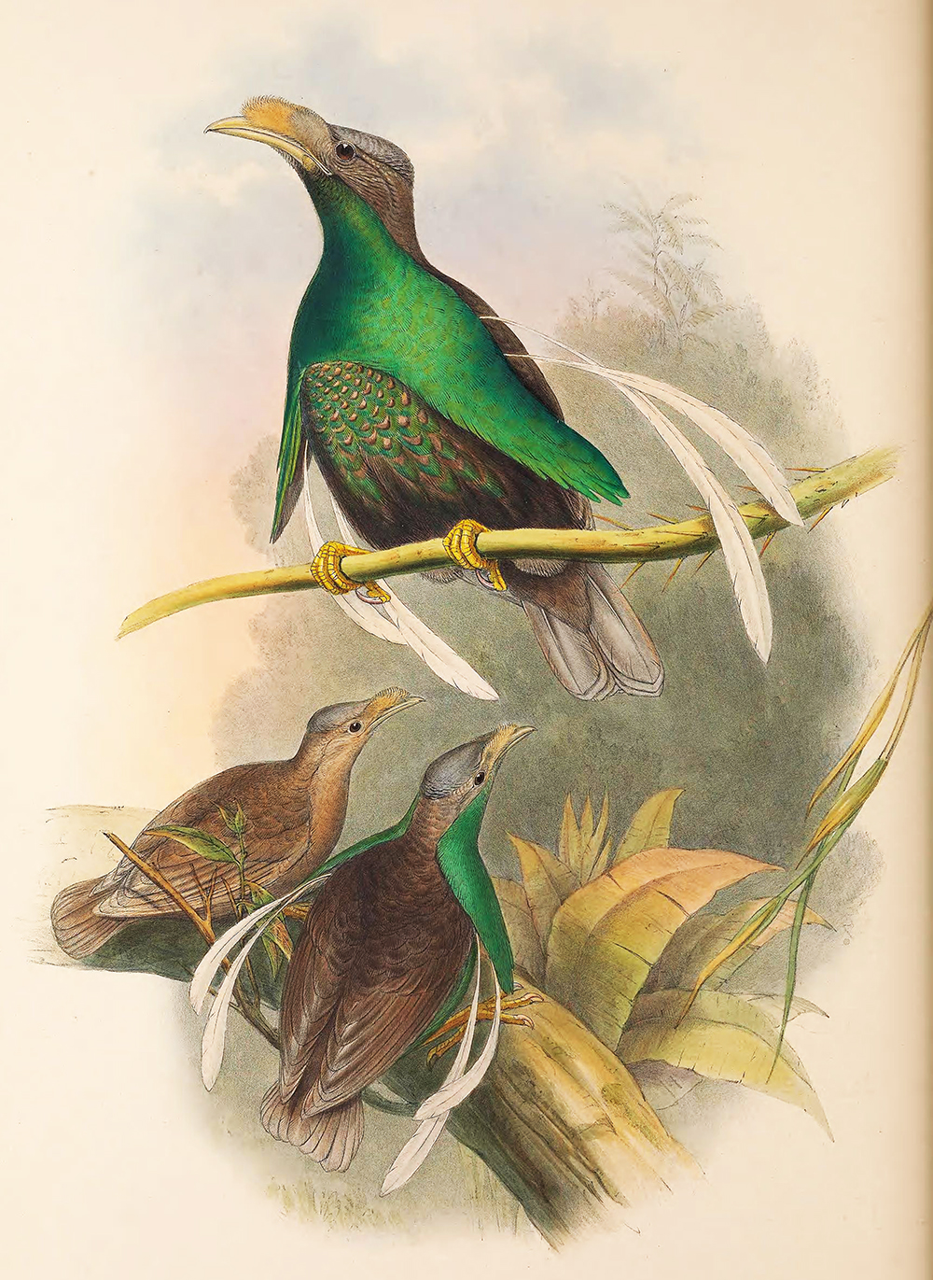
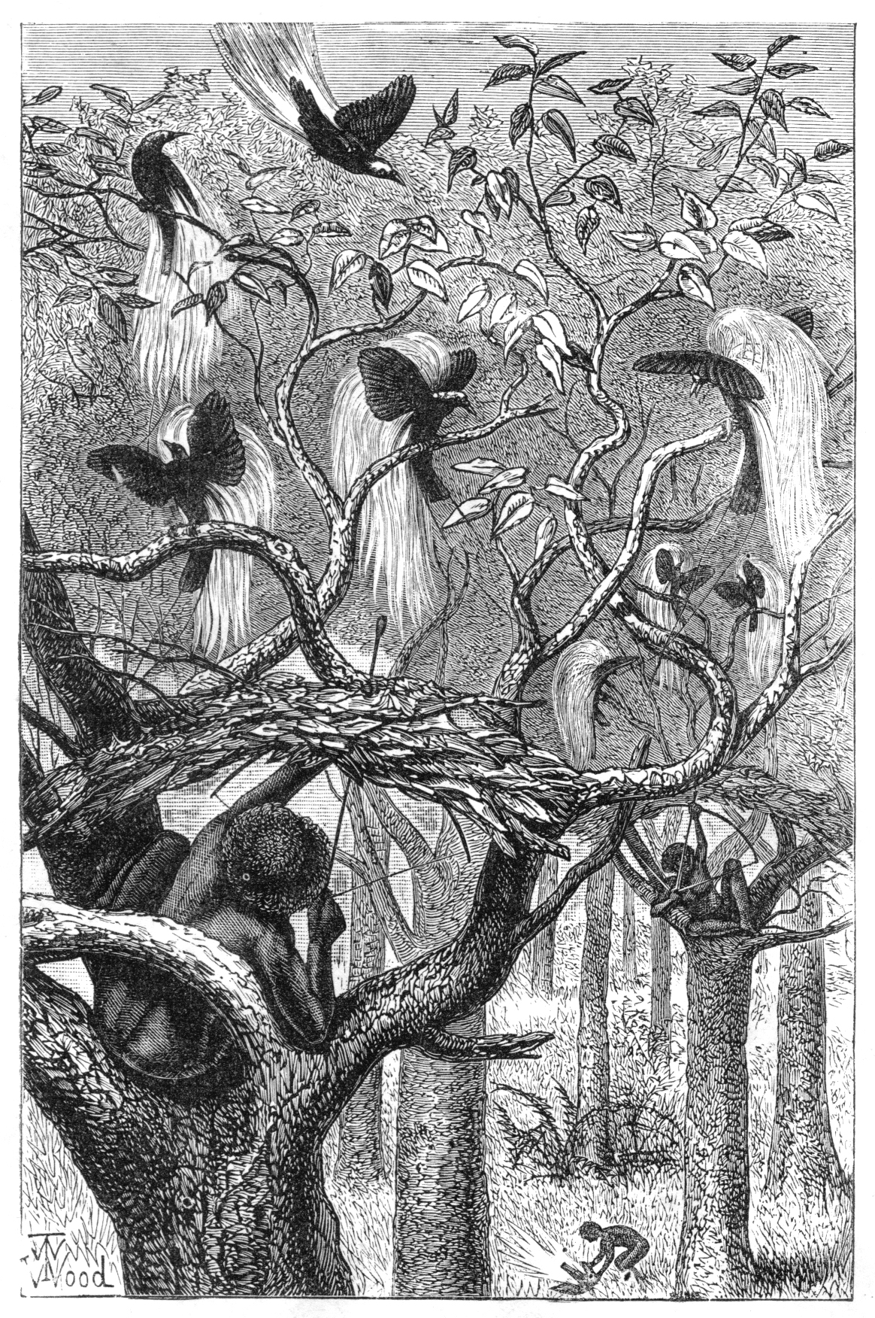
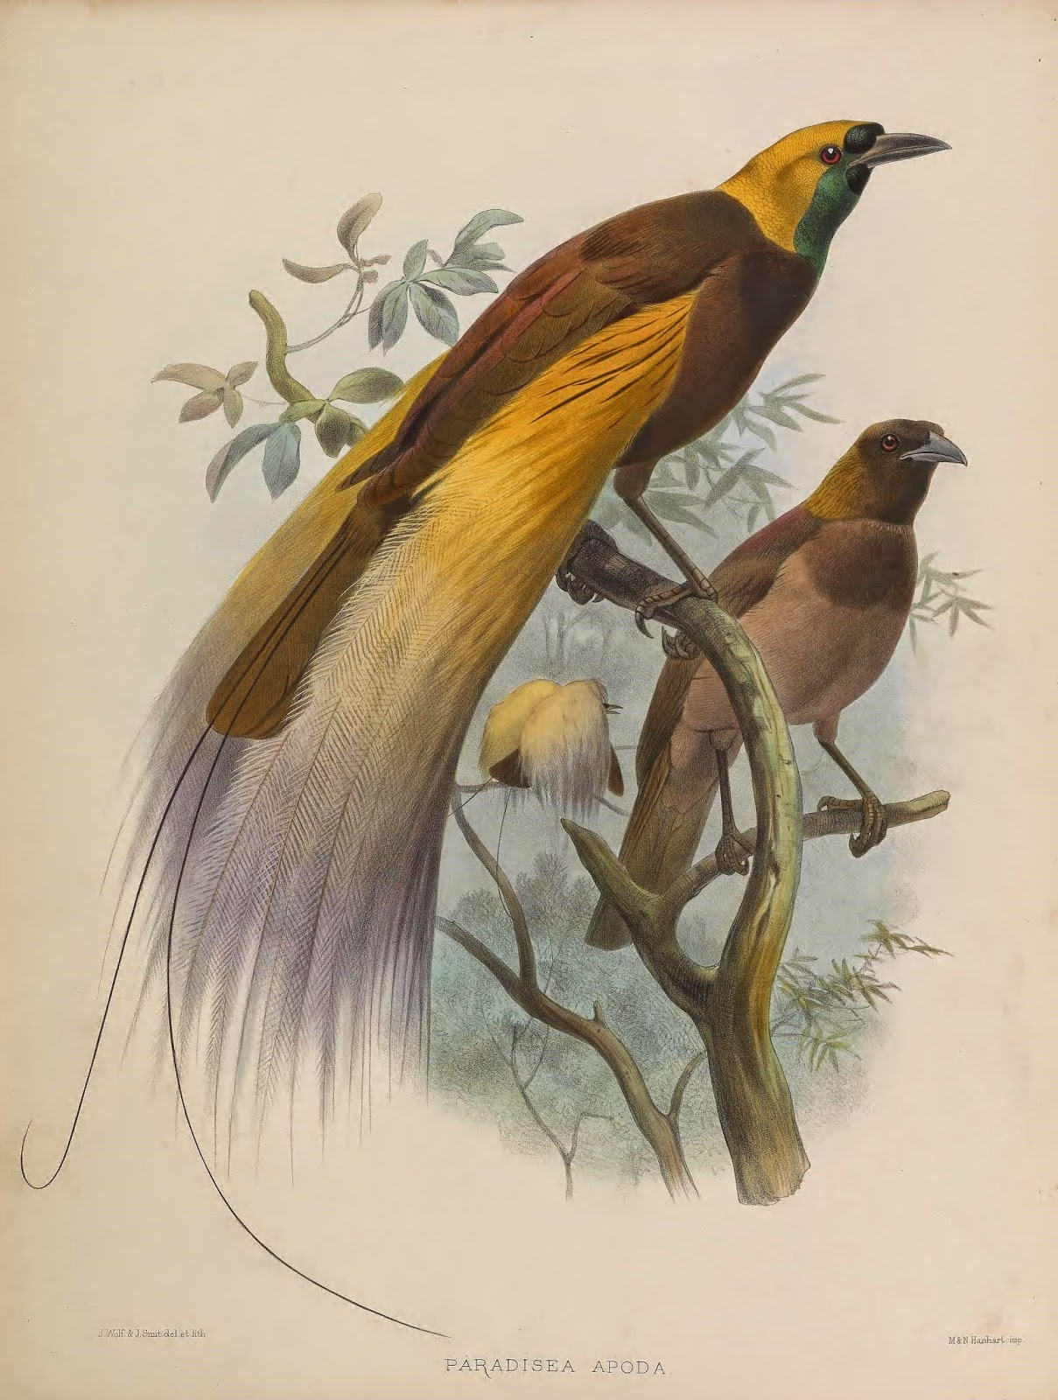
Birds of paradise.
In 1858 whilst in the Moluccas Wallace and Ali found a new species of bird of paradise. It was identified by Wallace in 1858 and named Semioptera wallacii or Wallace’s standard wing in his honour. It’s name derives from the male bird possessing two standard-like quills/plumes on either side of its flank.
Wallace would later travel to New Guinea to collect them and went on to collect 5 species of bird of paradise overall. They fetched a large price back in Europe and he made a lot of money from his specimens.
Wallace became the first European to observe birds of Paradise alive in their natural range and habitat.
“I thought of the long ages of the past, during which the successive generations of this little creature had run their course—year by year being born, and living and dying amid these dark and gloomy woods, with no intelligent eye to gaze upon their loveliness; to all appearance such a wanton waste of beauty. Such ideas excite a feeling of melancholy.”
“This consideration must surely tell us that all living things were not made for man.”

Slide 23
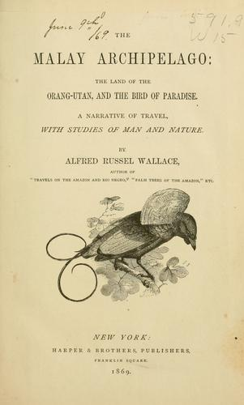
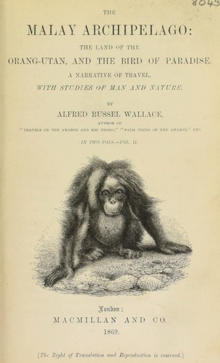
The Malay Archipelago:
The land of the orang-utan, and the bird of paradise.
A narrative of travel, with studies of man and nature (1869).
Wallace documented his travels and discoveries in the East in this book.
Since it initial publication it has never been out of print.
Many leading British, Dutch and German illustrators provided the accurate illustrations for the book based on Wallace’s accounts.
Has been described as one of the greatest travel journals ever written.
To CHARLES DARWIN
AUTHOR OF “THE ORIGIN OF SPECIES”
I dedicate this book, not only as a token of personal esteem and friendship but also to express my deep admiration for his genius and his works.

Slide 24
Some of the various topics within the book
Geology of the archipelago. Descriptions of the vegetation and landscapes and their physical features.
Description of the flora and fauna.
The geographical distribution and origins of species across the archipelago, both endemic and cosmopolitan.
The faunal assemblages across the archipelago.
The frequency of different species and species richness.
Acute observations of different species and their adaptations.
The natural history of each part of the archipelago and the evolutionary history of various species.
Stories of collecting and interactions with various animals.
Dispelling certain misconceptions about the tropics.
Descriptions of the different peoples of the archipelago, both native and settler and his interactions with them.
Both local and Dutch administration of different parts of the archipelago.
“Wallace was capable of great insights, as is revealed vividly through this account of his East Indian voyages. Made between 1854 and 1862, these involved travelling more than 14,000 miles and amassing 125,000 specimens of mammals, reptiles and insects, many new to science. Wallace also made scrupulous notes which form the basis of The Malay Archipelago, a book that subtly combines wildlife descriptions, geological musings and tales about the villagers, merchants and sultans he encountered on his travels through the East Indies. ”
“Persevere, however. This is an adventure story, a scientific masterpiece and, for good measure, one of the world's finest travel books.” – Robin McKie, 2009.

Slide 25
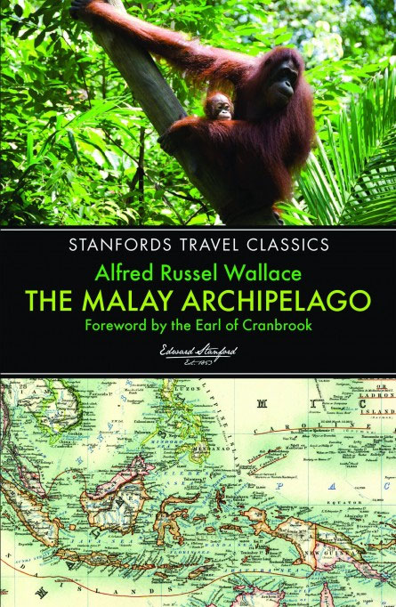
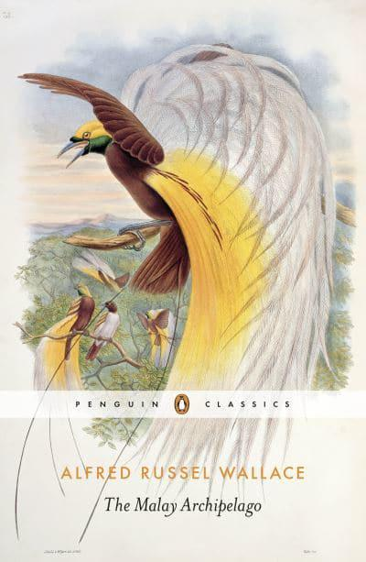
Good modern prints.
Many contemporary prints of The Malay archipelago exist today, but these vary heavily in quality. These two prints are recommended, retaining the original unbroken text as well as the illustrations. Both include good individual prefaces.
Left: Stanford Travel Classics.
Right: Penguin classics.

Slide 26

Biogeographic realms
Wallace would continue to study the distribution of organisms and created several biogeographical realms, denoting areas that shared distinct groups of flora and fauna. There are now known to be more biogeographical realms but Wallace’s original boundaries remain quite accurate.
Original biogeographical realms created by Wallace:
Palearctic
Oriental (now known as Indo-Malayan).
Ethiopian (now known as Afro-Tropical).
Nearctic
Neotropical
Australasian

Slide 27

The Geographical Distribution of Animals. With a study of the Relations of Living and Extinct Faunas (1876).
“Considered the nineteenth century's leading expert on the geographical distribution of animals, Wallace carried out extensive fieldwork in areas as diverse as North and South America, Africa, China, India and Australia to document the habitats, breeding, migration and feeding behaviour of thousands of species around the world, and the influence of environmental conditions on their survival. First published in 1876, this two-volume set presents Wallace's findings, and represents a landmark in the study of zoology, evolutionary biology and palaeontology which remains relevant to scholars in these fields today. Volume 2 explores the distribution of primates, the habitats and characteristics of mammals, birds, reptiles, fish and insects, and patterns of migration.”

Slide 28
Quotes
"...there is no more admirable character in the history of science." Sir David Attenborough
“It is curious how we hit on the same ideas." - Charles Darwin to Wallace, 1867
"...very few things in my life have been more satisfactory to me -
that we have never felt any jealousy towards each other, though in one sense rivals." Darwin to Wallace, 1870

Slide 29

The forgotten Voyage (1983)
https://www.youtube.com/watch?v=Z1eQ6DadodA&t=2459s&ab_channel=GeorgeBeccaloni
A good dramatization and condensing of Wallace’s expedition.
Shows Wallace’s discovery of the divide in faunal distribution between the archipelago.
Includes many quotes taken directly from Wallace’s book.

Slide 30




Bill Bailey’s Jungle Hero (2013).
https://naturedocumentaries.org/8250/wallace-borneo-bill-baileys-jungle-hero-bbc-2013/
An informative and amusing two part documentary across Indonesia documenting Wallace’s voyage and discoveries. Condenses most of his book down in an easy to follow retelling. Ended with a portrait of Wallace being unveiled in the Hintze hall of the Natural History Museum in London, next to Darwin’s statue.
Note: one minor criticism is that it gives the indication that Darwin ‘robbed’ Wallace of the discovery of natural selection, this is false. They received joint credit and later became good friends. Wallace showed no jealousy and was delighted to have received credit alongside Darwin, who had conceived the theory of evolution by natural selection years before Wallace.

Slide 31





Recent Wallace memorials

Slide 32

Wallace memorial fund
https://wallacefund.myspecies.info/

