Slide 1
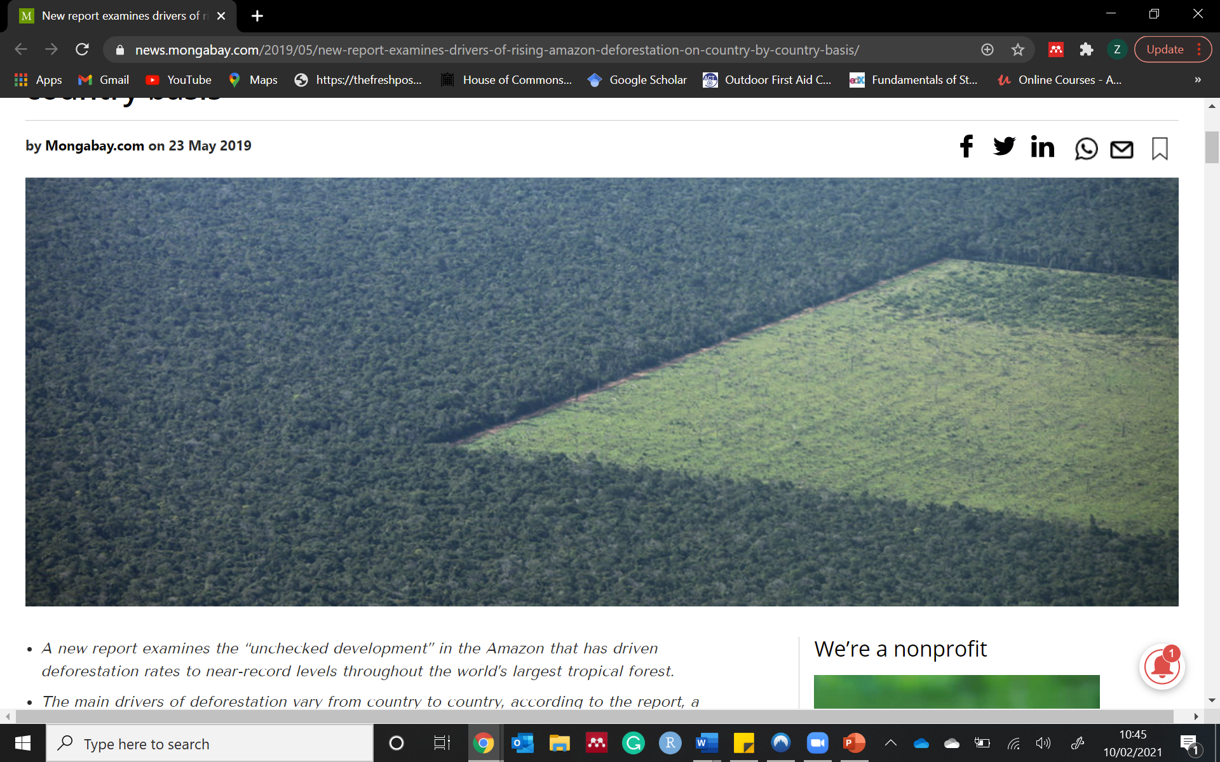
Deforestation Hotspot
Check the notes for more information!
Notes:
https://news.mongabay.com/2019/05/new-report-examines-drivers-of-rising-amazon-deforestation-on-country-by-country-basis/

Slide 2
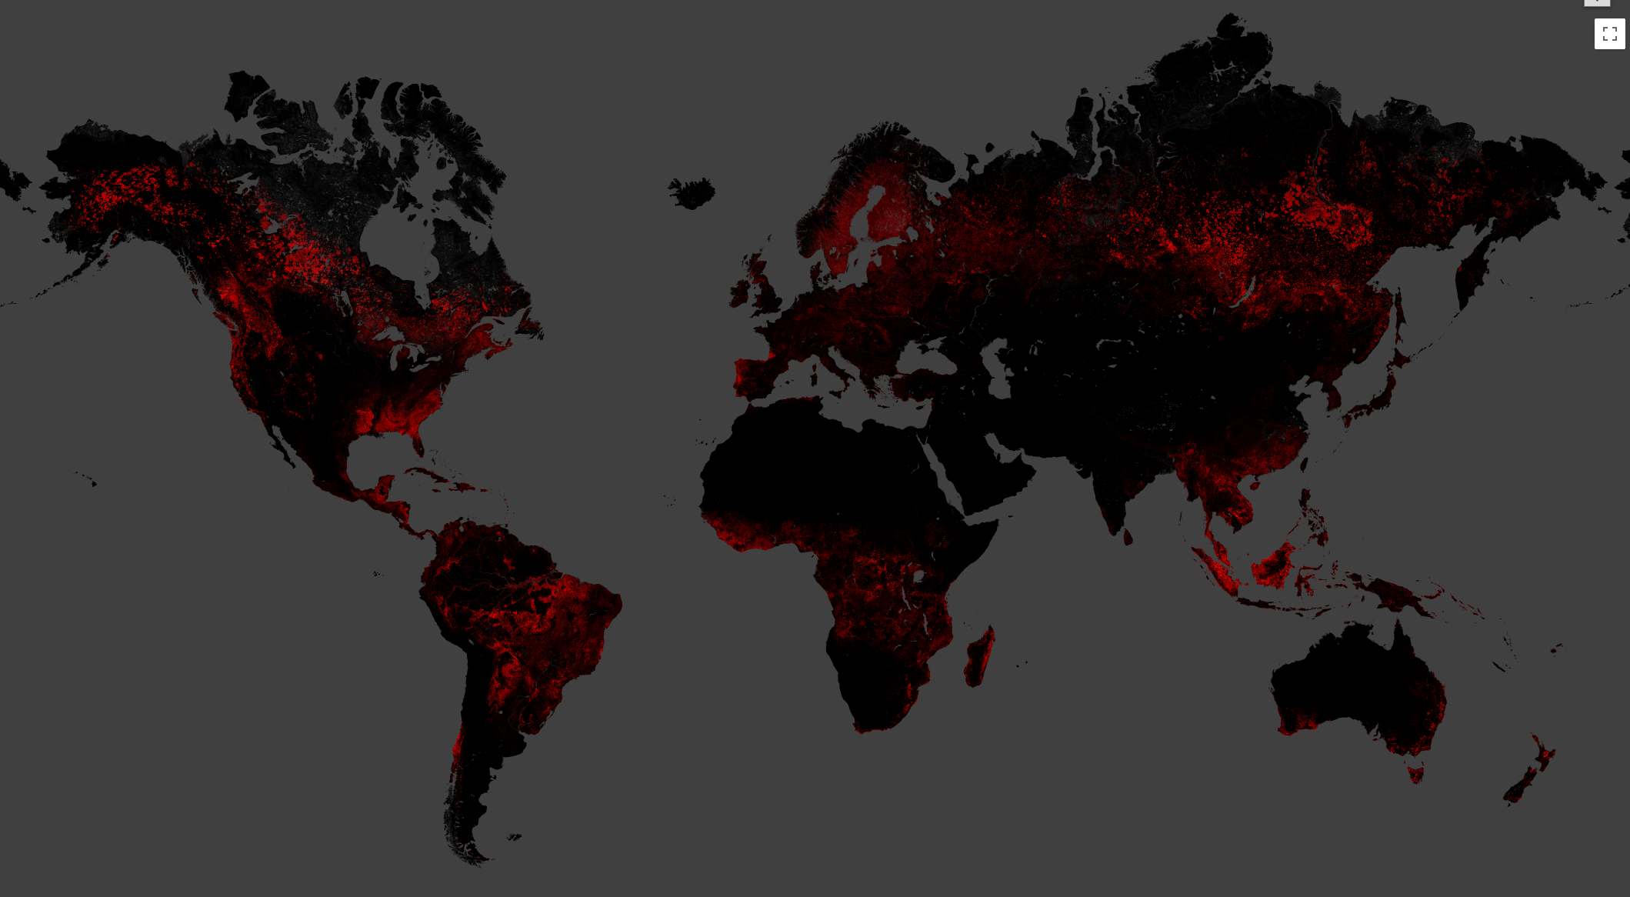
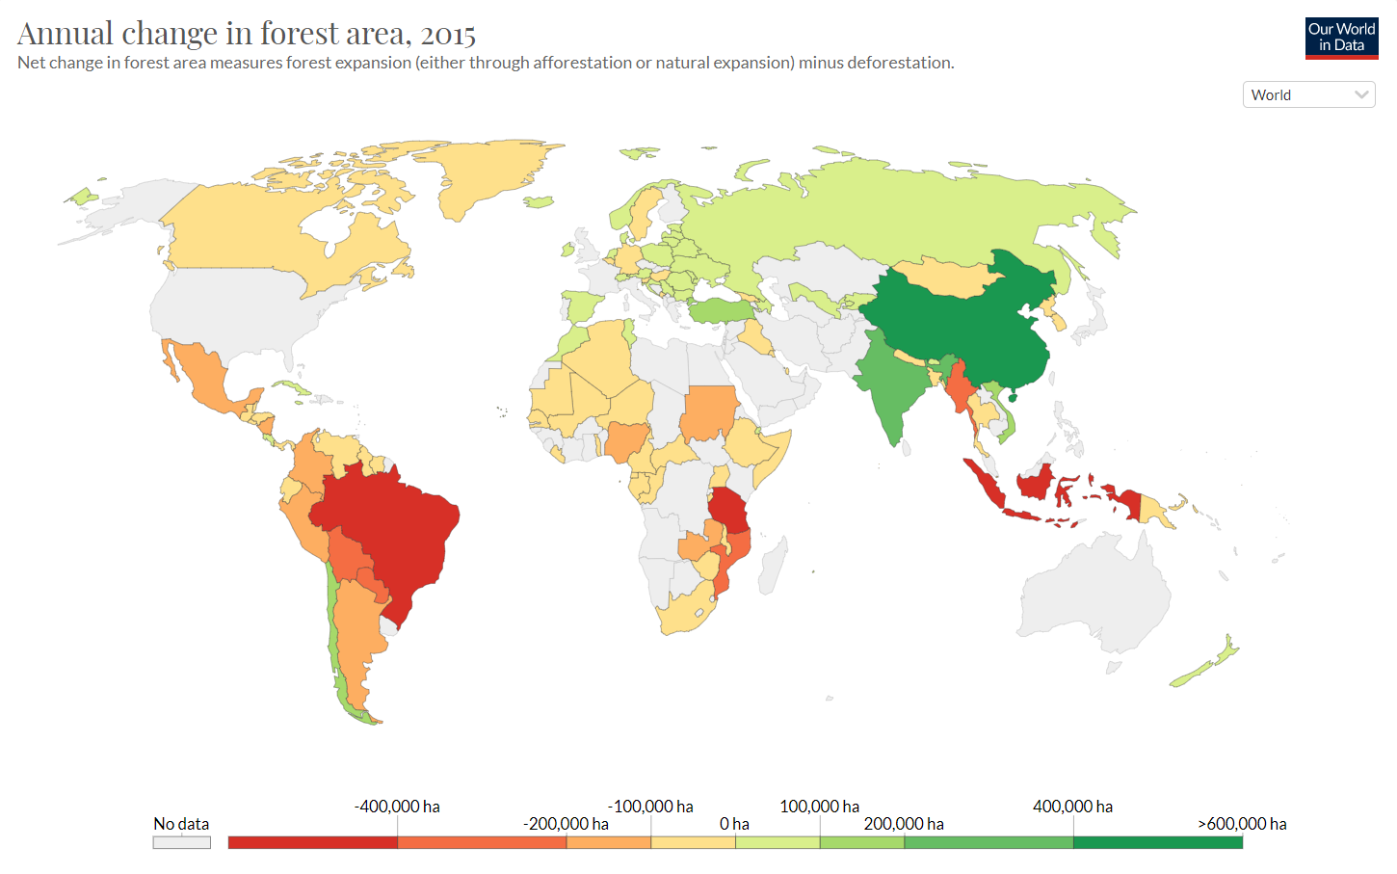
South America
Left image shows forest cover loss 2000-2019. South America shows a large amount has been lost, particularly focused around Brazil, Paraguay, Bolivia and Northern Argentina.
The right image shows how severe the loss has been in South America in comparison to the rest of the world (2015).
Notes:
Left image shows forest cover loss 2000-2019. South America shows a large amount has been lost, particularly focused around Brazil, Paraguay, Bolivia and Northern Argentina.
The right image shows how severe the loss has been in South America in comparison to the rest of the world (2015).

Slide 3
South America
At a Continental scale, the Americas (exl, Mexico) has the highest rate of tropical deforestation
Notes:
At a Continental scale, the Americas (exl, Mexico) has the highest rate of tropical deforestation
https://ourworldindata.org/forests-and-deforestation

Slide 4
South America
What is a deforestation hotspot?
“spatial clustering of woody vegetation change… at the country scale”.
(Sanchez-Cuervo and Aide 2013)
Brazil
Paraguay
Argentina
Notes:
And we can see this by looking at the deforestation hotspots that have been occurring, which has been described as a
“spatial clustering of woody vegetation change… at the country scale”.
Ref
https://www.researchgate.net/publication/258983907_Identifying_hotspots_of_deforestation_and_reforestation_in_Colombia_2001-2010_Implications_for_protected_areas

Slide 5
Drivers of Deforestation - Brazil
Notes:
At a country level we can see patterns starting to emerge

Slide 6
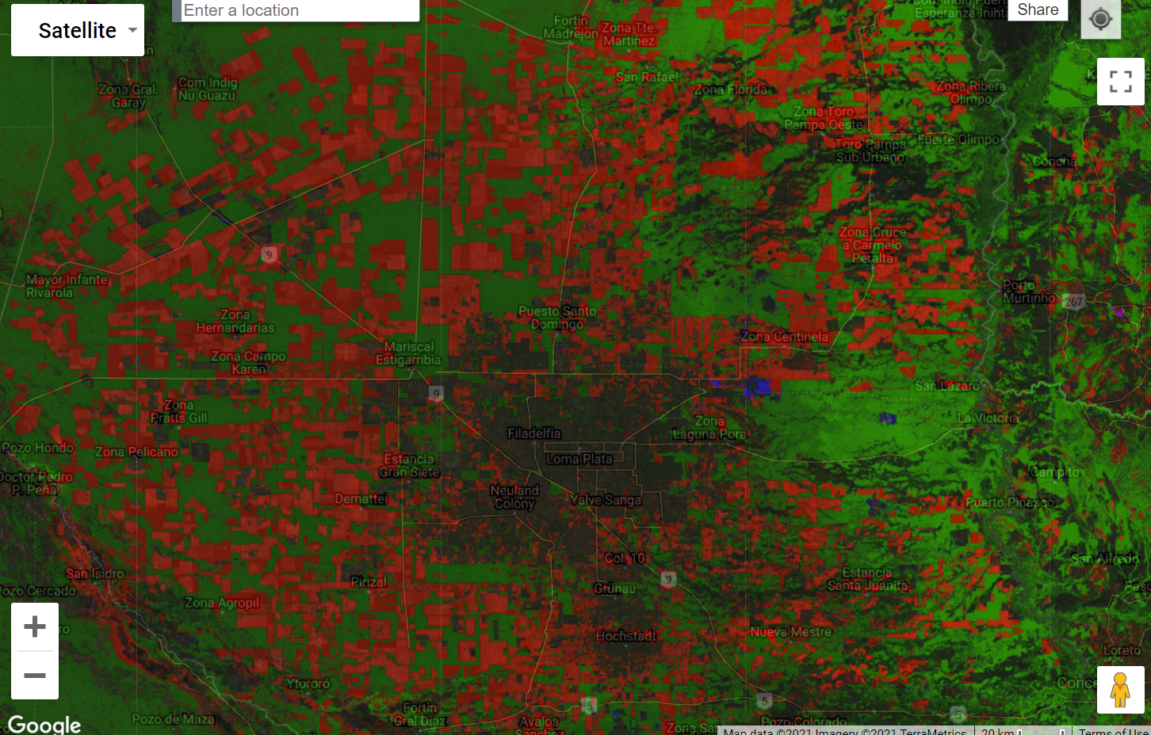
Drivers of Deforestation - Paraguay
Notes:
https://www.researchgate.net/publication/258983907_Identifying_hotspots_of_deforestation_and_reforestation_in_Colombia_2001-2010_Implications_for_protected_areas

Slide 7
Drivers of Deforestation - Argentina

Slide 8
Drivers of Deforestation
All three countries share a similar characteristic!
In which they all have:
Sharp boundaries and geometrical shapes (rectangles)
Suggest planned change and management primarily in the agriculture sector .
Notes:
https://ourworldindata.org/forests-and-deforestation

Slide 9
Study area - Brazil
Notes:
By looking at the annual change in forest area we can see that in 2000 – Deforestation has reduced significantly within 15 years – which could suggest improved farming methods that increase crop yield and/or other sources of income from different economic sectors
Which from looking at the second graph helped improve Brazil GPD substantially during the 15yrs period

Slide 10
Study area - Brazil
Life expectancy 70
Life expectancy 75
Notes:
As a result their population demographic shifted by reducing population growth and increasing life expectancy by 5 years

Slide 11
Study area - Brazil
Notes:
The rate at which deforestation has decreased could optimistically suggest that Brazil could be at a turning point towards a Post-industrial economy, but given Brazil alone has the highest deforestation and without more analysis on the different drivers of deforestation such as the socio-political forces, its remains uncertain

Slide 12
Study area - Paraguay
At a Country scale, Deforestation in Paraguay is attributed to Soybean production.

Slide 13
Study area - Paraguay
Notes:
However, when we look at where deforestation has occurred compared to the population density - we can see the highest density in population is located around the capital of Paraguay in the South-west.
Whereas in the north where there is a significant deforestation rate the population is spatially distributed
However, even in sparsely inhabited areas, external forces such as development aid like the Sustainable Agriculture & Rural Development Project (PRODERS) (initiated by the World Bank) which was used to fight rural poverty, greatly benefited the agricultural sector which would have had a hand in driving deforestation.
https://www.worldbank.org/en/country/paraguay/overview#3

Slide 14
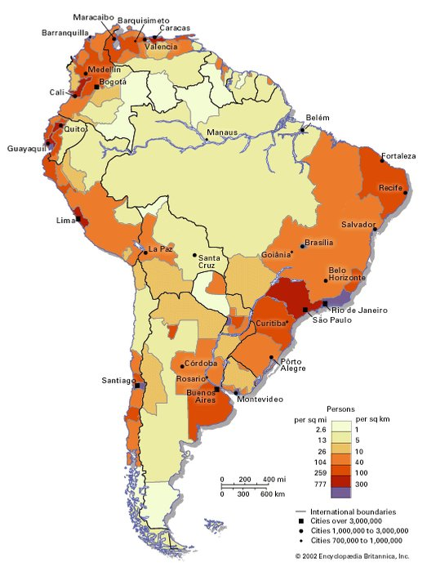
Population – South America
As is the trend with most developing countries the proportion of the population moving from rural areas to urban areas is increasing.
In 1980, 68% lived in urban areas compared to 85.5% in 2020.
Population is within coastal towns and cities.
Notes:
As is the trend with most developing countries the proportion of the population moving from rural areas to urban areas is increasing.
In 1980, 68% lived in urban areas compared to 85.5% in 2020.
The image below shows the population density and demonstrates how dense the population is within coastal towns and cities.

Slide 15
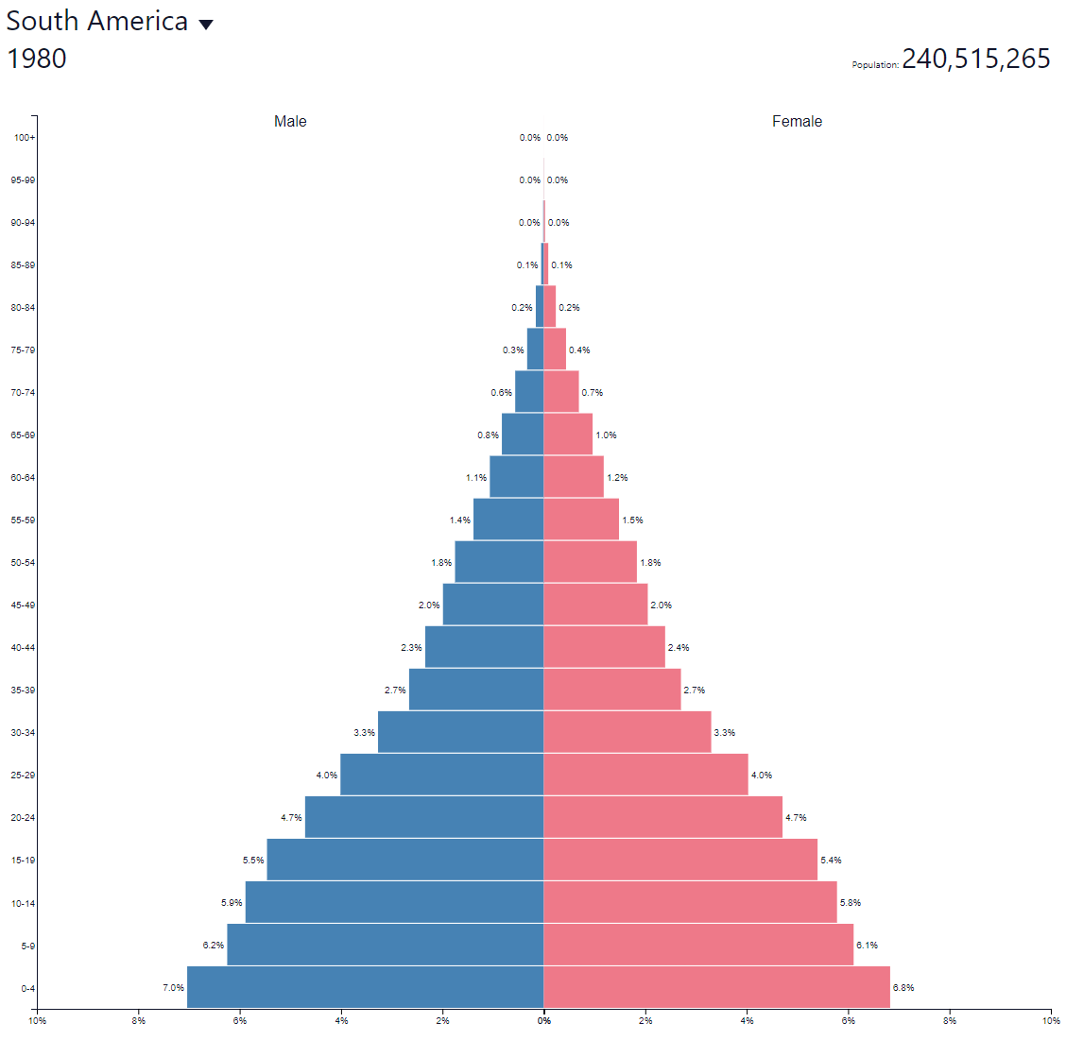
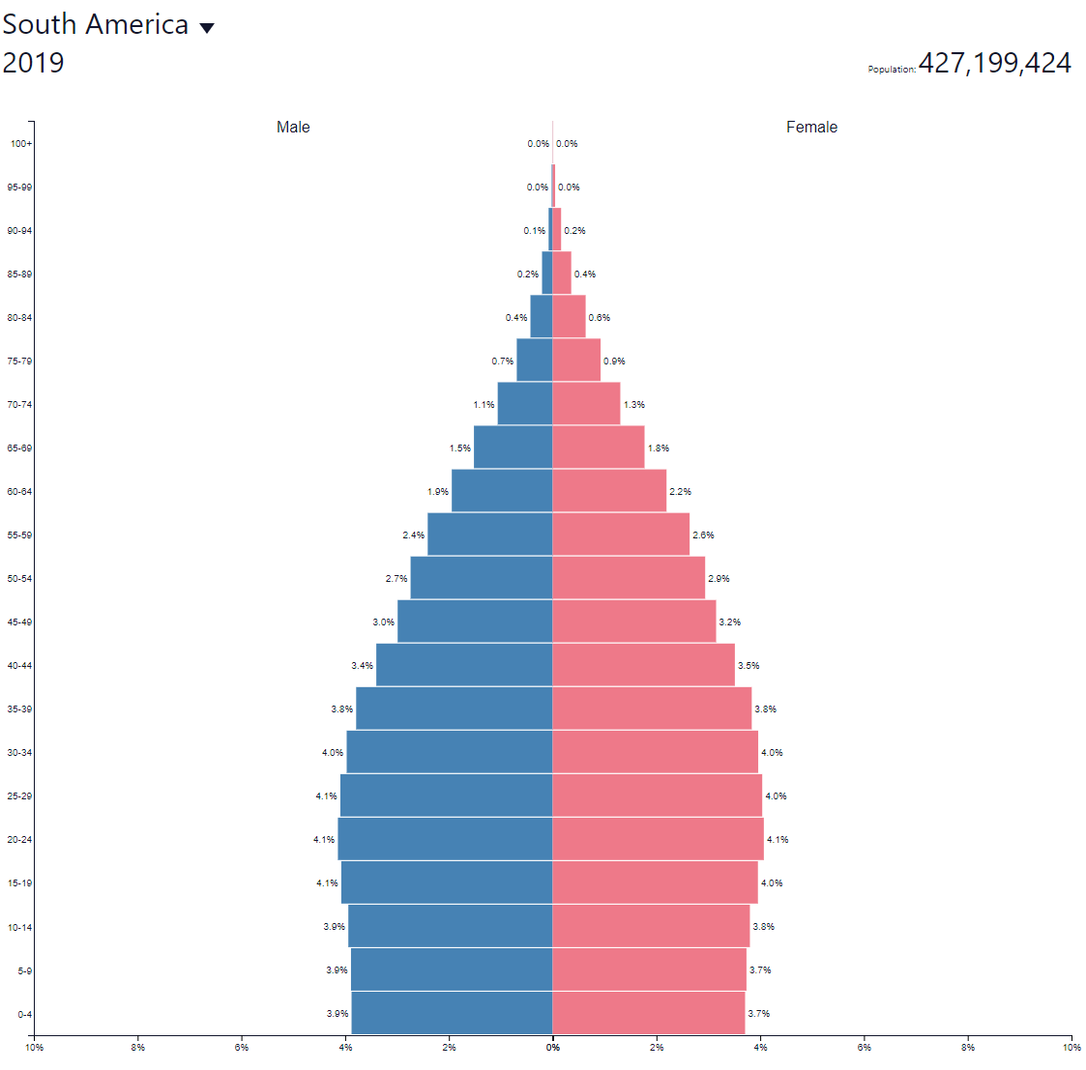
Population - South America
Demographic in 1980 has changed from a particularly young growing population to in 2019 to a more balanced, stable population where the majority is distributed between 0-29 years old.
South America has experienced rapid population growth, almost doubling in 30 years.
Notes:
Demographic in 1980 has changed from a particularly young growing population to in 2019 to a more balanced, stable population where the majority is distributed between 0-29 years old.
South America has experienced rapid population growth, almost doubling in 30 years (exl Brazil)

Slide 16
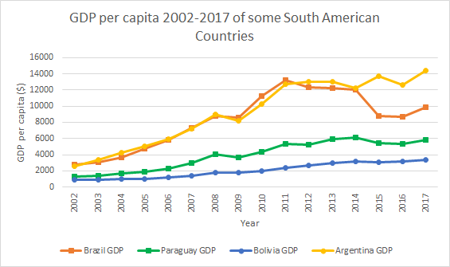
Economic Situation
As can be seen in the graph, the overall trend in GDP per capita is increasing, despite some years which have decreased.
Notes:
As can be seen in the graph, the overall trend in GDP per capita is increasing, despite some years which have decreased.
Data extracted from the database made available by Duncan

