Slide 1
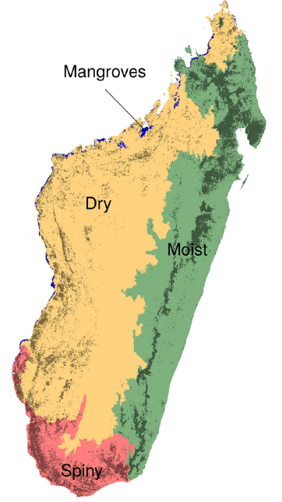
Madagascar
World’s 4th largest island
4 ecoregions
Mangroves
Dry Forest
Moist Forest
Spiny Forest
Tropical Biodiversity Hotspot
High levels endemism

Slide 2
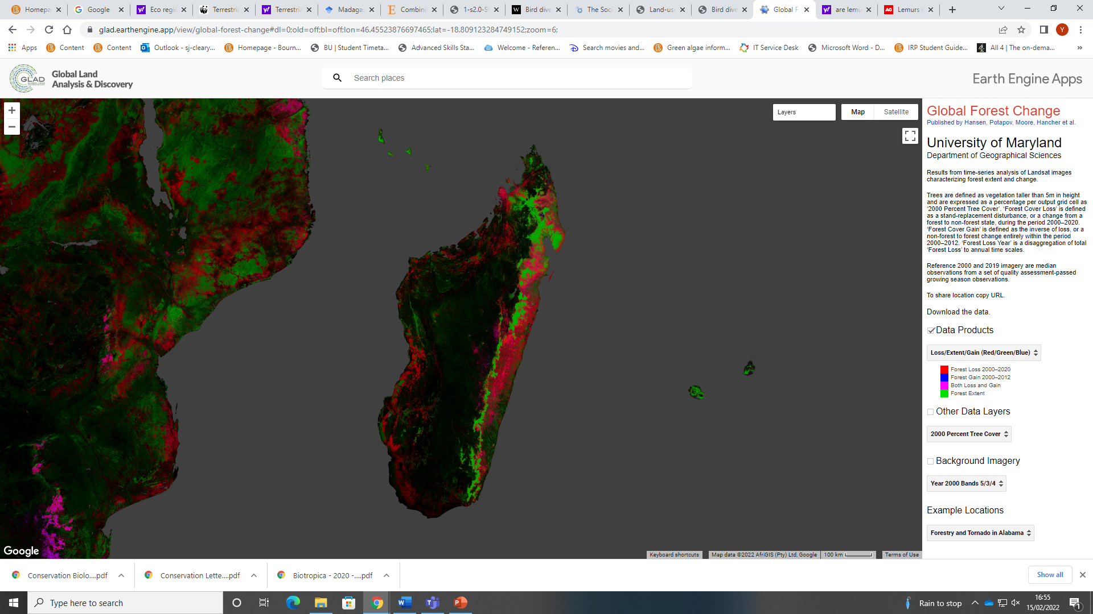
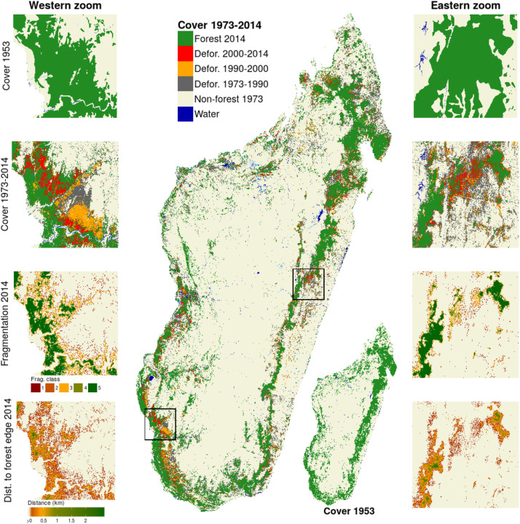
Forest Cover 1953-2020
Forest loss 2020 on left (Hansen et al)
Forest Cover 1953 on right (Vieilledent et al 2018)
Deforestation appears unmanaged with no gain; small areas in east & south east of loss with gain – possibly regrowth after historic clearing
Very little spiny forest in 2020

Slide 3
Environmental Degradation
According to IUCN (2017) – approx. only 10% natural vegetation intact (Myers et al 2000)
Spiny Forest Ecoregion- most economically disadvantaged area
In South Madagascar- semi arid - important ecological region
Numerous endemic species- e.g radiated tortoise and highest level plant endemism on the island
Maize Boom of 1980’s and 90’s changed much of L.U. to agriculture
Regrowth of dry forest after Slash and Burn is slow.
Poorly defined land ownership makes forest vulnerable to migrating settlers
Mahafaly Plateau approx. 8000km² av temp= 24°C, Av Rainfall 300-600mm Nov-April
90% population below $1.60/day- extreme poverty –no electricity or running water

Slide 4
Protected Areas
Protected Forest Areas - 25% in 2000; 39.8% in 2020 (UNFAO)
But rate of deforestation remains flatlined at 2015 levels
Some evidence of PAs mitigating Forest Loss (Eklund et al 2016) but deforestation still occurring inside Pas
Need Better Management
Local Community driven conservation
Develop ecotourism and research
October- week long World Lemur Festival for schoolchildren
Post Covid social and economic recovery

Slide 5
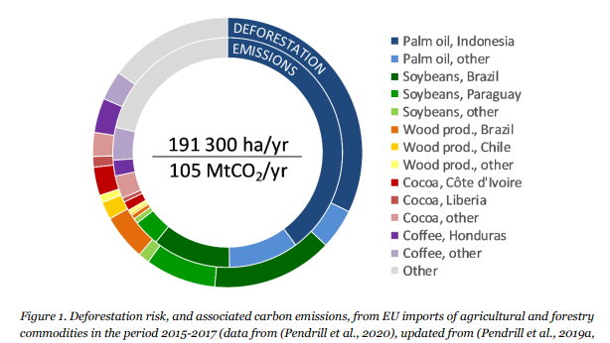
Drivers of deforestation
Resources –timber paper charcoal
Land- crops livestock
Development- construction Roads
Governance – economics, lack of regulation and clear land ownership
International Markets-
Some reports of developed countries driving tropical deforestation by consumer demand for commodities
Population-

Slide 6
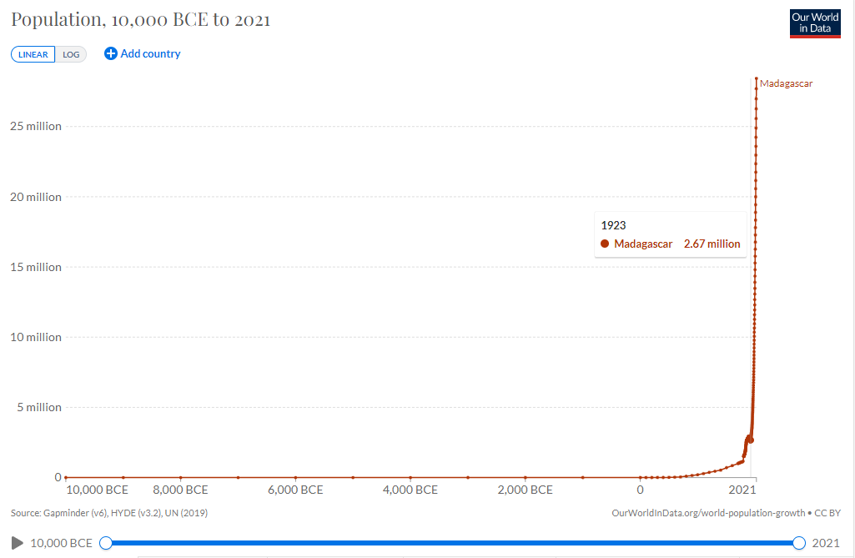
Rapid Population growth in politically unstable country

Slide 7
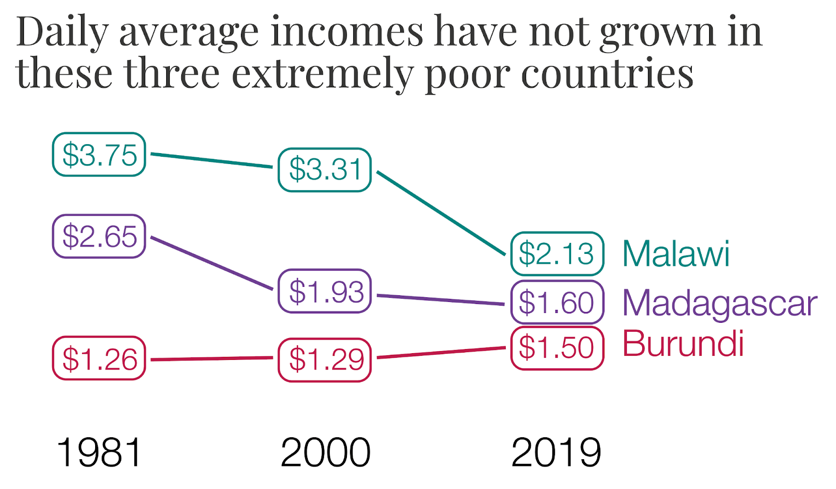
Rising population with stagnant economy puts pressure on natural resources

Slide 8
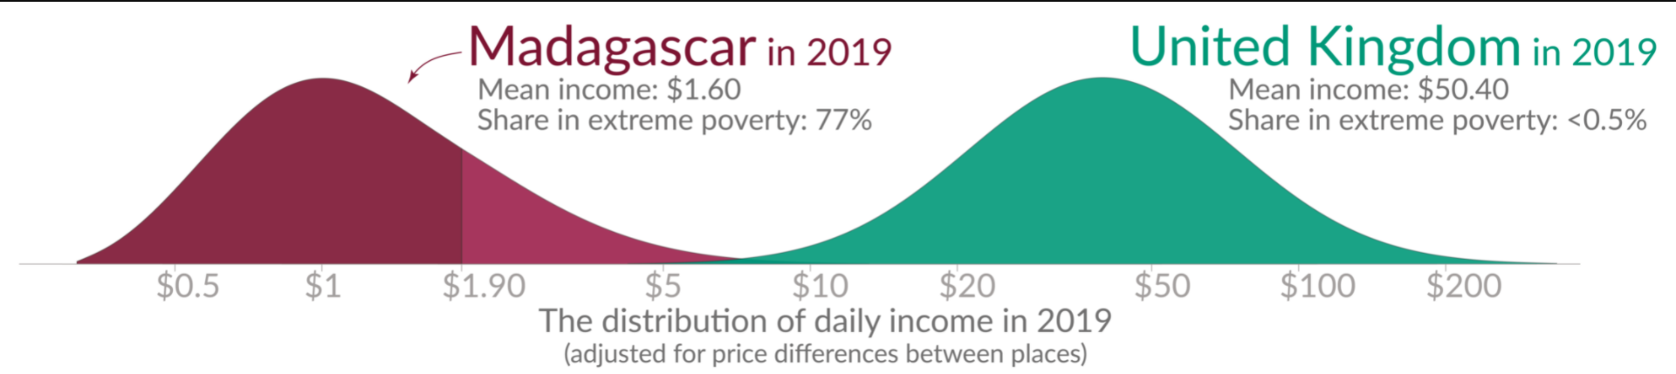
Comparison with UK
Madagascar one of poorest countries in the world.
Poverty is as Bleak as Biodiversity loss (Balmford 2012)

Slide 9
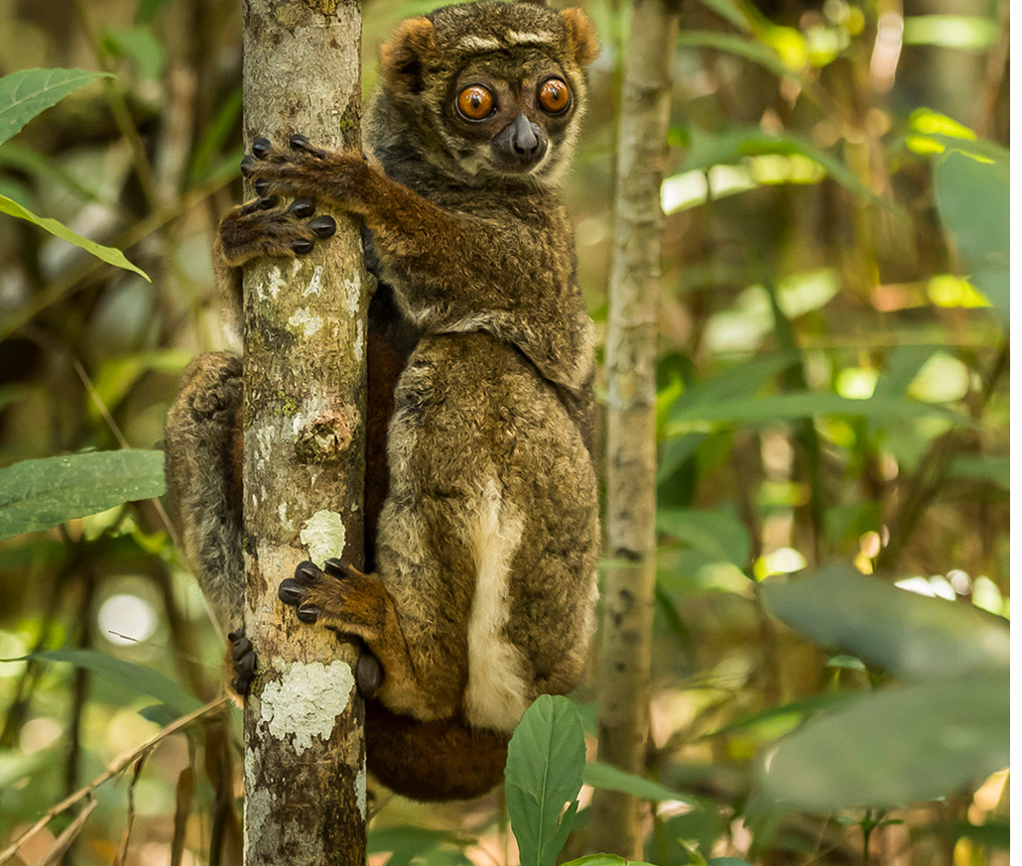
Lemur
Flagship species
An eastern woolly lemur (Avahi laniger)

Slide 10
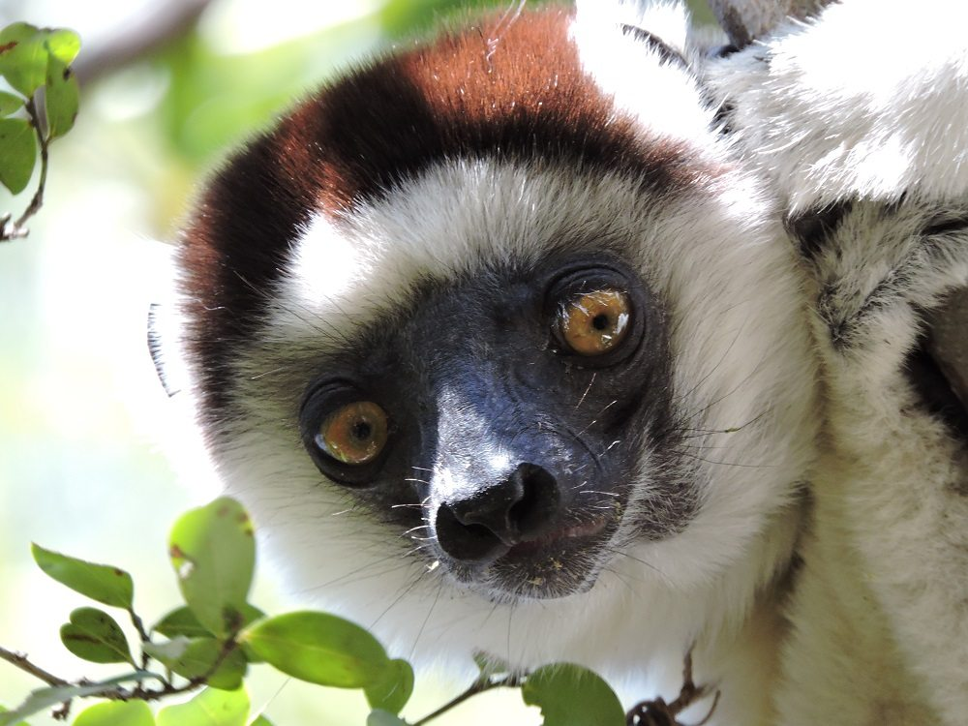
Lemurs co-evolved with the forests – important for
-seed dispersal,
-pollination and
-maintain forest structure
-increasing interest for research and scientists

