Slide 1
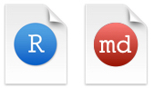

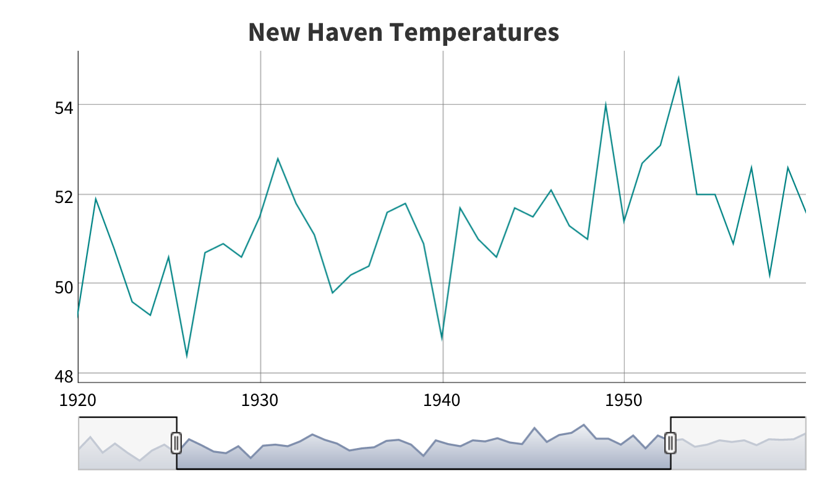
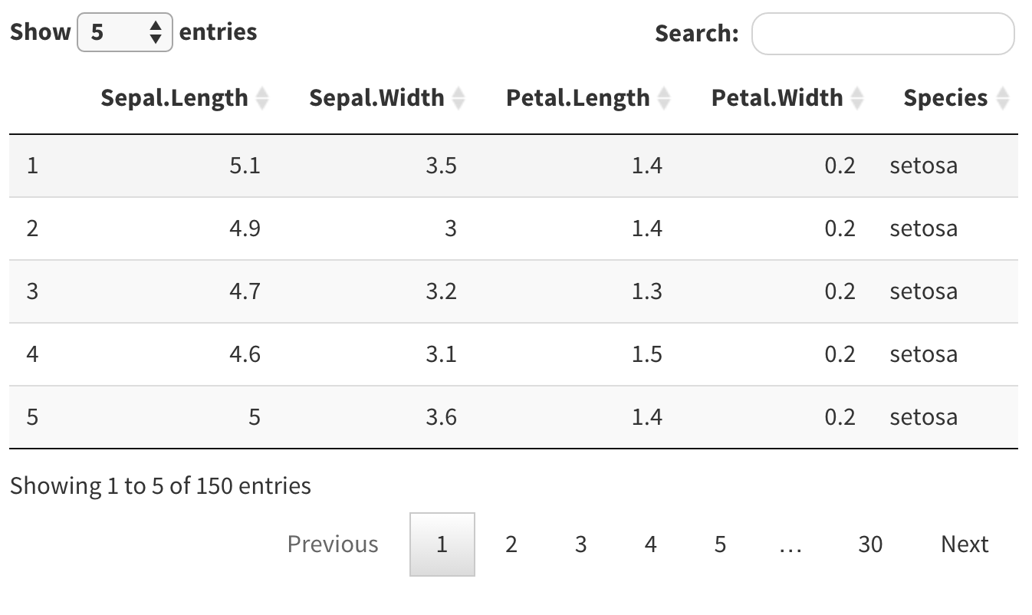
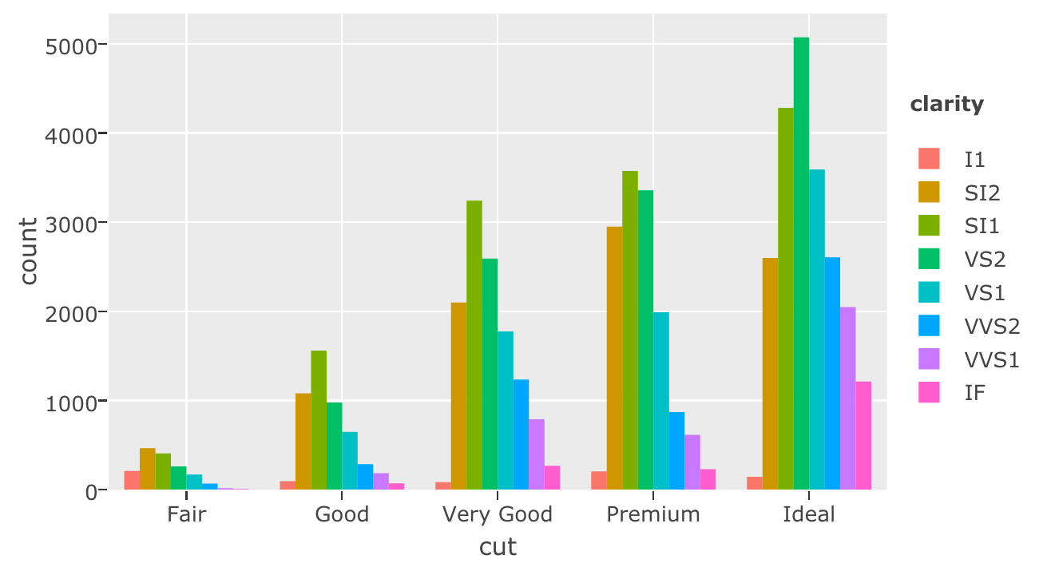







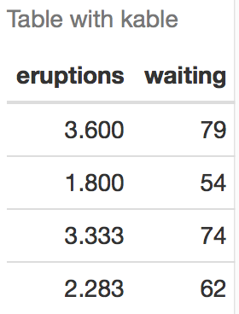

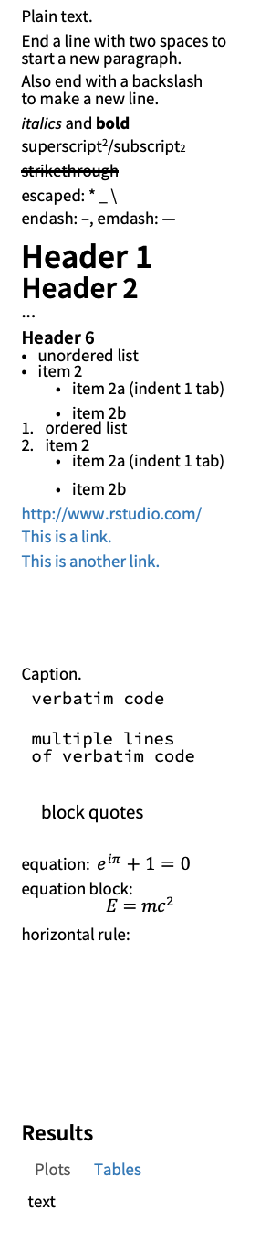
rmarkdown : : CHEAT SHEET
  What is rmarkdown?
  SOURCE EDITOR
  RENDERED OUTPUT
file path to output document
  Write with
  Markdown
1. New File
5. Save and Render
6. Share
find in document
.Rmd files · Develop your code and ideas side-by-side in a single document. Run code as individual chunks or as an entire document.
Dynamic Documents · Knit together plots, tables, and results with narrative text. Render to a variety of formats like HTML, PDF, MS Word, or MS Powerpoint.
Reproducible Research · Upload, link to, or attach your report to share. Anyone can read or run your code to reproduce your work.
publish to rpubs.com,
shinyapps.io,
RStudio Connect
Rmd
set preview location
insert code chunk
go to code chunk
run code chunk(s)
The syntax on the left renders as the output on the right.
show outline
Plain text.
End a line with two spaces to start a new paragraph.
Also end with a backslash\
to make a new line.
*italics* and **bold**
superscript^2^/subscript~2~
~~strikethrough~~
escaped: \* \_ \\
endash: --, emdash: ---
# Header 1
## Header 2
...
###### Header 6
- unordered list
- item 2
- item 2a (indent 1 tab)
- item 2b
1. ordered list
2. item 2
- item 2a (indent 1 tab)
- item 2b
<link url>
[This is a link.](link url)
[This is another link][id].
At the end of the document:
[id]: link url
![Caption](image.png)
or ![Caption][id2]
At the end of the document:
[id2]: image.png
`verbatim code`
```
multiple lines
of verbatim code
```
> block quotes
equation: $e^{i \pi} + 1 = 0$
equation block:
$$E = mc^{2}$$
horizontal rule:
---
| Right | Left | Default | Center | |-------:|:------|-----------|:---------:|
| 12 | 12 | 12 | 12 |
| 123 | 123 | 123 | 123 |
| 1 | 1 | 1 | 1 |
HTML Tabsets
# Results {.tabset}
## Plots text
text
## Tables
more text
Plain text.
End a line with two spaces to start a new paragraph.
Also end with a backslash
to make a new line.
italics and bold
superscript²/subscript2
strikethrough
escaped: * _ \
endash: –, emdash: —
Header 1
Header 2
...
Header 6
unordered list
item 2
item 2a (indent 1 tab)
item 2b
ordered list
item 2
item 2a (indent 1 tab)
item 2b
http://www.rstudio.com/
This is a link.
This is another link.
Caption.
verbatim code
multiple lines
of verbatim code
block quotes
equation: $e^{iπ}+1=0$
equation block:
$$E=mc^{2}$$
horizontal rule:
Results
Plots Tables
text
4. Set Output Format(s) and Options
reload document
3. Write Text
run all previous chunks
modify chunk options
run current chunk
  Workflow
1
2. Embed Code
Open a new .Rmd file in the RStudio IDE by going to File > New File > R Markdown.
Embed code in chunks. Run code by line, by chunk, or all at once.
Write text and add tables, figures, images, and citations. Format with Markdown syntax or the RStudio Visual Markdown Editor.
Set output format(s) and options in the YAML header. Customize themes or add parameters to execute or add interactivity with Shiny.
Save and render the whole document. Knit periodically to preview your work as you write.
Share your work!
2
3
4
  VISUAL EDITOR
insert citations
style options
  Insert Citations
5
Create citations from a bibliography file, a Zotero library,
or from DOI references.
BUILD YOUR BIBLIOGRAPHY
Add BibTeX or CSL bibliographies to the YAML header.
---
title: "My Document"
bibliography: references.bib
link-citations: TRUE
---
If Zotero is installed locally, your main library will automatically be available.
Add citations by DOI by searching "from DOI" in the Insert Citation dialog.
INSERT CITATIONS
Access the Insert Citations dialog in the Visual Editor
by clicking the @ symbol in the toolbar or by clicking Insert > Citation.
Add citations with markdown syntax by typing [@cite] or @cite.
6
add/edit attributes
  Embed Code with knitr
  CODE CHUNKS
OPTION | DEFAULT | EFFECTS
echo | TRUE | display code in output document
error | FALSE | TRUE (display error messages in doc) FALSE (stop render when error occurs)
eval | TRUE | run code in chunk
include | TRUE | include chunk in doc after running
message | TRUE | display code messages in document
warning | TRUE | display code warnings in document
results | "markup" | "asis" (passthrough results) "hide" (don't display results) "hold" (put all results below all code)
fig.align | "default" | "left", "right", or "center"
fig.alt | NULL | alt text for a figure
fig.cap | NULL | figure caption as a character string
fig.path | "figure/" | prefix for generating figure file paths
fig.width & fig.height | 7 | plot dimensions in inches
out.width |  | rescales output width, e.g. "75%", "300px"
collapse | FALSE | collapse all sources & output into a single block
comment | "##" | prefix for each line of results
child | NULL | files(s) to knit and then include
purl | TRUE | include or exclude a code chunk when extracting source code with knitr::purl()
See more options and defaults by running str(knitr::opts_chunk$get())
Surround code chunks with ```{r} and ``` or use
the Insert Code Chunk button. Add a chunk label and/or chunk options inside the curly braces after r.
```{r chunk-label, include=FALSE}
summary(mtcars)
```
  SET GLOBAL OPTIONS
Set options for the entire document in the first chunk.
```{r include=FALSE}
knitr::opts_chunk$set(message = FALSE)
```
  Insert Tables
Right | Left | Default | Center
12 | 12 | 12 | 12
123 | 123 | 123 | 123
1 | 1 | 1 | 1
Output data frames as tables using
kable(data, caption).
```{r}
data <- faithful[1:4, ]
knitr::kable(data,
caption = "Table with kable")
```
Other table packages include flextable, gt, and kableExtra.
  INLINE CODE
Insert `r <code>` into text sections. Code is evaluated
at render and results appear as text.
"Built with `r getRversion()`" --> "Built with 4.1.0"
RStudio® is a trademark of RStudio, PBC • CC BY SA RStudio • info@rstudio.com • 844-448-1212 • rstudio.com • Learn more at rmarkdown.rstudio.com • rmarkdown 2.9.4 • Updated: 2021-08

Slide 2


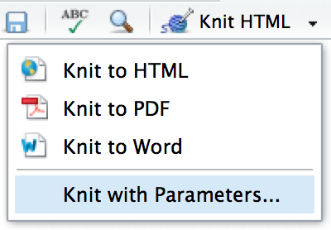
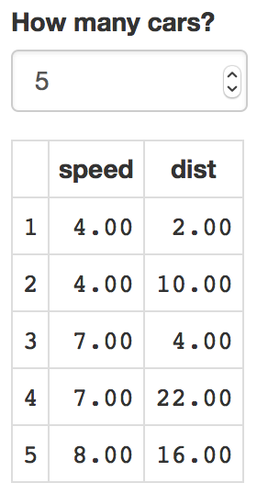
  Set Output Formats and their Options in YAML
MS Word
  Render
HTML
MS PPT
PDF
Use the document's YAML header to set an output format and customize it with output options.
IMPORTANT OPTIONS | DESCRIPTION
anchor_sections | Show section anchors on mouse hover (TRUE or FALSE) | X
citation_package | The LaTeX package to process citations ("default", "natbib", "biblatex") |  | X
code_download | Give readers an option to download the .Rmd source code (TRUE or FALSE) | X
code_folding | Let readers to toggle the display of R code ("none", "hide", or "show") | X
css | CSS or SCSS file to use to style document (e.g. "style.css") | X
dev | Graphics device to use for figure output (e.g. "png", "pdf") | X | X
df_print | Method for printing data frames ("default", "kable", "tibble", "paged") | X | X | X | X
fig_caption | Should figures be rendered with captions (TRUE or FALSE) | X | X | X | X
highlight | Syntax highlighting ("tango", "pygments", "kate", "zenburn", "textmate") | X | X | X
includes | File of content to place in doc ("in_header", "before_body", "after_body") | X | X
keep_md | Keep the Markdown .md file generated by knitting (TRUE or FALSE) | X | X | X | X
keep_tex | Keep the intermediate TEX file used to convert to PDF (TRUE or FALSE) |  | X
latex_engine | LaTeX engine for producing PDF output ("pdflatex", "xelatex", or "lualatex") |  | X
reference_docx/_doc | docx/pptx file containing styles to copy in the output (e.g. "file.docx", "file.pptx") |  |  | X | X
theme | Theme options (see Bootswatch and Custom Themes below) | X
toc | Add a table of contents at start of document (TRUE or FALSE) | X | X | X | X
toc_depth | The lowest level of headings to add to table of contents (e.g. 2, 3) | X | X | X | X
toc_float | Float the table of contents to the left of the main document content (TRUE or FALSE) | X
Use ?<output format> to see all of a format's options, e.g. ?html_document
When you render a
document, rmarkdown:
Runs the code and embeds
results and text into an .md
file with knitr.
Converts the .md file into the output format with Pandoc.
---
title: "My Document"
author: "Author Name"
output:
html_document:
toc: TRUE
---
Indent format 2 characters, indent options 4 characters
.Rmd
knitr
.md
pandoc
HTML
PDF
DOC
OUTPUT FORMAT | CREATES
html_document | .html
pdf_document* | .pdf
word_document | Microsoft Word (.docx)
powerpoint_presentation | Microsoft Powerpoint (.pptx)
odt_document | OpenDocument Text
rtf_document | Rich Text Format
md_document | Markdown
github_document | Markdown for Github
ioslides_presentation | ioslides HTML slides
slidy_presentation | Slidy HTML slides
beamer_presentation* | Beamer slides
* Requires LaTeX, use tinytex::install_tinytex()
Also see flexdashboard, bookdown, distill, and blogdown.
Save, then Knit to preview the document output. The resulting HTML/PDF/MS Word/etc. document will be created and saved in the same directory as the .Rmd file.
Use rmarkdown::render() to render/knit in the R console. See ?render for available options.
  Share
Publish on RStudio Connect
to share R Markdown documents
securely, schedule automatic
updates, and interact with parameters in real time. rstudio.com/products/connect/
  More Header Options
  PARAMETERS
  BOOTSWATCH THEMES
  STYLING WITH CSS AND SCSS
  INTERACTIVITY
Parameterize your documents to reuse with new inputs (e.g., data, values, etc.).
Customize HTML documents with Bootswatch themes from the bslib package using the theme output option.
Use bslib::bootswatch_themes() to list available themes.
Add CSS and SCSS to your document by adding a path to a file with the css option in the YAML header.
Turn your report into an interactive
Shiny document in 4 steps:
Add runtime: shiny to the YAML header.
Call Shiny input functions to embed input objects.
Call Shiny render functions to embed reactive output.
Render with rmarkdown::run() or click Run Document in RStudio IDE.
Add parameters in the header as sub-values of params.
Call parameters in code using params$<name>.
Set parameters with Knit with Parameters or the params argument of render().
---
params:
state: "hawaii"
---
---
title: "My Document"
author: "Author Name"
output:
html_document:
css: "style.css"
---
```{r}
data <- df[, params$state]
summary(data)
```
---
title: "Document Title"
author: "Author Name"
output:
html_document:
theme:
bootswatch: solar
---
Apply CSS styling by writing HTML tags directly or:
Use markdown to apply style attributes inline.
Bracketed Span
A [green]{.my-color} word.
Fenced Div
::: {.my-color}
All of these words
are green.
:::
Use the Visual Editor. Go to Format > Div/Span and add CSS styling directly with Edit Attributes.
---
output: html_document
runtime: shiny
---
```{r, echo = FALSE}
numericInput("n",
"How many cars?", 5)
renderTable({
head(cars, input$n)
})
```
  CUSTOM THEMES
A green word.
All of these words
are green.
  REUSABLE TEMPLATES
Customize individual HTML elements using bslib variables. Use ?bs_theme to see more variables.
Create a new package with a inst/rmarkdown/templates directory.
Add a folder containing template.yaml (below) and skeleton.Rmd (template contents).
---
name: "My Template"
---
Install the package to access template by going to
File > New R Markdown > From Template.
---
output:
html_document:
theme:
bg: "#121212"
fg: "#E4E4E4"
base_font:
google: "Prompt"
---
Also see Shiny Prerendered for better performance. rmarkdown.rstudio.com/authoring_shiny_prerendered
Embed a complete app into your document with shiny::shinyAppDir(). More at bookdown.org/yihui/rmarkdown/shiny-embedded.html.
.my-css-tag
...
More on bslib at pkgs.rstudio.com/bslib/.
This is a div with some text in it.
RStudio® is a trademark of RStudio, PBC • CC BY SA RStudio • info@rstudio.com • 844-448-1212 • rstudio.com • Learn more at rmarkdown.rstudio.com • rmarkdown 2.9.4 • Updated: 2021-08

